Slide 1
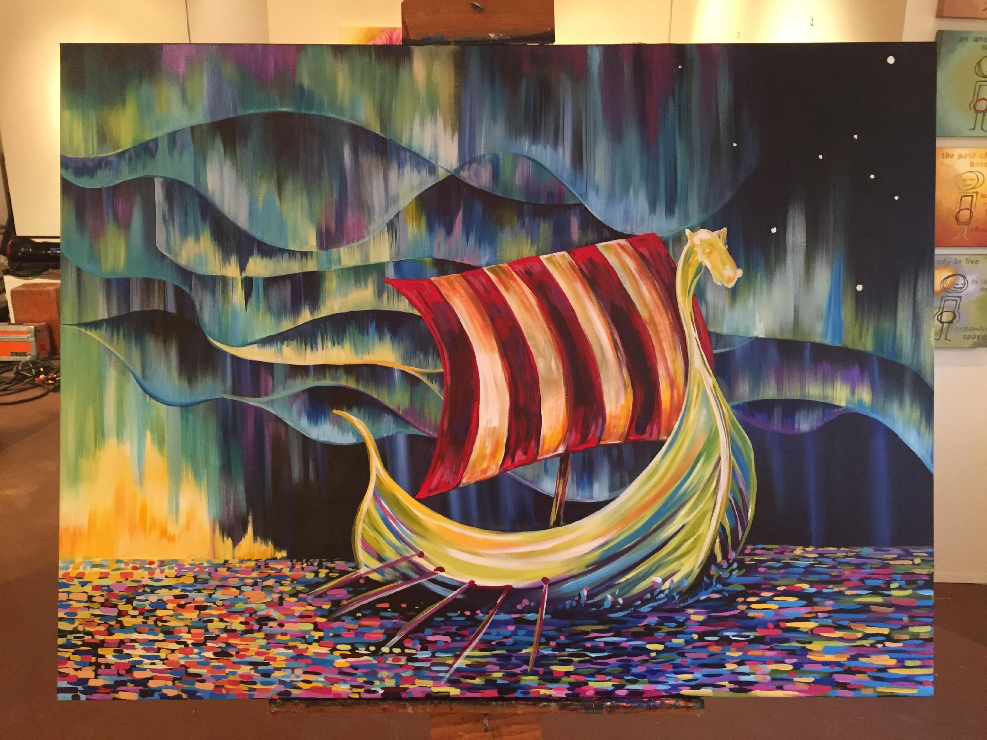
Shared Values
A Simple Promise
A Member Timeline

Slide 2
Step 1: Raising Awareness of Sons of Norway
Things we can all do:
Talk with friends and family about Sons of Norway
Keep recruiting materials on hand
Invite them to your lodge and ask them to join!

Slide 3
Step 2: A Potential Member Attends a Meeting
Make sure you have a greeter at the meeting
Remember, they’ll answer questions and introduce them to other members
Provide an engaging lodge program
For example, use the Group Cultural Skills lesson
Don’t forget – end the evening with an invitation to join!

Slide 4
Step 3: President Calls a Potential Member
Thank them for attending the lodge meeting
Most important, include an ask to join the lodge

Slide 5
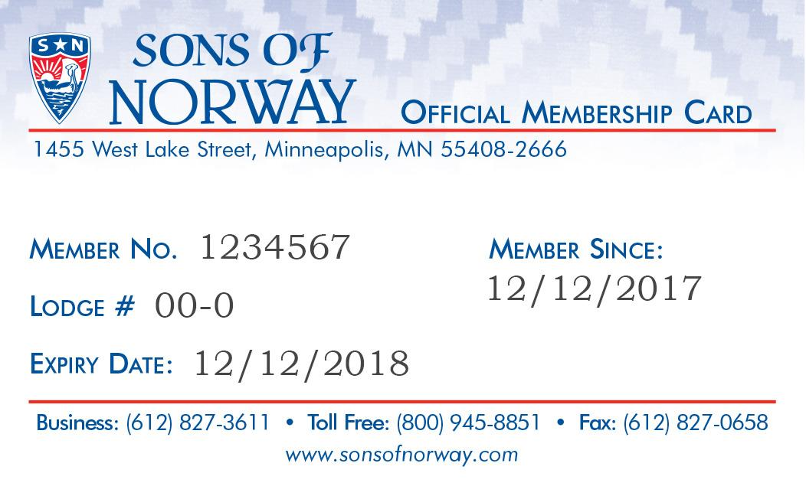
Step 4: Guest Becomes a Member
A notification is sent to lodge officers when a member joins online
Their new member card arrives a couple weeks after they join
A member welcome kit arrives a couple weeks after that

Slide 6
Step 5: A Brief Bio Appears in the Newsletter
A short bio should include fun tidbits about the new member, introducing them to fellow members
Demonstrates your lodge is a welcoming home and strengthens connection with new member
Welcome Caroline Smith!

Slide 7
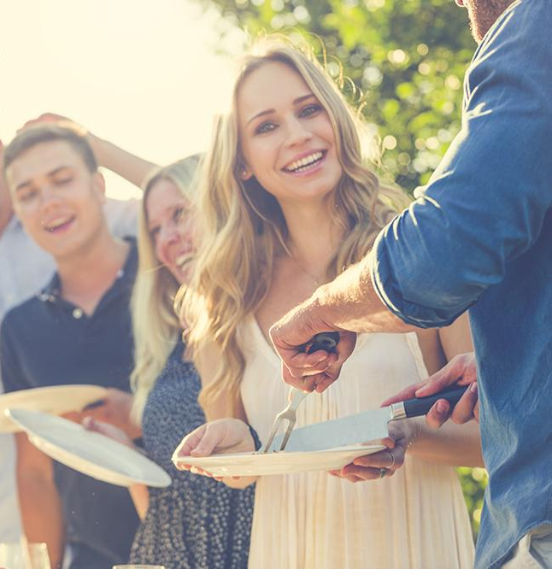
Step 6: Distribute a Calendar of Events
Planning events a year ahead of time keeps members informed about activities and helps make the lodge a priority in their own planning
Keep reaching out to the member and including them in activities

Slide 8
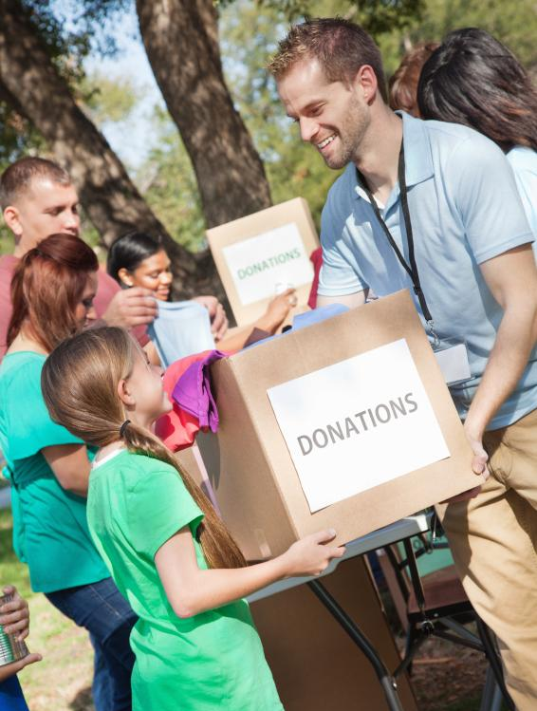
Step 7: An Invitation to other Lodge Activities
This invitation should be related to interests of the new members
These could be volunteering, a cooking group or a walking club

Slide 9
Step 8: Introduce the New Member to Your FBC
Your FBC is a powerful tool to help keep members engaged in the lodge
An introduction helps a new member understand the financial products available through Sons of Norway and how they impact the vitality of the organization

Slide 10
Step 9: Happy Anniversary!
The Membership Secretary uses the lodge activity report to find members with upcoming renewal dates
The Vice President calls members and thanks them for their membership. Don’t forget to encourage them to renew

Slide 11
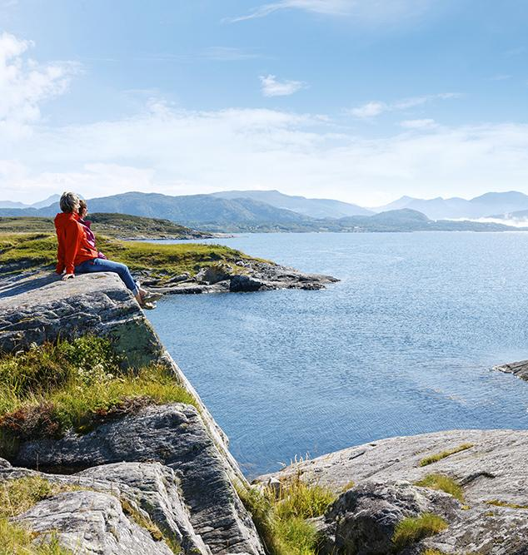
Step 10: Looking to the Future
All members should take the Member Satisfaction Survey to gauge their interests and skills
After a year, gauge potential interest in members in serving in leadership roles within the lodge
After a year, member and their children/grandchildren become eligible for many Sons of Norway Foundation scholarships

Slide 12
Don’t Forget!
We’re all in this together!
Share successes and resources
Solicit feedback
Ask questions

