Slide 1
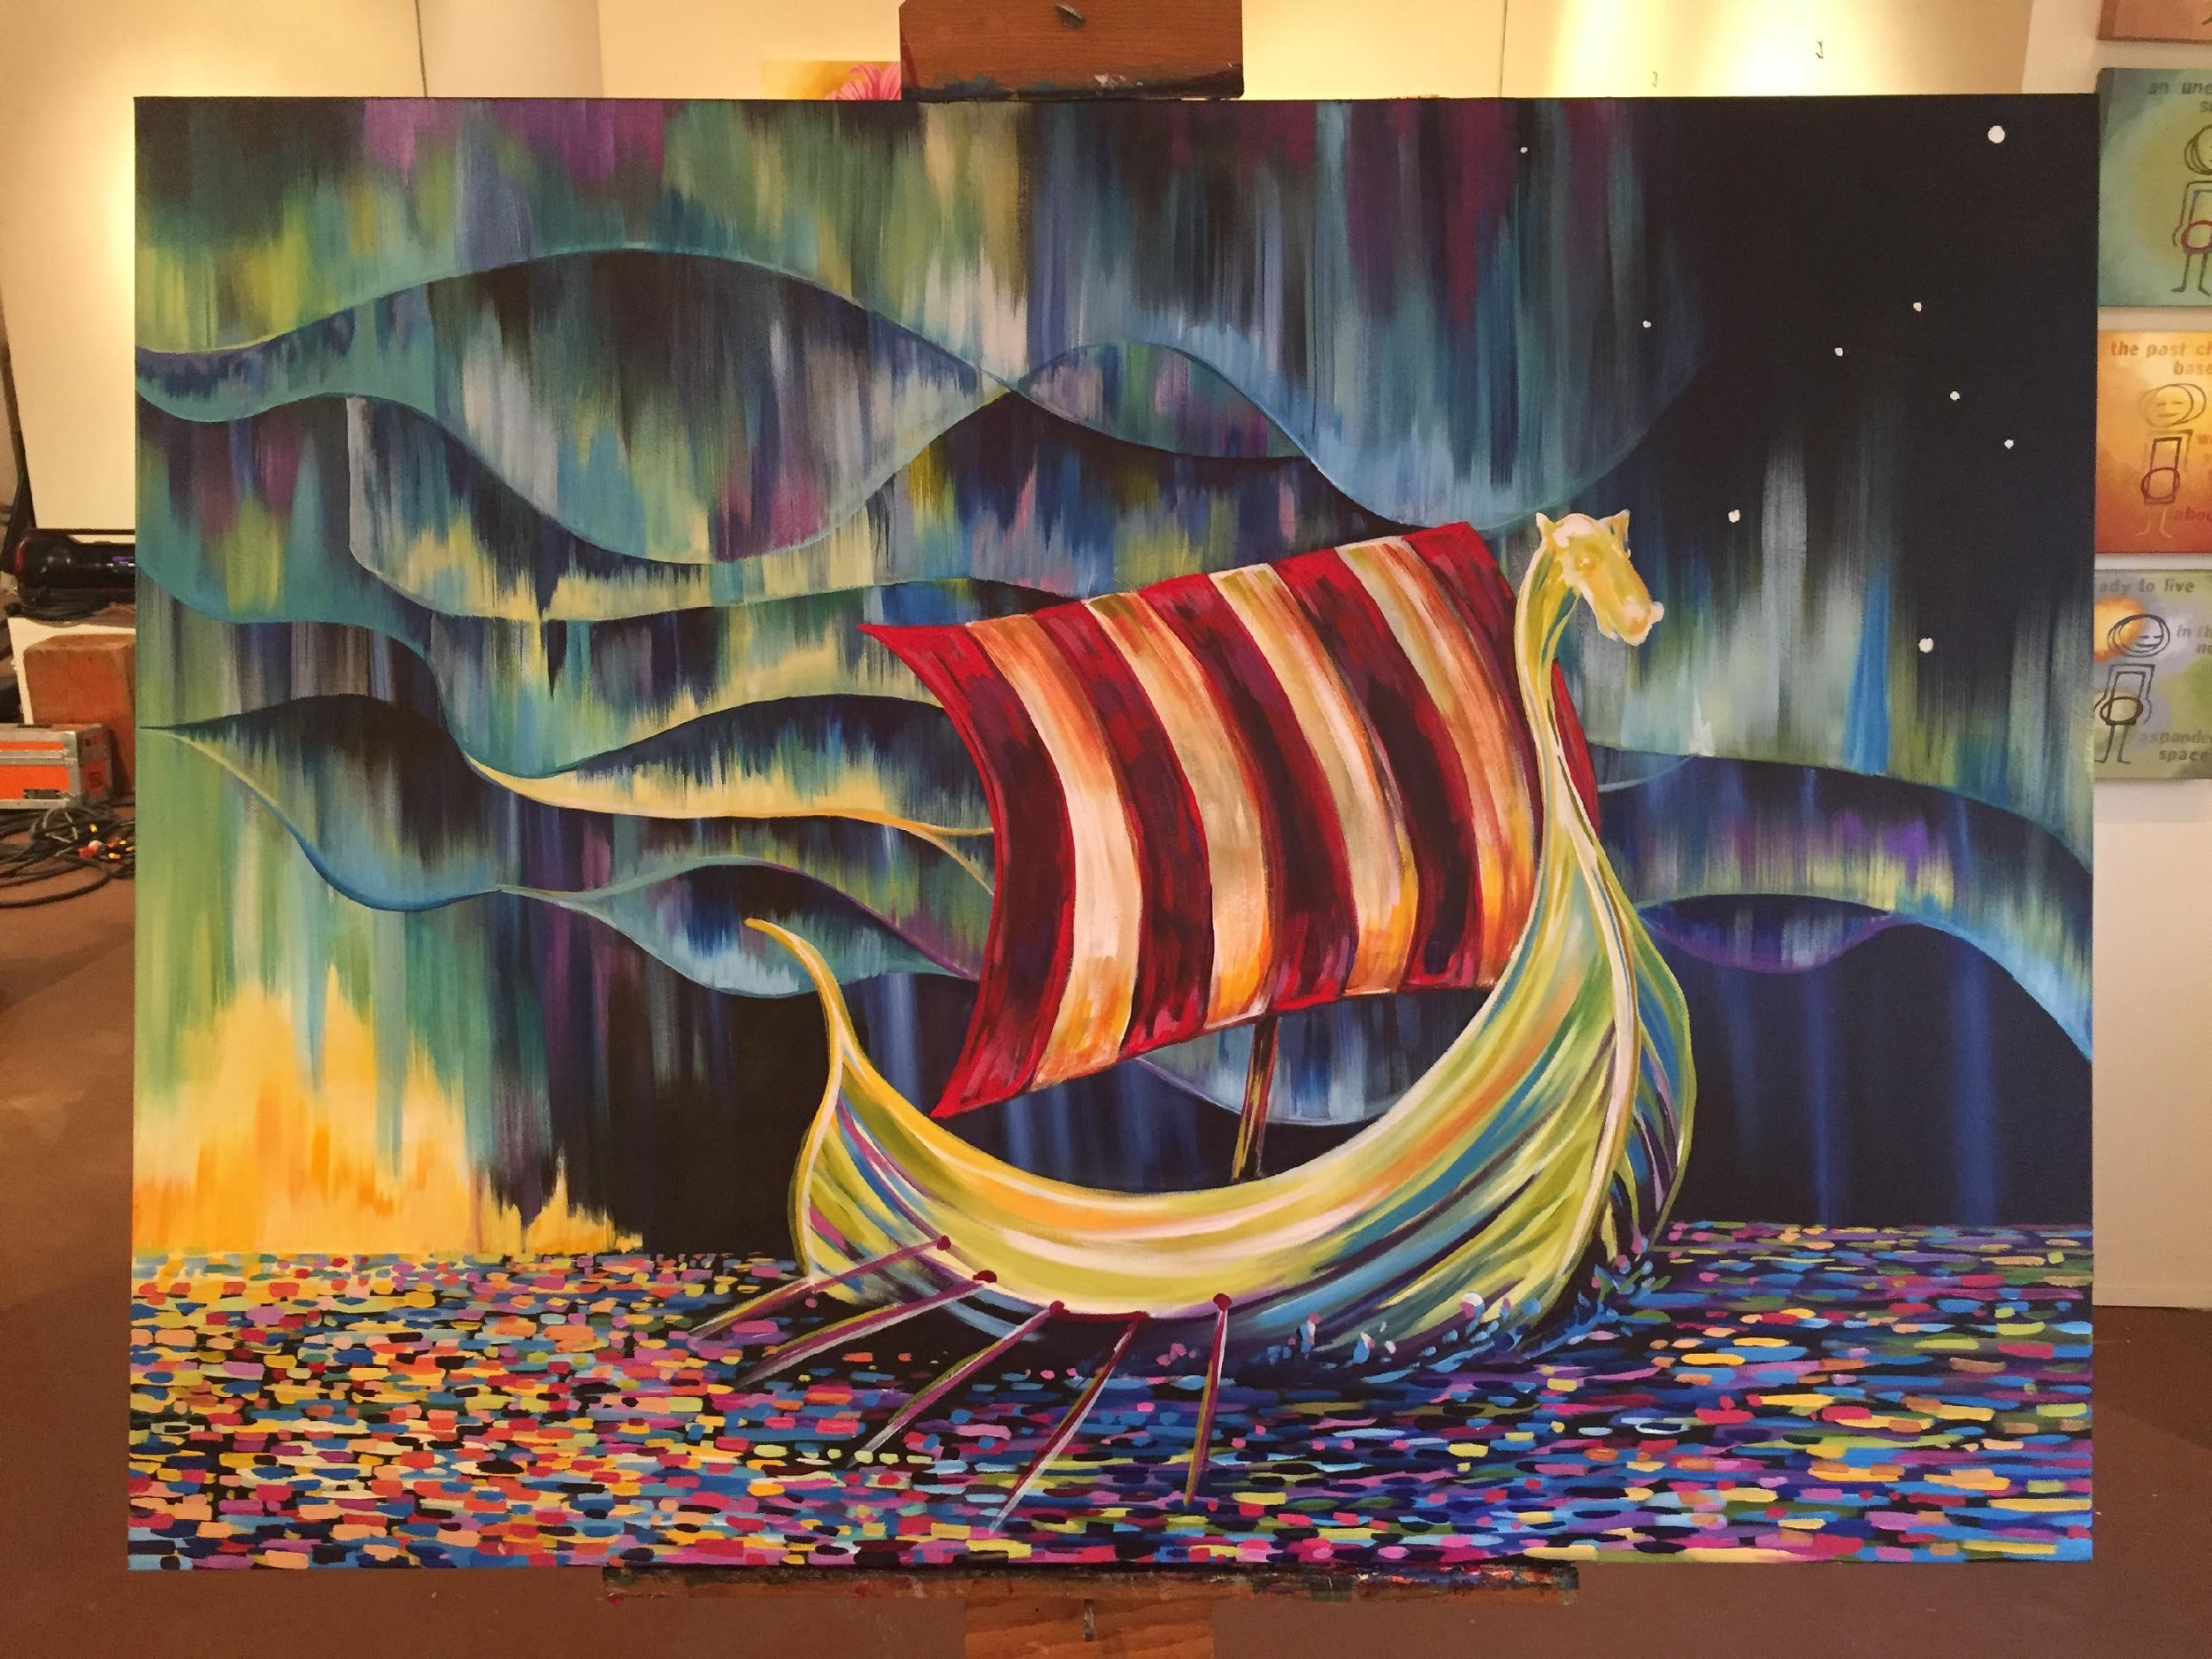
Shared Values
A Simple Promise
Recruitment & Retention Resources

Slide 2
Sons of Norway Recruitment & Retention Tools
Tangible Resources
Intangible Resources
Viking Magazine
Sons of Norway Foundation scholarships
Outstanding financial products
Sense of fellowship from lodges
Greater connection to Norwegian heritage
Greater sense of community through volunteerism

Slide 3
Fellowship
Being a member of a lodge is the #1 benefit of belonging to Sons of Norway: It connects people with a common interest in Norwegian culture and heritage
Recruitment
Potential members have a desire to connect with other people
Invite friends and family to join you at your lodge
Retention
Members engaged in the lodge are more likely to renew
Follow up with members if you’ve noticed their absence

Slide 4
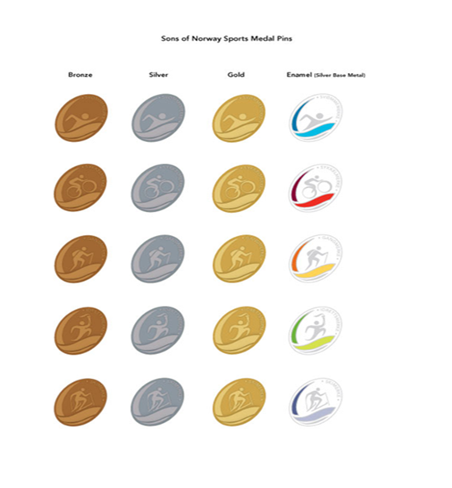
Sports Medal Program
Provides an exciting incentive for participating in a variety of outdoor activities
Recruitment
Excellent for active families: combine Norwegian culture with healthy living
Retention
Create a lodge sports medal program to keep members engaged
A full list of the available Sports Medals is available online in the
Members Section

Slide 5
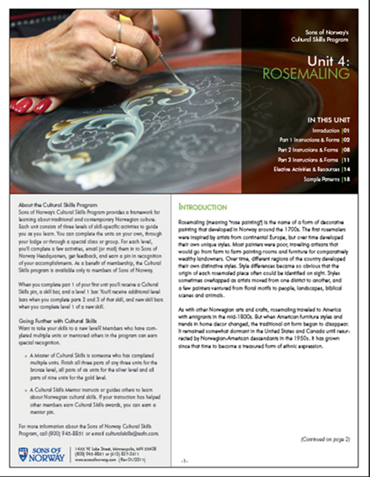
Cultural Skills Program
A step-by-step guide to learning many Norwegian arts and crafts skills
Recruitment
Offer an introductory lesson in the community
Retention
Utilize Cultural Skills as a group activity or program in your lodge
A full list of the available Cultural Skills units is available in the Members Section

Slide 6
Volunteer Opportunities
Potential members are looking for opportunities to volunteer in their communities
Recruitment
Showcase your lodge volunteer projects as an incentive for prospective members: invite them along.
Retention
Participate in regular volunteer activities that engage and mobilize your membership
For tips & ideas, contact membership@sofn.com

Slide 7
Sons of Norway Foundation Scholarships
Scholarships from the Sons of Norway Foundation help offset the cost of education
Recruitment
Keep a list of available Foundation scholarships at tabling events
Retention
Many scholarships are exclusively for Sons of Norway members
More information is available at sonsofnorway.com/foundation

Slide 8
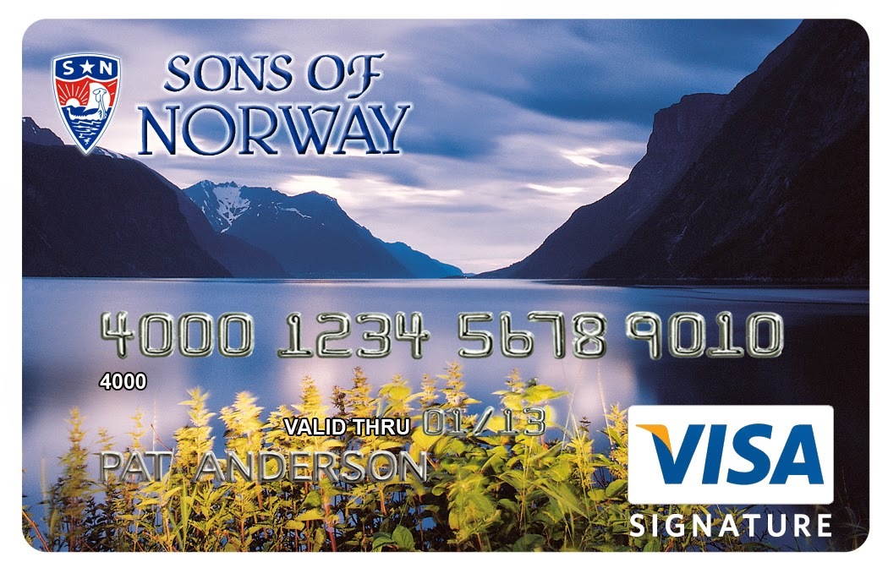
Member Discounts
Sons of Norway offers a number of member discounts ranging from travel to every day purchases
Recruitment
Many discounts can offset the cost of membership for a year
Retention
Discounts like Perkspot are available only to members
A complete list of discounts is available on the Sons of Norway website

Slide 9
Viking Magazine
Sons of Norway’s most popular member benefit
Recruitment
Leave copies in waiting rooms or coffee shops
Retention
Viking is only available to members
Extra copies are available from
the Supply Department

Slide 10
Sons of Norway Financial Products
Sons of Norway has strong, affordable financial products suitable for all stages of life
Recruitment
Coordinate a New Member Dinner with your FBC
Retention
Members receive a complimentary financial check-up from the FBC
Consult your FBC for more information

Slide 11
The Communications Toolkit
The toolkit includes all the materials for a successful outreach plan to your community and members alike
Recruitment
Use the toolkit to enhance your social media presence and engage non-members
Retention
Utilize the Newsletter Service resources to enhance your lodge newsletter
Available in the Members Section of
the Sons of Norway website

Slide 12
Discussion
What unique ways is your lodge using to reach out to the community?
Does your lodge have any success stories using some of these approaches?

