Slide 1

Turning Hunger
into Hope:
The Power of Volunteers
DRAFT 12 20 16

Slide 2
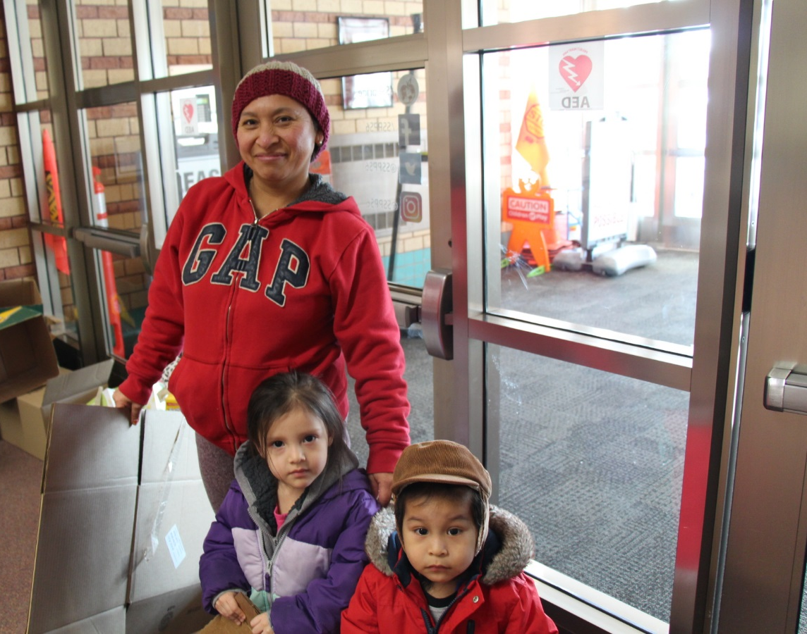
Thanks for making our work possible
We could never achieve our record of 81 million meals distributed or the growing amount of fresh produce we can offer families facing hunger without your amazing generosity!

Slide 3
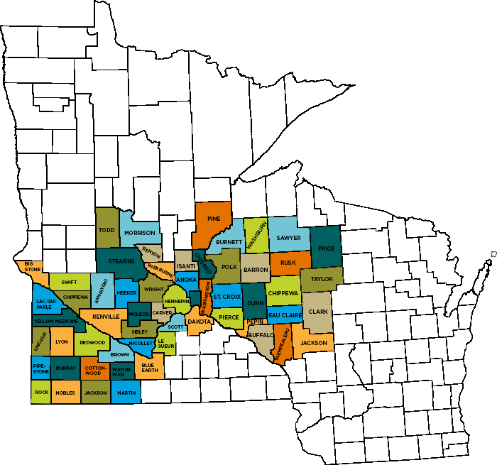
Working Together: What We Do With You
We serve nearly 1,000 local programs – like food pantries and homeless shelters, providing on average 74% of the food distributed by these great local partners.
Growing to Meet Demand
Fresh food
(bakery, dairy, meat and produce)
93,492
81,031*
41,391
Second Harvest Heartland is the second largest of 201 food banks (by volume of food distributed) in the national Feeding America network.
For every $1 donated, we can distribute more than $7 worth of food and grocery products.
34,493
* Includes meals provided through SNAP and Summer Food Service Program

Slide 4
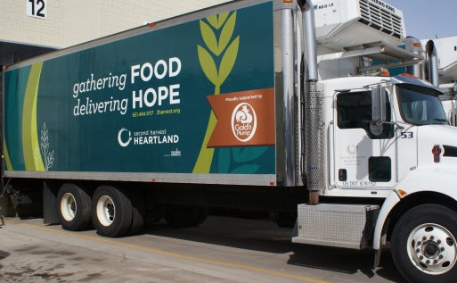

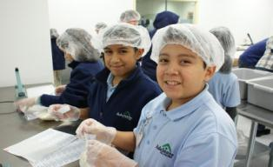
2017 Impact
Distributed more than 81 million meals
57.5% of the food we distributed was fresh
Recruited 31,175 volunteers who
donated more than 128,268 volunteer hours

Slide 5
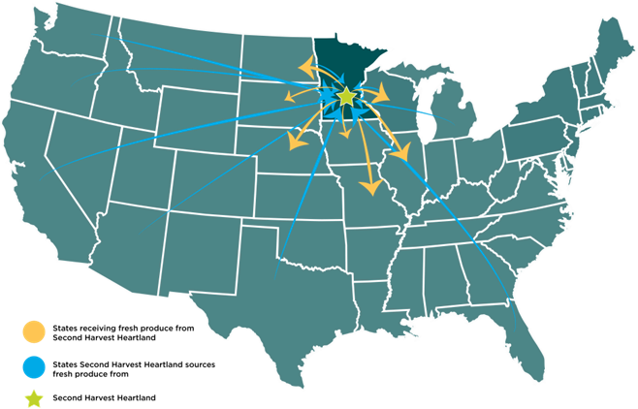
Supporting Partners Beyond Our State with Produce

Slide 6
Doing More to Engage Our Volunteers
In 2018 we’ll engage more than 35,000 volunteers in 130,000 Hours of service…
…We can do better
My Best Self as Neighbor
Community Education
Quality – Skilled Labor
Efficiency – Make the most of Dollars

Slide 7

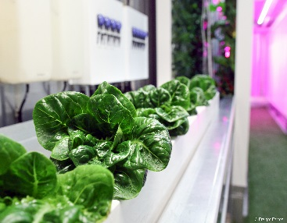
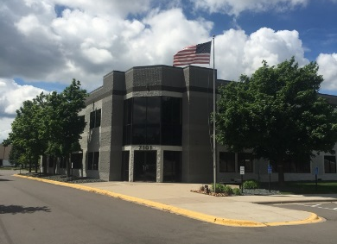
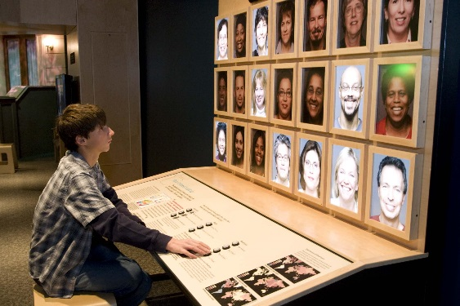
Four Areas of Growing Focus
Health Care:
Food Is Medicine
Our Farm: A Hydroponic Pilot
New Facility in
Brooklyn Park
Education Center

Slide 8

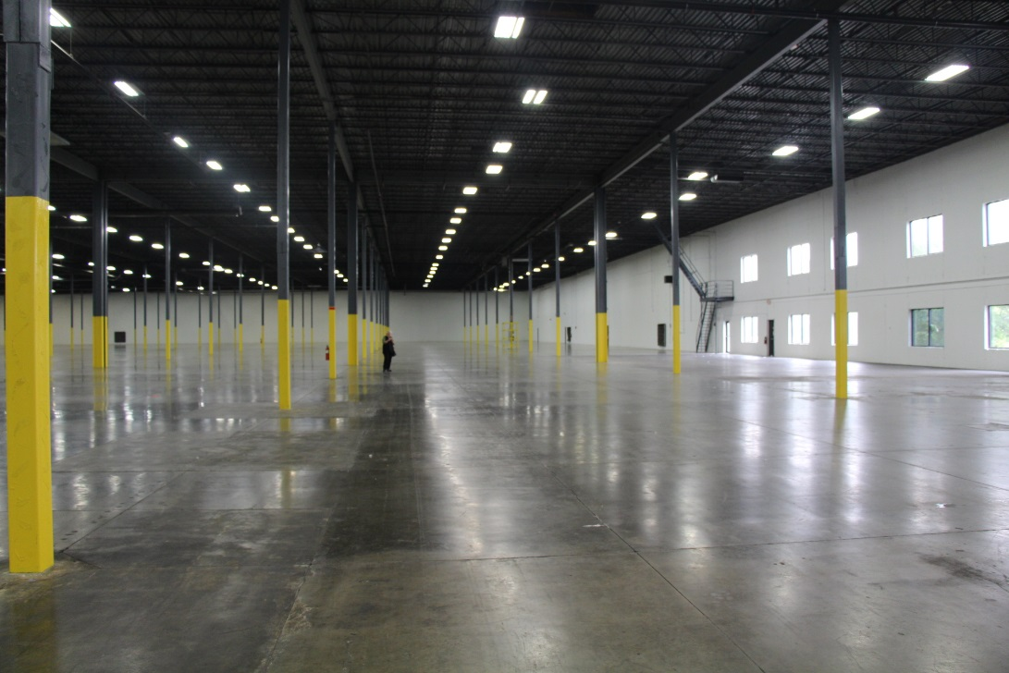
New Facility in Brooklyn Park – Building For Volunteers
In alignment with our strategic plan, we launched a capital campaign because:
We are out of space in Maplewood
Based on forecasted demand, we can’t meet future needs
Comprehensive campaign for programs and space
PICTURE
PICTURE
  Best-in-class facility:
  2x bigger distribution center
  3.5x more cooler and freezer space
  2x more dock doors
  Space for innovation (e.g., commercial kitchen)

Slide 9
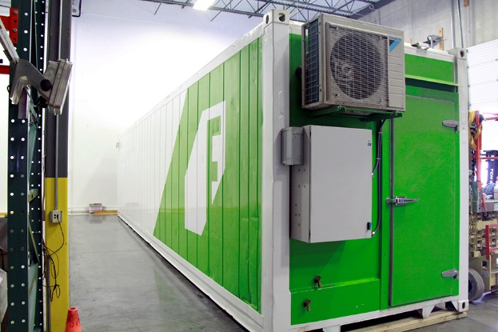
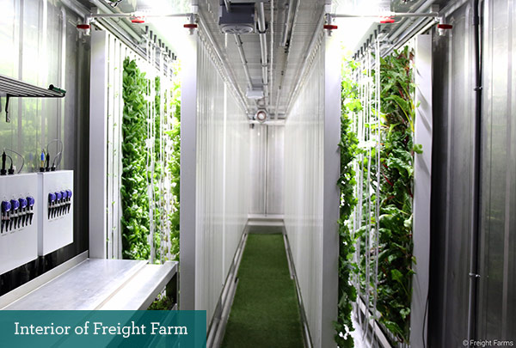
Our Farm - Hydroponic farming
Pioneering innovation
Engaging with our community
Meeting the need

Slide 10
Improving Quality of Skilled Volunteer Opportunities
Service Enterprise Certification – completed 2018!
Second Harvest Heartland Executive Corps
Better Presenting Opportunities to skilled Teams
  3M - Lean processes
  Change Management – through Ameriprise

Slide 11
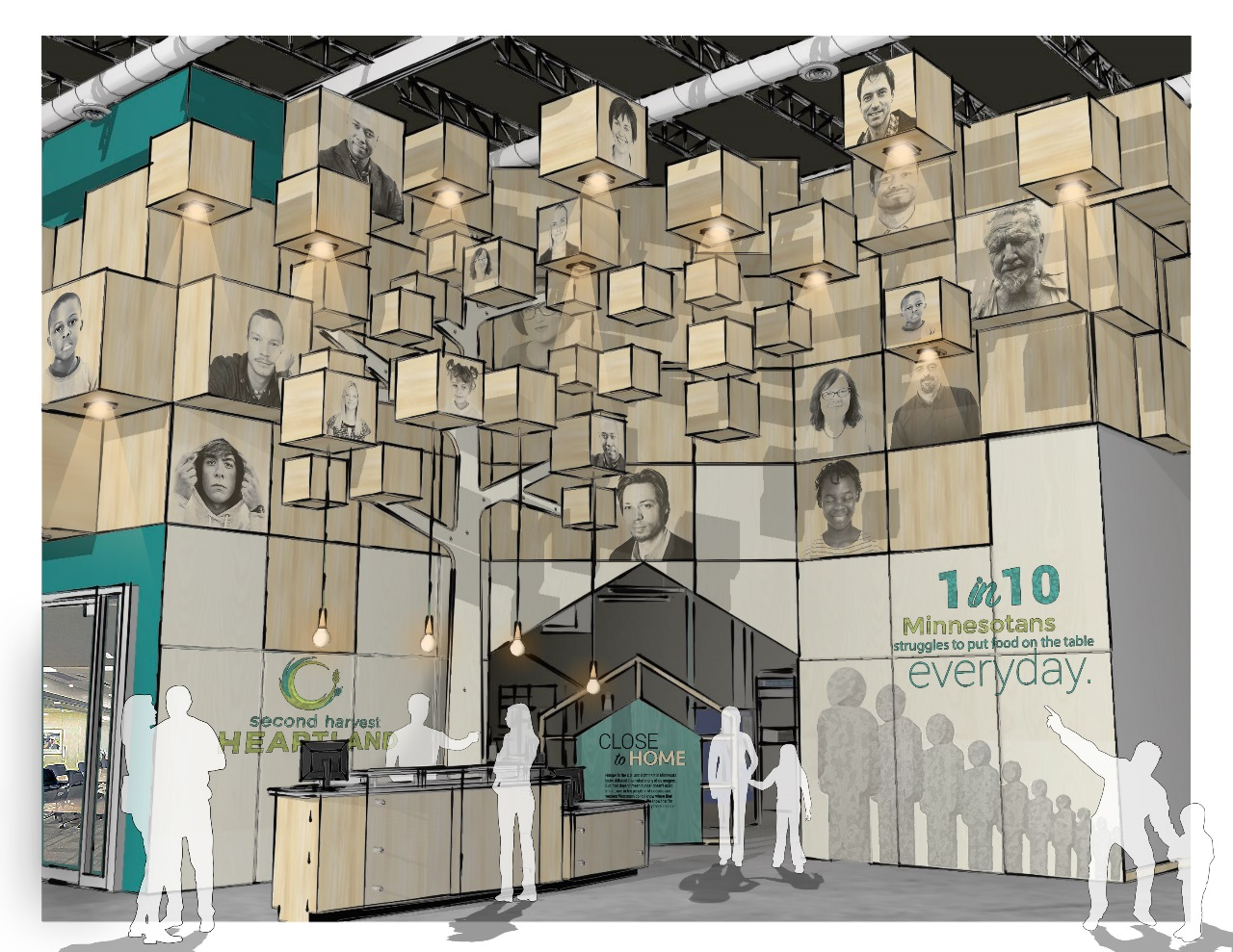
Education Center – engaging our volunteers
Busting myths about who is hungry and why
Museum component in new facility, including interactive exhibits with true stories of hungry people in Minnesota and western Wisconsin
Will augment with a Community Artist Exhibit and build strong partnerships with local arts institutions focused on similar empathy-driving work
Empathy will inspire action for our 30,000+ visitors every year

Slide 12
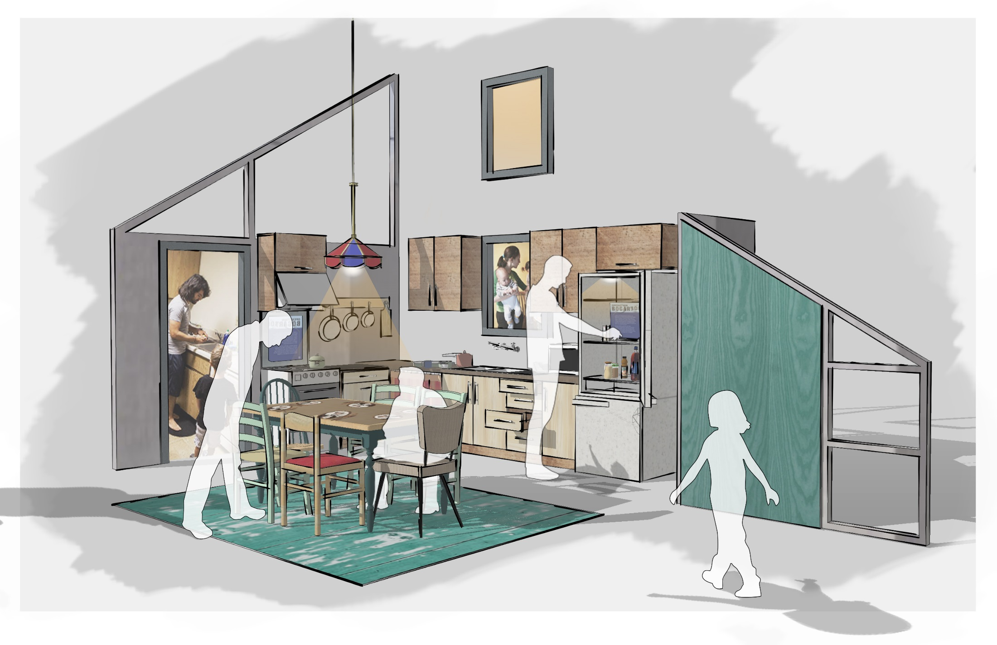

Slide 13


