Slide 1
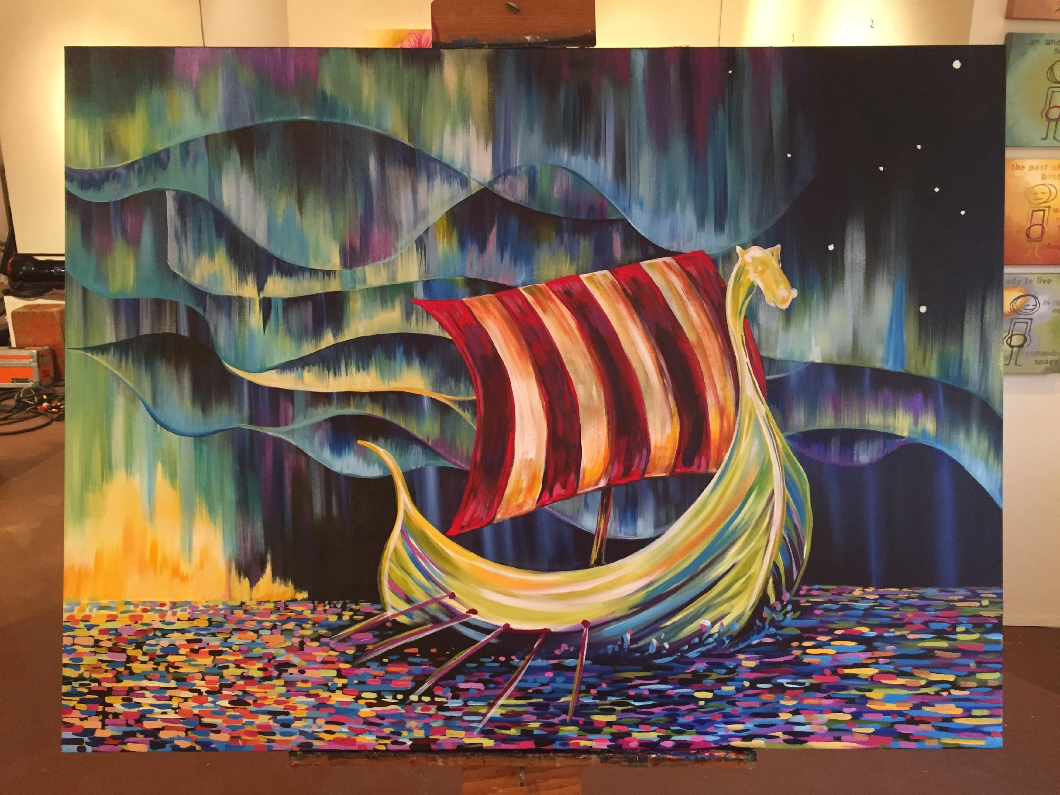
Shared Values
A Simple Promise
Lodge Name

Slide 2
Sons of Norway’s Mission
The mission of Sons of Norway is to promote and to preserve the heritage & culture of Norway, to celebrate our relationship with other Nordic Countries, and to provide quality insurance and financial products to its members.

Slide 3
Headline
Sub-headline
Bullet Point Text: Description Text
Bullet Point Text: Description Text
Bullet Point Text: Description Text

Slide 4
Headline
Sub-headline
Bullet Point Text: Description Text
Bullet Point Text: Description Text
Bullet Point Text: Description Text

Slide 5
Headline
Sub-headline
Bullet Point Text: Description Text
Bullet Point Text: Description Text
Bullet Point Text: Description Text

Slide 6
Questions?

Slide 7
Contact Information
Name
Phone Number
Email

