Slide 1

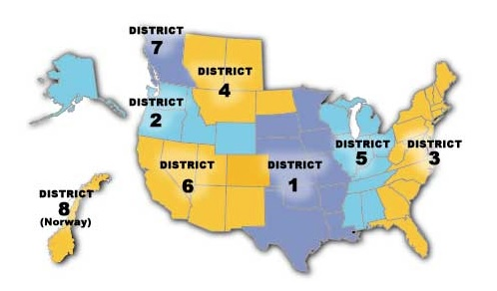
Sons of Norway
Since 1895
Leadership Training

Slide 2
Sons of Norway - Who We Are, What We Do
Sons of Norway, a financial services and international cultural organization headquartered in Minneapolis, began with shared values and a simple promise of financial security when like-minded people came together to protect their families, celebrate their culture and strengthen their community.
For 125 years, we’ve lived our mission to promote and preserve the heritage and culture of Norway, celebrate our relationships with other Nordic countries and provide quality insurance and financial products to our members. Now approximately 50,000 members strong, we play an active role in communities throughout North America and Norway.
Notes:
SONS OF NORWAY WAS ORGANIZED IN MINNEAPOLIS, MINNESOTA ON JANUARY 16, 1895, BY 18 NORWEGIAN IMMIGRANTS WHO SOUGHT TO PROTECT THEIR FAMILIES IN TIMES OF SICKNESS OR DEATH IN THE FAMILY.
- TODAY SONS OF NORWAY IS THE LARGEST NORWEGIAN ORGANIZATION OUTSIDE NORWAY.

Slide 3
Sons of Norway’s Mission
The mission of Sons of Norway is to promote and to preserve the heritage & culture of Norway, to celebrate our relationship with other Nordic Countries, and to provide quality insurance and financial products to its members.

Slide 4
Honoring Our Past, Embracing the Future
Sons of Norway’s internal creative and strategic planning teams, along with external marketing consultants, recently developed an updated look and branding inspired by
our members and the following terms:
Fellowship
Family connections
Light
Warmth
Community
Trust
Strength
Space
Notes:
THE UPDATED BRANDING REFLECTS THE PRINCIPLES OF MODERN SCANDINAVIAN DESIGN WHILE MAINTAINING THE WARMTH, TRADITION AND SPIRIT OF THE LOGO WE HAVE USED SINCE 1955.

Slide 5
Training Objectives
Provide District Board members and lodge leaders with the information and tools needed to effectively lead their lodges utilizing a series of stand-alone modules to be employed as needed.
Module 1 – incorporates a few presentations
  About Sons of Norway for leaders
  Lodge leadership
  Local Lodge Leadership Toolkit (may be specific to different districts)
Module 2 – Governing Documents and Roles and responsibilities
  Governing Documents
  District Officer roles
  Local Lodge Officer roles
Module 3 – The Local Lodge – the Local Lodge Toolkit
  Recruitment
  Resources
  Lodge calendar
  Conducting a meeting
  Improvising when there are not enough officers

Slide 6
Objectives - continued
Module 4 – Publicity
  Social Media
  Social Media Policy (https://www.sofn.com/member_resources/lodge_leadership_resources/administrative_resources/communications_tool_kit/social_media_policy_for_lodges/)
    Facebook (https://docs.google.com/presentation/d/1rMnFkP5FnIdqknM-q4yGnJ47i1eTFQPN1RZoueRKdls/edit#slide=id.g23f3581cd4_0_26)
      Using facebook effectively (https://docs.google.com/presentation/d/1RqsujmLf7-ikoEqy3GQXnfjE47fQNnxLaTCL1EbGfEo/edit#slide=id.g23f5de4ef3_0_1)
    Facebook Policy
    Lodge website (D6 has great tutorials for creating a lodge website page)
    Twitter
  Newsletter – Ideas for newsletter content posted every other month: https://www.sofn.com/member_resources/lodge_leadership_resources/administrative_resources/communications_tool_kit/newsletter_content/
  Advertising
  Photo guide

Slide 7
Objectives - continued
Module 5 – Foundation
Module 6 – Financial

Slide 8
Objectives - continued
Sons of Norway – what it offers members
  Financial
  Foundation
  Fraternal
    Medal program
      Sports
      Cultural
    Grant opportunities

Slide 9
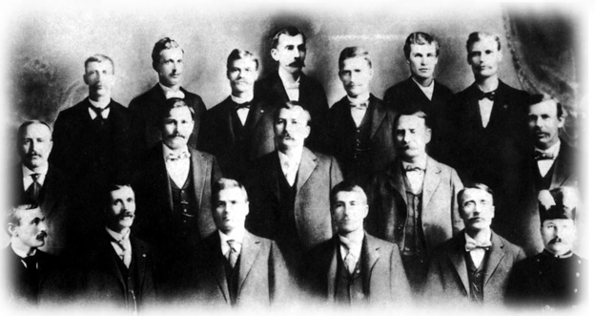
Who Are We?
We were founded by 18 Norwegian immigrants in 1895...
More than 120 years later, we continue to advance our mission to promote and preserve the heritage and culture of Norway, celebrate our relationships with other Nordic countries and provide quality insurance and financial products to our members.

Slide 10
18 Norwegian immigrants in Minneapolis, Minnesota, organized Sons of Norway as a fraternal benefit society on Jan 16, 1895. The purposes and goals of the Founding Fathers were to protect members of Sons of Norway and their families from the financial hardships experienced during times of sickness or death in the family. Over time, the mission of Sons of Norway was expanded to include the preservation of Norwegian heritage and culture in our Society.
We have grown since our beginning and are now the largest Norwegian organization outside Norway. We are organized as a fraternal benefit society under IRC 501(c) (8).
Why was Sons of Norway founded?

Slide 11
Sons of Norway Today
Sons of Norway is a fraternal life insurance company devoted to supporting members through every stage of life, while providing opportunities for a vibrant social experience around Norwegian culture.
Sons of Norway members can reconnect with their heritage, learn about modern Norway, build a strong financial foundation and participate in philanthropic endeavors that make a positive impact in your community.
As of 2020:
  50,000 members strong with 360 lodges in North America and Norway
  Life insurance in force = $743,000,000
  Insurance certificates in force = 15,500

Slide 12
About Sons of Norway Video

Slide 13
Sons of Norway Today
In staying true to its mission statement, Sons of Norway focuses on three core
business areas:
Cultural Programming: Whether your passion is art, language, fitness or simply getting together with like-minded people to celebrate your heritage, there are offerings for everyone.
Financial Products: We provide financial security to members and invest the proceeds back into the organization so we can continue to support our shared values.
Philanthropic Outreach: We are known for giving back and investing in our communities through volunteer programs or supporting our Foundation, which offers scholarships, grants and emergency assistance.

Slide 14

How Do We Do This?
Members
Lodges
Insurance Professionals
Int’l & Foundation Boards
District
HQ

Slide 15
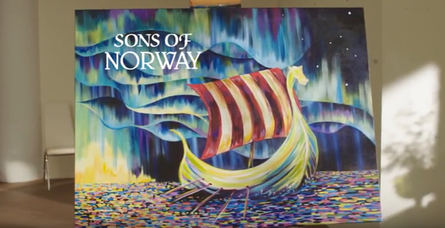

Sons of Norway – Amplifying Awareness
We’ve been busy following through on our promises.
These two new marketing assets are now available to you:
Watch at sonsofnorway.com/aboutus or on YouTube at
www.youtube.com/user/sonsofnorwayhq
*Now available for ordering; call the Supply Department

Slide 16
What is a fraternal benefit society?
Fraternal Benefit Societies, like Sons of Norway, play a vital role in the world today. We are defined by four key aspects: Our members enjoy a common bond and they are protected by the financial products we offer. What's more, we are all made up of local chapters/networks and our members serve a benevolent purpose through community service
What is a Fraternal Benefit Society Video

Slide 17
How do we promote and preserve our heritage and culture?
Today, Sons of Norway members promote Norwegian and Scandinavian traditions and fellowship through the cultural and social opportunities offered in local lodge and district lodge activities. These ‘fraternal’ activities include language camps and classes, scholarships, handicrafts, cooking and heritage classes, heritage programs, sports programs, travel opportunities, Viking Magazine and outreach programs sponsored by the Sons of Norway Foundation. Families continue the traditions passed down as well as integrating the skills learned in Sons of Norway classes into the family.

Slide 18
Cultural Heritage
Many members join Sons of Norway to connect to their roots and learn the things they might not have had the time nor opportunity to learn when they were younger. The Sons of Norway Cultural skills program offers many opportunities.
How to make lefse video

Slide 19
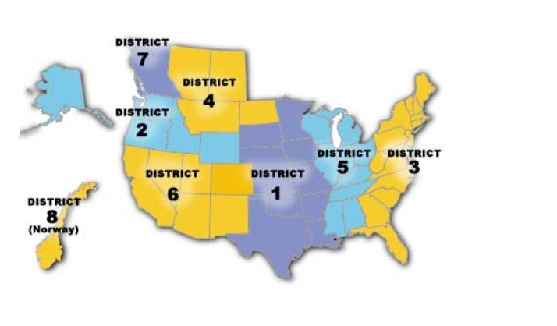
How many Districts and Lodges do we have? https://members.sofn.com/lodgeDirectory/

Slide 20
Districts
There are eight districts
Five in the US
One spanning both the US and Canada
One in Canada
One in Norway
Each District is made up of
  Zones
  Lodges
  Central lodge
  Spirit New Century Lodge
Some Districts have their own property which is used for youth camp and cultural programs
The number of District Board positions may vary by District

Slide 21
District Board
Number of officers defined by the District by-laws and the Sons of Norway Charter and Constitution
District boards can be comprised of the Executive Committee and the District Officers
District Officer Titles (not all used in all districts):
President
Vice President
Secretary
Treasurer
Social Director
Cultural Director
Youth Director
Sports/Rec Director
Publicity Director
Editor
Zone Director
Counselor
Foundation Director
Scholarship Chair
Adopt a School
Camp Manager

Slide 22
Local Lodges
A local lodge is an organizational unit of Sons of Norway that provides regular gathering opportunities for individuals sharing an interest in Norwegian heritage and culture, philanthropy, fellowship and community service.
Sons of Norway has 360 local lodges, spread across 38 US states, three Canadian provinces and the country of Norway
Must meet at least 8 times a year.

Slide 23
Central Lodge & Spirit New
Century Lodges
Central Lodge 000
  Each district has a Central Lodge: 1-000, 2-000, 3-000 etc.
  Members in central lodge tend to own financial products, or be long term members who are unconnected with a local lodge.
Spirit New Century 999
Each district has a Spirit New Century Lodge: 1-999, 2-999, 3-999 etc.
Members join online or by paper application without specifying a local lodge.
After their first year, members who have not transferred into a local lodge are transferred into Central Lodge 000.

Slide 24
Local Lodge Officers
Executive Committee – a lodge must have the top 4 officers to function.
Additional Lodge Officer Titles
President
Vice President
Secretary
Treasurer
Any other officers or directors as outlined in the lodge’s bylaws
Financial Secretary
Membership Secretary
Social Director
Cultural Director
Editor
Publicity Director
Foundation Director
Youth Director
Sports/Rec Director
Foundation Director
Counselor
Adopt a School
Volunteer Coordinator
Webmaster
Auditors
Support Officers: Marshals, Greeters, Trustees, Historian, Librarian, Musician, Sunshine Director, Other

Slide 25
Membership Reports
Membership List
  Available for download by top officers from their profile page on www.sonsofnorway.com in PDF or Excel formats.
  Can be requested from Membership Services at Sons of Norway Headquarters as a PDF or Excel file attachment to an email.
  Can be sent by regular mail per request to Membership Services.
  Only officers registered with Headquarters have access to lodge lists.
  Membership Labels
  Can be automatically mailed out from Sons of Norway Headquarters to a lodge officer at the end of every month for a fee.
  Typically are organized in zip-code order, one label per household, adult members only (ages 16 and up).
  Can be requested at any time from Membership Services at Sons of Norway Headquarters.

Slide 26
Membership Reports Continued
Membership Activity Report
  Sent to lodge vice presidents and financial/membership secretaries every month, and any other lodge officers per request to Membership Services.
  Generated and emailed on the 2nd of each month.
  Officers without emails or who have requested paper forms will receive them in the regular mail around mid month.
  Can be downloaded by top officers from their profile page on www.sonsofnorway.com as PDF files.
  Provides details about lodge membership activity during the previous month.

Slide 27
Membership Reports Continued
Lodge Monthly Dues Report
  Lists Individual Members and the primary members of Family Memberships who have paid dues during the last month, along with the date they paid, their new paid to date, and the local lodge portion of their dues.
  If the dues for that month add up to $25 or more, a check will be sent along with the report. If the amount is less than $25, it is included in a future check.
  If a lodge has a Financial Secretary, they will receive the report and check.
  If a lodge has a Membership Secretary, the Treasurer will receive the report and check. The Membership Secretary will receive a copy of the report.
  Not currently available for download from www.sonsofnorway.com.

Slide 28
Fund Raising Ideas
Dinners (Lutefisk, Torsk, Julebord)
Bake or Craft Sales
Silent Auctions
Raffles
Special Events

Slide 29
Local Lodge planning/calendars
Some lodges plan out their whole year of meetings and events in January or February of each year, other lodges only plan one or two quarters ahead.
There is no wrong way to plan, if it works for the lodge.
Keep updating your meeting and event information on the calendar published in the lodge newsletter, website, and/or social media such as Facebook.
Be open to new ideas, and improvements to old ones.

Slide 30
Tracking with FraternalsGive.org
Easy way to track lodge events, activities and volunteer hours.
The lodge Secretary, an Assistant Secretary or the Lodge Volunteer coordinator can sign on to www.fraternalsgive.org
Each lodge has a preset user name and password.
  The user name is the lodge name and the lodge number without the district number and any place holding zeros. For example: Olso2, Tordenskjold55, MountainVikings690.
  The password is set as Password1.
  If you have problems with FraternalsGive or have questions, contact Membership Services at Sons of Norway Headquarters.

Slide 31
Governing Documents
Charter and Constitution
Policy and Procedures
District by-laws
District Policies and Procedures
District Ltd by-laws
Bylaws for District Recreation Center (if applicable)
Local Lodge by-laws
Roberts Rule of Order

Slide 32
Lodge Leadership Tool Kit
Lodges should contact their district officers to see if a Lodge Leadership Tool Kit is available.

Slide 33
Next
The next module in the series will review the governing documents as well as the roles and responsibilities of the District and Local Boards.

