Slide 1
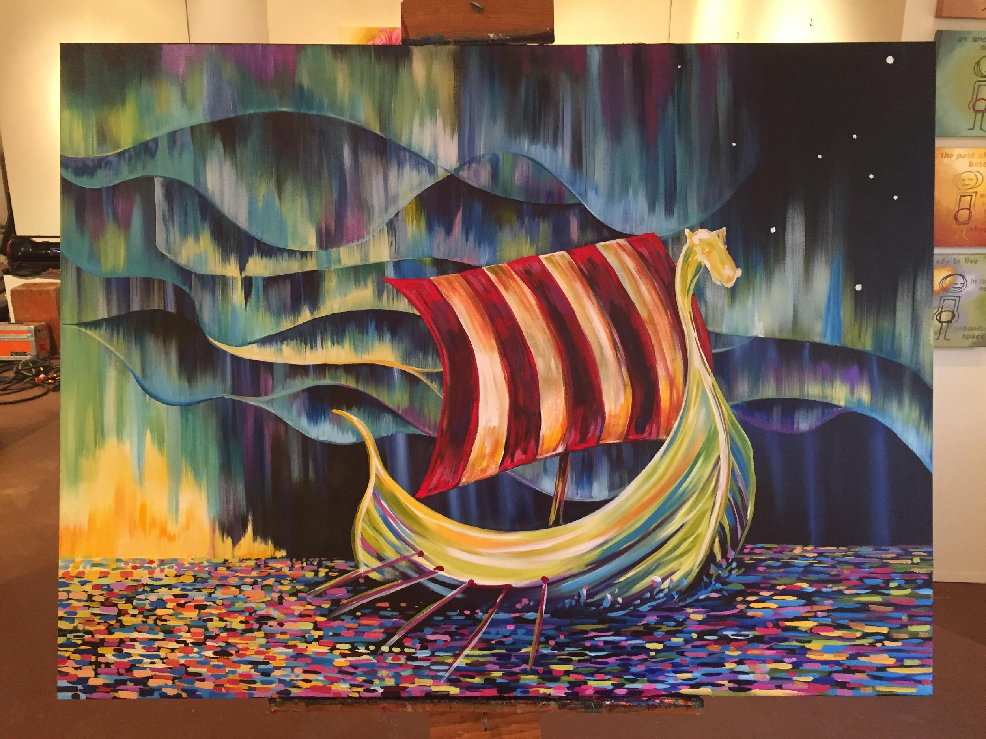
Sons of Norway
Since 1895
Leadership Training
Module 2 – Governing Documents
  Roles and Responsibilities

Slide 2
Module Objectives
Why we do what we do?
  IRC 501(c)(8)
  IRC 501(c)(2) – property
  IRC 501(c)(3)
  Charter, Constitution Polices and Procedures
  District by-laws
  Local Lodge by-laws
How does it all get done?
  Home Office paid staff
  Volunteer leadership

Slide 3
501(c)(8) - Sons of Norway- Fraternal Benefit Society
As a fraternal benefit society, Sons of Norway is exempt under Section 501(c)(8) of the Internal Revenue Code, which relates specifically to fraternal benefit societies. To qualify as an exempt fraternal benefit society, an organization must meet the following requirements:
Must have a fraternal purpose;
Must operate under the lodge system; and
Must provide for the payment of life, sick, accident, or other benefits.
"Fraternal" means a common tie or goal, such as the Sons of Norway goal of promoting and preserving the heritage and culture of Norway.
In order to maintain an exempt status as a fraternal benefit society, a society may not engage in unlimited non-fraternal activities or provide unlimited non-fraternal benefits.
Notes:
The key is that there must be balance between the fraternal side and the financial side.

Slide 4
501(c)(8) - continued
An organization is operating under a "lodge system" if it is carrying out its activities under a form of organization that comprises of local branches called lodges or chapters.
The local lodges must be chartered by a parent organization and be largely self-governing.
The term "operating under the lodge system" implies at a minimum, two active entities, a parent organization and a subordinate.
In the case of Sons of Norway, the organization is governed by the International Lodge, and through the International Officers and International Board of Directors.
Contributions for fraternal or social purpose are not tax deductible. Donations are deductible if made to a segregated scholarship fund.

Slide 5
501(c)(2) – Title Holding Corporation
for Real Property
A 50l(c)(2) organization, also referred to as a "Title Holding Corporation" is one that is formed for the exclusive purpose of holding title to property, collecting income related to the property, and turning over the income, less expenses, to a parent organization (the Lodge) .
Title Holding Corporations are generally created to limit the parent organization's liability from real property ownership, clarify title to property, simplify accounting, and comply with state law requirements.
The Sons of Norway bylaws provide that when a Lodge desires to acquire real property, it shall organize a separate non-profit Title Holding Corporation to take title to the real estate.
Holding title to property through the Title Holding Corporation can limit the liability of the Lodge. The 501(c)(2) status allows the corporation to be recognized as a non-profit for federal lax purposes.
Donations to an exempt title holding company are not tax deductible.
Notes:
D3 has some lodges which own property, e.g., Hudson Valley. It is in the SofN charter and constitution and each lodge must comply with the requirement. If not, the local lodge charter will most likely be pulled.

Slide 6
501(c)(3) – SofN Foundation;
Charitable Trust
A 50l(c)(3) organization is the most common type of tax-exempt nonprofit organization.
An approved 50l(c)(3) exemption allows donors to reduce their own taxable incomes by deducting the amounts of their donations given.
The 50I(c)(3) exemption allows the organization to avoid federal income taxes on the difference between revenues (donations, grants, service fees) received vs. expenses(wages, supplies, state and local taxes paid, etc.) .
The organization is exempt from federal income taxes if its activities of the organization consist of such activities as the following: charitable, religious, educational, etc.
The majority of 50I(c)(3) organizations, are eligible to receive tax-deductible contributions.
In the case of the Sons of Norway Foundation, the organization is governed by the Foundation Board of Governors.

Slide 7
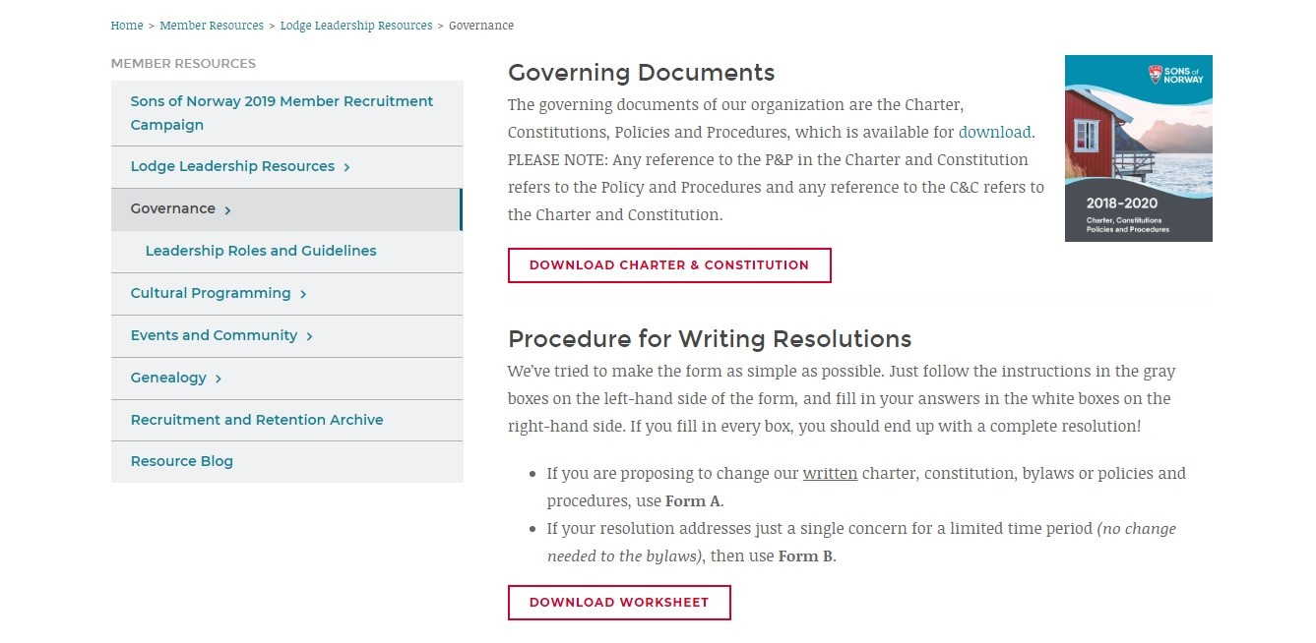
Charter, Constitution, Policies and Procedures
The Sons of Norway is governed by its Charter, Constitution, Policies and Procedures which can be found on the SofN website.
Notes:
Tell the audience how to find the documents Home to Member Resources to Lodge Leadership Resources to Governance. The key points to make is that the booklet is divided in a few sections – General, International, District and Local Lodge. The local lodge leaders should be familiar with what is in the local lodge section.

Slide 8
District Lodge
The District Policies and Procedures are being updated and must be approved by the District Board. Anticipated to be completed Spring 2020.
The District by-laws are undergoing a critical review to update. Any substantive changes must be approved at the 2020 District Convention.
Notes:
The District Board has a working copy of the current by-laws which is available upon request.

Slide 9
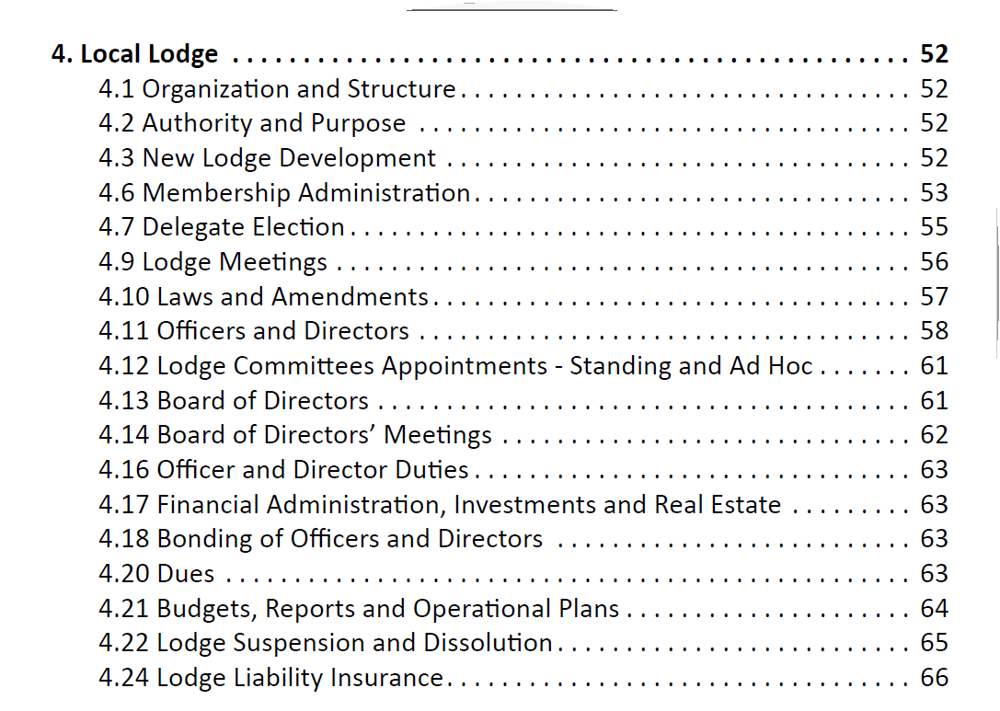
Local Lodge
Notes:
Points to make – read the CCP. There is a similar section for the District which should be read too especially if someone wants to run for District office. At this point you may want to refer to the Zone Director toolkit starting with page 11, Roles of the leadership team and pages 12 -14

Slide 10
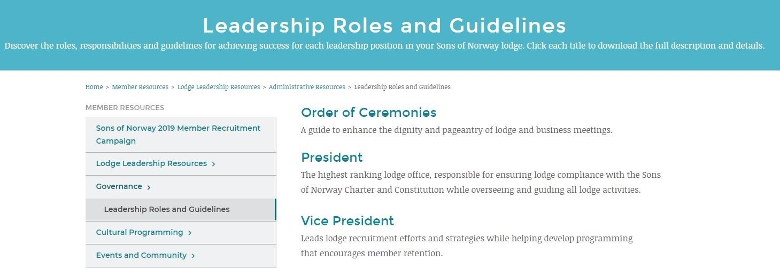
Roles and Responsibilities
Notes:
A description of the various roles and responsibilities can be found on the Sons of Norway website. Keep in mind that not all Districts have all the officers described on the SofN website. For example, 3D has a Counselor, many Districts to do not. Likewise many local lodges do not have all the officer positions described in the guide.

Slide 11
How does it all get done?
Sons of Norway Headquarters Staff:
  Accounting
  Actuarial
  Executive
  Fraternal / Marketing
  Human Resources
  Information Services
  Sales
Insurance Professionals
  Most lodges in the USA are assigned an Insurance Professional who provides information, guidance and purchasing opportunities for Sons of Norway Financial Products.
  The lodge Insurance Professionals are listed on the lodge director on www.sonsofnorway.com. Lodges can also contact the Sales Department at Sons of Norway Headquarters for more information.
Volunteer Leadership
Sons of Norway International, District and Lodge Officers are all dedicated volunteers.
Some officers do receive a small stipend for their service.

Slide 12
Shared Values
A Simple Promise

