Slide 1
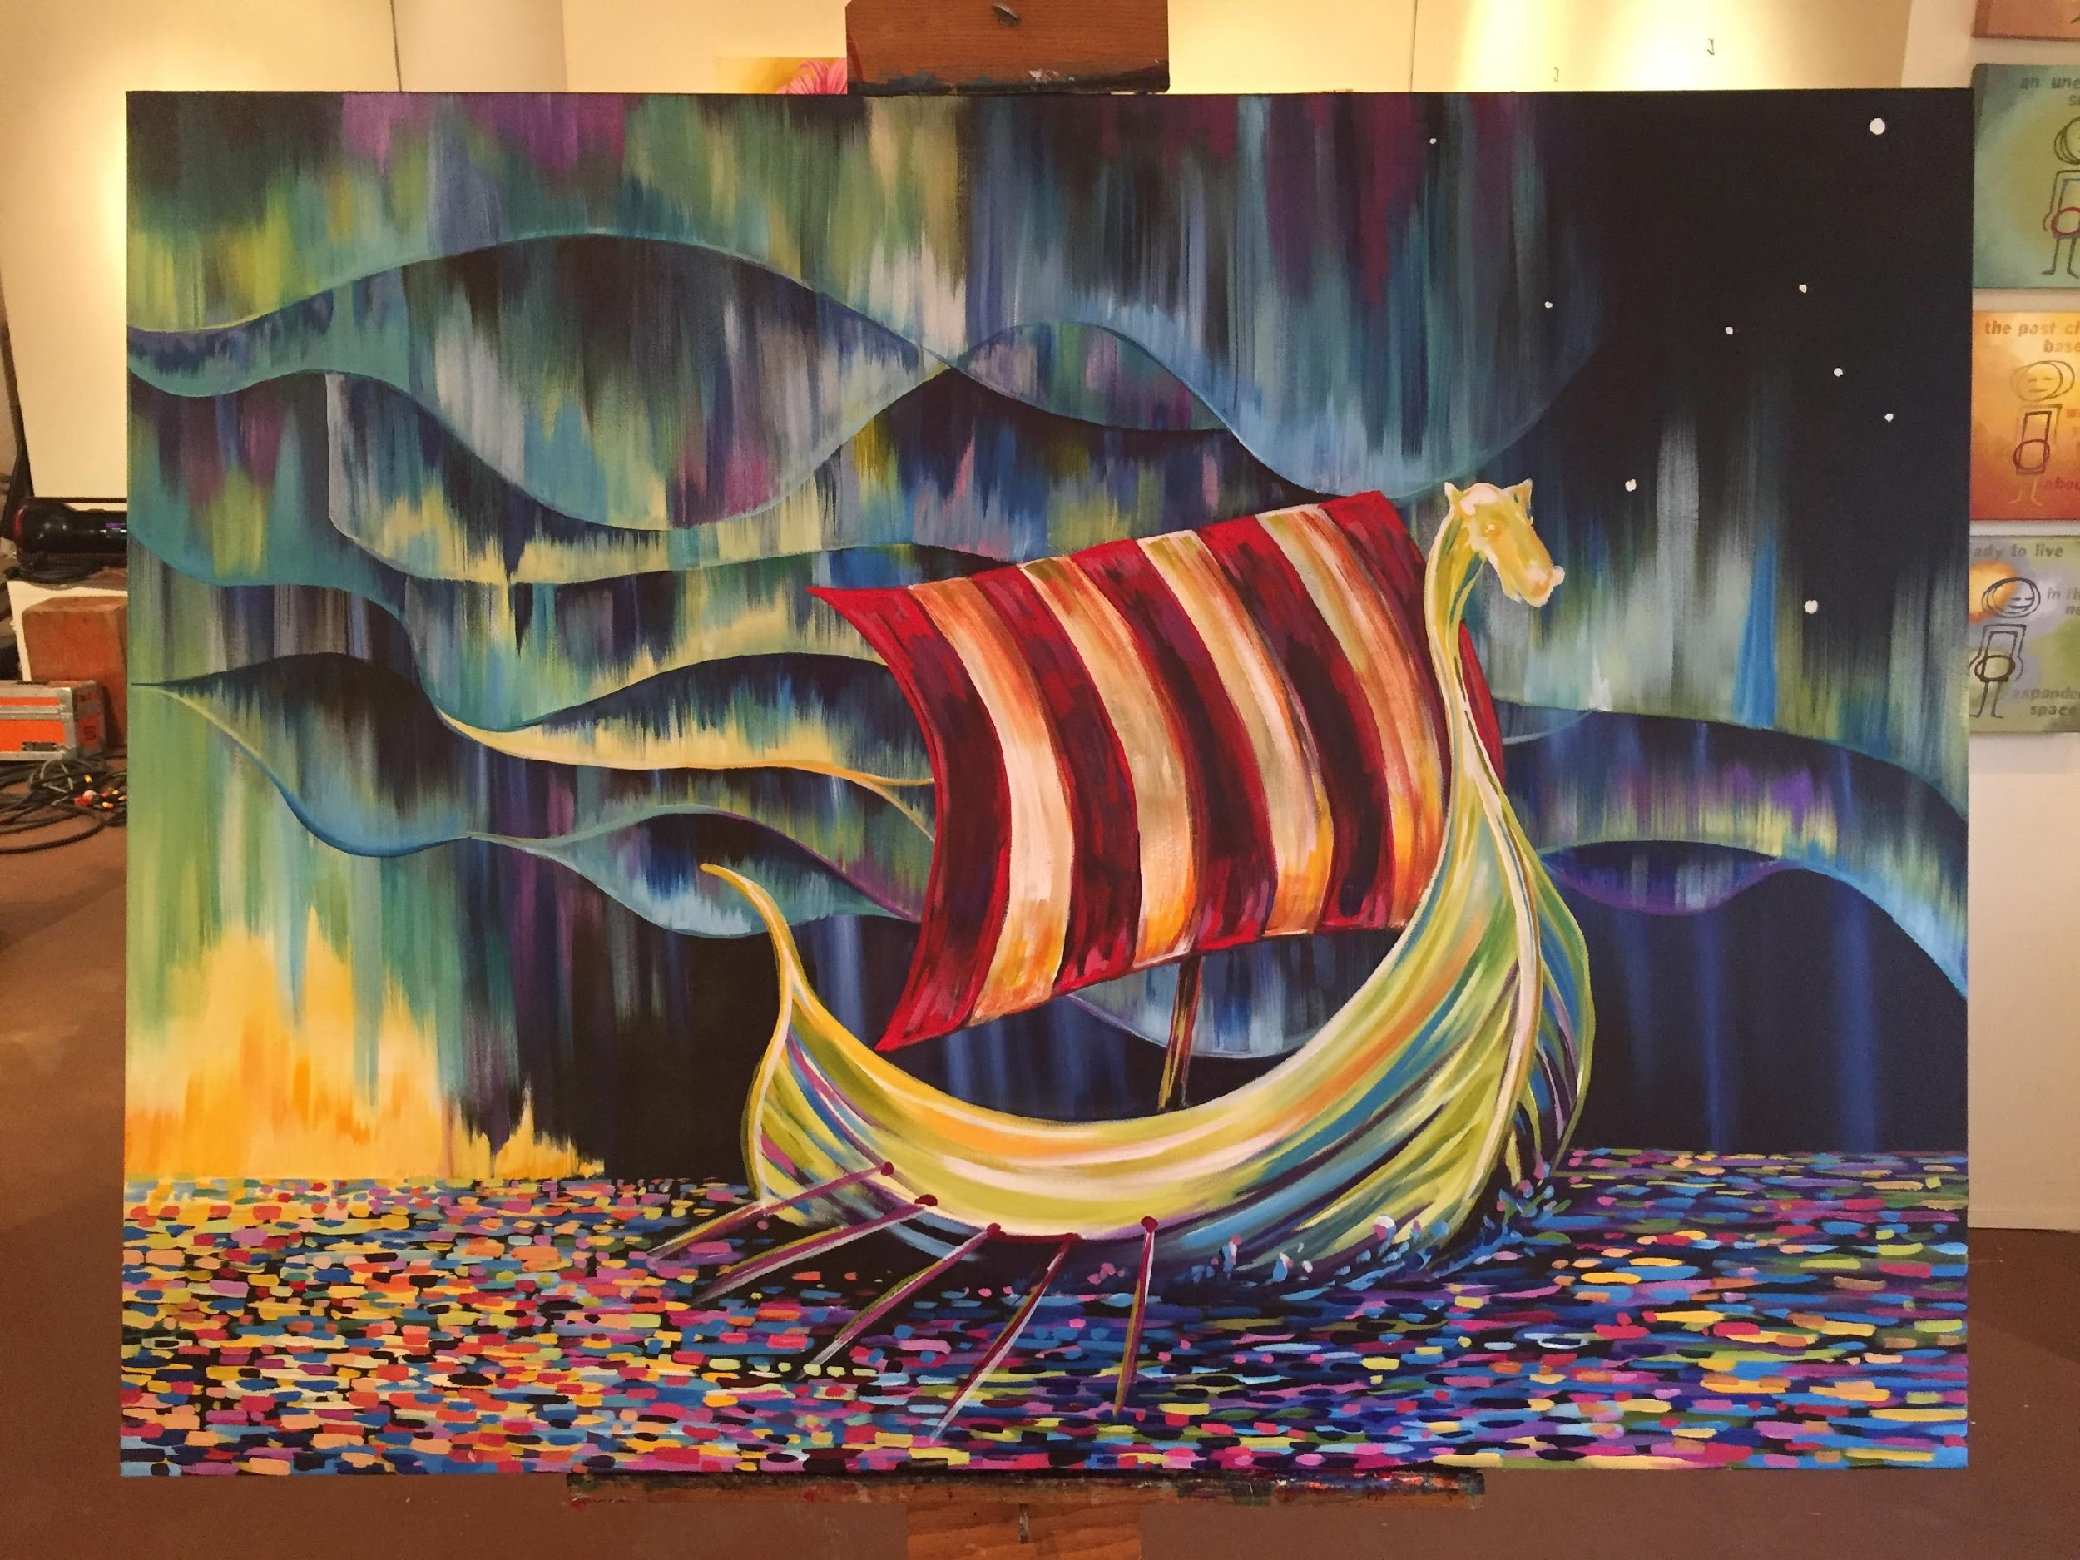
Sons of Norway
Since 1895
Leadership Training
Module 3 – The Local Lodge

Slide 2
Module Objectives
How does the Local Lodge fit into the District?
How does the District fit into the entire Order?
Roles and Responsibilities
  Lodge meetings
    How many?
    How do you conduct a meeting?
    Sample meeting agenda
  Annual Reporting Requirements
    D-17
    990
    D-63
    Lodge Liability Insurance
    Lodge Achievement Form

Slide 3
Module Objectives - continued
Code of Ethics
Social Media Policy
Privacy Policy
Recruitment and Retention
Lodge Disbanding Procedures
New Lodge Formation
Lodge Mergers
Record Retention
Available Resources

Slide 4
Districts
Sons of Norway is divided into 8 regional districts.
Each district has a set of district officers: District President, District Vice President, District Secretary, District Treasurer etc. They are also each represented by an International Director on the International Board.
All districts except for Norway (District 8) are further divided into zones. At least one District Zone Director is assigned to each zone, to oversee and aid the lodges in the region.
The Districts hold a District Convention every two years. The lodge delegates vote on proposals, on new District Officers, and to determine who will be sent to represent the district as delegates at the upcoming International Convention.

Slide 5
Lodges
Lodges serve as local chapters of Sons of Norway.
The Lodge Board includes the President, Vice President, Secretary and Treasurer. A lodge needs these four officers to function. The same person cannot fill multiple offices at this level.
There are other offices which are important for lodge administration, growth and engagement : Membership or Financial Secretary, Social Director, Cultural Director, and more.
In even years, each lodge is invited to send proposals to the district to be voted on at its District Convention in the spring. Each lodge sends a number of delegates to the convention, based on the number of members it had at the end of the previous year. The delegate count for each lodge is determined by the District Secretary.

Slide 6
Combining Lodge Officer Duties
Several lodges do not have enough leadership focused members to complete a full roster of officers:
The lodge officially only needs 4 officers to run: President, Vice President, Secretary and Treasurer. These offices must be held by separate people.
Some offices can be combined: for example, the social director and cultural director titles can be shared by the same member. Publicity Director tasks be fulfilled by the lodge editor, etc.
Some potential officers are intimidated by the thought of handling the duties alone. Many lodges have co-social directors or cultural committees, who work together to accomplish the duties of their collective office.

Slide 7
Lodge Roles and Responsibilities

Slide 8
Meetings
Local Lodge
Sons of Norway lodges typically meet once or twice a month.
A lodge must hold at least eight meetings annually.
At least four times a year, the majority of the business of the lodge should be transacted.
Business meetings and social meetings can be held separately.
Social meetings do not need to take place at the lodge’s regular meeting location: they can consist of a field trip to a local museum, a theater, a cultural fair, a park, a volunteer opportunity, or any other place or event, preferably with a Nordic focus.

Slide 9
Meetings Continued…
How do you conduct a meeting?
The lodge president presides at all meetings of the lodge.
The most recent edition of “Robert’s Rules of Orders” shall be the recognized parliamentary authority at lodge meetings.
Guidelines for business meeting protocol can be found in the Order of Ceremonies, which can be downloaded from www.sofn.com or requested by mail from Membership Services.
Social Meetings do not need to follow strict formal procedures.

Slide 10
Meetings Continued…
Sample meeting agenda:
Lodge President calls meeting to order.
Members stand as flags are presented and all three national anthems are sung.
Officer reports and communications.
  Treasurer’s Report
  Secretary presents last board minutes and last general meeting minutes.
  Cultural Directors Minute
  Letters and Communications
  Sunshine Committee
Guests are welcomed.
Honors and Awards are presented.
New Members are welcomed.
Unfinished business is discussed.
New business is presented and discussed.
Closing announcements
Meeting adjourned.

Slide 11
Annual Reporting Requirements
D17 Financial Statement
Used to record details about the lodge’s Income Statement and Balance Sheet.
Instructions are sent every winter from Sons of Norway Headquarters to the lodge treasurer and can be downloaded at any time from the forms area of the website. Completed forms are due in mid February.
Can be filed and signed online at www.sonsofnorway.com or downloaded as an editable PDF, which should be signed by all parties and sent to Sons of Norway Headquarters.
To avoid penalties, all filings must occur on a timely basis.

Slide 12
Annual Reporting Requirements Continued…
990 – Return of Organization Exempt from Income Tax
The 990 form is used by tax exempt organizations to provide the IRS with required information.
Instructions are sent out to the lodge treasurer along with the information about the D17 Financial Form.
They are due from each lodge to the IRS on May 15th every year.
Help with the 990 is available from the IRS at www.irs.gov.

Slide 13
Annual Reporting Requirements Continued…
D63/Lodge Officer Updates
Lodges should hold their elections for new officers in November. Some lodges hold elections every other year.
After the election, the lodge secretary needs to notify Membership Services at Sons of Norway Headquarters about their new roster. They may also need to notify their district secretary.
New officer rosters and lodge meeting information, can be changed via a link on the Secretaries Profile Page on www.sonsofnorway.com. A blank PDF version of the D63 form can also be downloaded from the Forms area of the website.
From mid October, through mid January, changes made to officers and lodge locations will not be live in the system at Headquarters until 01/15. The ‘old’ officer roster and lodge meeting information will appear on the online Lodge Directory during this transitional period.
Starting in 2020, paper versions and directions will not be automatically mailed out to lodge secretaries. Paper forms personalized for the lodge can be mailed out by request by Membership Services.
New Lodge Officer rosters are due on 12/31 each year.

Slide 14
Annual Reporting Requirements Continued…
Lodge Liability Insurance
Each summer, Sons of Norway renews its Lodge Liability Insurance.
All lodges are automatically covered by the policy. However, most lodges need to pay a portion of the premium based on their lodge population at the end of July.
The paperwork is sent to Lodge Treasurers in mid-August or September. The due date is indicated on the invoice.
Payments are waived for lodges with fewer than 25 members.

Slide 15
Annual Reporting Requirements Continued…
Lodge Achievement Program
Forms are completed by the lodge secretary with the help of lodge officers and members.
By the beginning of November, updated Lodge Achievement forms(LA), Family Lodge of the Year (FLOY) forms and AFA Year End Report forms are available on www.sofn.com. They can all be downloaded as PDFs. The LA and FLOY forms can also be filled out entirely online.
Paper forms are not mailed out to all lodges. They can be requested by contacting Membership Services at Sons of Norway Headquarters.

Slide 16
Annual Reporting Requirements Continued…
Lodge Achievement Program Continued…
Forms are due to Membership Services by 02/15 every year.
If a lodge recorded their events and volunteer hours using FraternalGives.org, they do not need to fill out the AFA Year End Report form.
Based on the scores on these forms, lodges can win:
  Gold, Silver or Bronze Merit Awards
  District Family Lodge of the Year
  District Small or Large Lodge of the Year
  International Small or Large Lodge of the Year
Awards are distributed biannually at District and International Conventions.

Slide 17
Code of Ethics
To the Members and Others
  Confidential Information
  Gifts to and from Members and Others
  Avoid Conflict of Interest
  Do Not Offer Legal or Tax Advice
  Avoid Even the Appearance of Impropriety
To the Sons of Norway
  Respect Sons of Norway Property and Confidential Information
  Recording and Reporting Information
  Use SofN Funds and Assets for Legitimate Business Purposes
  Maintain Complete and Accurate Accounting Records
Notes:
Use the Sons of Norway Code of Ethics as your talking points

Slide 18
Social Media Policy
Sons of Norway has an official, three page Social Media Policy that lodges must follow. A policy specific to Facebook is also available.
These polices can be downloaded from www.sonsofnorway.com under “Social Media Tips” on the Communications Tool Kit page.
Starting in 2020, lodges can elect or appoint an official “Webmaster” as a lodge officer.

Slide 19
Privacy Policy
Sons of Norway Headquarters mails out a copy of the Privacy Policy once a year to all members. It can also be accessed at www.sofn.com/privacy_policy/
This policy explains what information Sons of Norway collects, how it is used, and how it is protected.
Sons of Norway officers must understand that membership lists and reports are strictly confidential. They must never share personal contact, medical or financial information for any purpose other than approved Sons of Norway business, and must safe guard it to prevent unauthorized use.

Slide 20
Shared Values
A Simple Promise
Recruitment & Retention Resources

Slide 21
Sons of Norway Recruitment &
Retention Tools
Tangible Resources
Intangible Resources
Viking Magazine
Sons of Norway Foundation scholarships
Outstanding financial products
Sense of fellowship from lodges
Greater connection to Norwegian heritage
Greater sense of community through volunteerism

Slide 22
Fellowship
Being a member of a lodge is the #1 benefit of belonging to Sons of Norway: It connects people with a common interest in Norwegian culture and heritage
Recruitment
Potential members have a desire to connect with other people
Invite friends and family to join you at your lodge
Retention
Members engaged in the lodge are more likely to renew
Follow up with members if you’ve noticed their absence

Slide 23
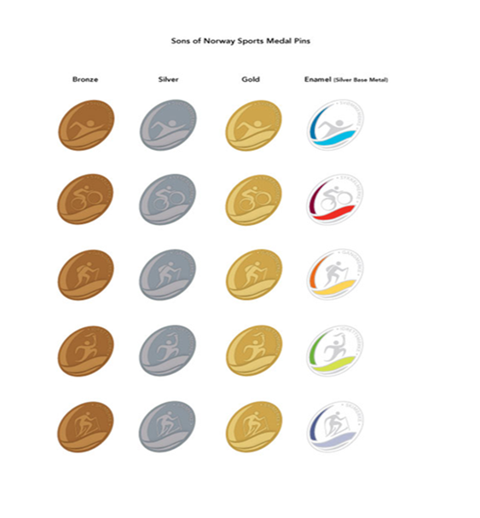
Sports Medal Program
Provides an exciting incentive for participating in a variety of activities
Recruitment
Excellent for active families: combine Norwegian culture with healthy living
Retention
Create a lodge sports medal program to keep members engaged
A full list of the Sports Medals is available online in the
Members Section

Slide 24
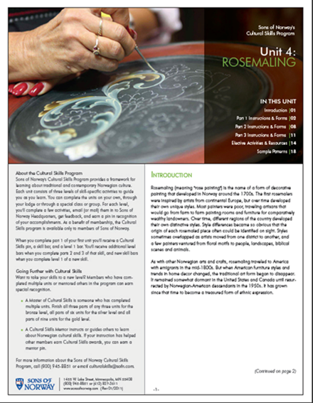
Cultural Skills Program
A framework for learning about traditional and contemporary Norwegian culture
Recruitment
Offer a demo or introductory lesson in the community
Retention
Utilize Cultural Skills as a group activity or
program in your lodge
A full list of the available Cultural Skills units is available under Members Resources

Slide 25

Volunteer Opportunities
Potential members are looking for opportunities to volunteer in their communities
Recruitment
Showcase your lodge volunteer projects as an incentive for prospective members: invite them along.
Retention
Participate in regular volunteer activities that engage and mobilize your membership
For tips & ideas, contact membership@sofn.com

Slide 26

Sons of Norway Foundation Scholarships
Scholarships from the Sons of Norway Foundation help offset the cost of education
Recruitment
Keep a list of available Foundation scholarships at tabling events
Retention
Many scholarships are exclusively for Sons of Norway members
More information is available at sonsofnorway.com/foundation

Slide 27





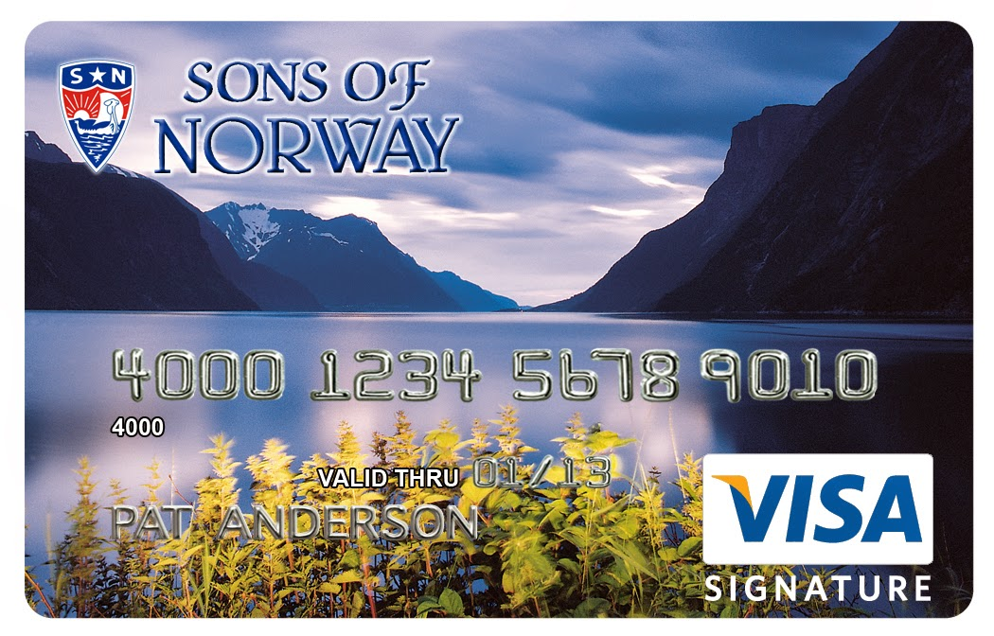

Member Discounts
Sons of Norway offers a number of member discounts ranging from travel to every day purchases
Recruitment
Many discounts can offset the cost of membership for a year
Retention
Discounts like Perkspot are available only to members
A complete list of discounts is available on the Sons of Norway website

Slide 28

Viking Magazine
Sons of Norway’s most popular member benefit
Recruitment
Leave copies in waiting rooms or coffee shops
Retention
Viking is only available to members
Extra copies are available from
the Supply Department

Slide 29

Sons of Norway Financial Products
Sons of Norway has strong, affordable financial products suitable for all stages of life
Recruitment
Coordinate a New Member Dinner with your Insurance Professional.
Retention
Members receive a complimentary financial check-up from the Insurance Professional.
Consult your Insurance Professional for more information

Slide 30
The Communications Toolkit
The toolkit includes all the materials for a successful outreach plan to your community and members alike
Recruitment
Use the toolkit to enhance your social media presence and engage non-members
Retention
Utilize the Newsletter Service resources to enhance your lodge newsletter
Available in the Members Resources section of
the Sons of Norway website

Slide 31
Discussion
What unique ways is your lodge using to reaching out to the community?
Does your lodge have any success stories using some of these approaches?

Slide 32
Lodge Disbanding Procedures
A letter detailing the disbanding process along with dissolution forms is available from Headquarters.
To disband, a lodge must hold a series of two meetings, as they would for a bylaws change.
If a lodge votes to disband, these completed forms and materials must be submitted to Membership Services.
  D17 Financial Statement up to the date of the vote.
  Official Notification of Lodge Disbandment
  Disbursement of Assets Notice
  Original Lodge Charter (if available)

Slide 33
New Lodge Formation
A new lodge needs 25 members to institute.
New Lodge Organization Guide brochures are available by request from Membership Services. Theses guides include the New Lodge Organizational Inquiry form to be completed and mailed to the District President.
Organizing members host a series of informational and organizational meetings. The process culminates with the Institutional Meeting, celebrating the official start of a new Sons of Norway lodge.
The lodge charter remains open 60 or 90 days after the Institution.

Slide 34
Lodge Mergers
There are two types of mergers
  In a formal merger, the governments of two lodges join together to create a completely new lodge. This lodge can retain the name of one lodge and the member number of the other, can have a new name, etc.
  In an informal merger, a lodge disbands and all its members transfer together into another local lodge. The lodge retains the number, name and officers of the absorbing lodge.
Information about how to conduct mergers and merger forms can be requested from Membership Services at Sons of Norway Headquarters.

Slide 35
Record Retention
Sons of Norway doesn’t have official rules regarding the retention of lodge paperwork.
Some paperwork and items do need to be kept in perpetuity, but others only needs to be kept for seven years, two years, or only one year.
Suggested guidelines can be found by searching for ‘Record Retention’ on www.sonsofnorway.com or by contacting Membership Services.

Slide 36
Available Resources
Lodge forms, information about programming and many other resources can be found on www.sonsofnorway.com.
District website provide news and district forms.
Supplies can be ordered from Sons of Norway Headquarters by email at supply@sofn.com or by phone at 1-800-945-8851 x4645.
Zone Directors and other District Officers, as well as Financial Benefit Counselors can provide assistance to local lodges.
Membership Services at Headquarters can answer questions and provide guidance: 1-800-945-8851 x4643, fraternal@sofn.com.

