Slide 1
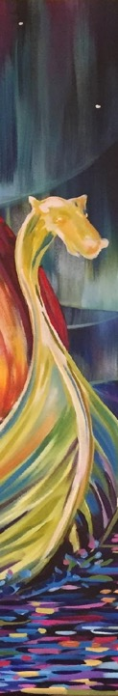
Sons of Norway
Since 1895
Leadership Training
Module 4 - Publicity

Slide 2

Honoring Our Past, Embracing the Future
Working closely with the strategic planning and financial teams, Sons of Norway has updated materials to reflect our evolving brand and promote our latest financial products.

Slide 3
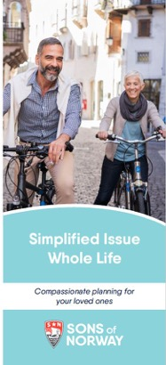
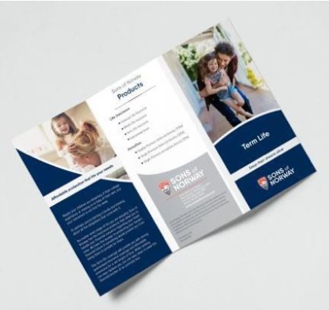
Integrating the New Look
A sampling of our newly-branded items
Notes:
HERE ARE A FEW OF OUR LATEST MATERIALS:
A FLYER THAT INTRODUCES OUR ARRAY OF FINANCIAL PRODUCTS
A NEWLY UPDATED DESIGN FOR THE ADVISOR NEWSLETTER, MAILED TO ALL MEMBERS WITH THE IMPRINT OF THEIR FINANCIAL BENEFITS COUNSELORS
ONE OF SEVERAL PRODUCT CARDS THAT SHOWCASE OUR PRODUCTS IN A BRIGHT AND INVITING FORMAT

Slide 4
Amplifying our Message
Upward trend in website engagement
 | June 2017 | March 2020
Users | 10,758 | 17,426
Sessions | 14,298 | 24,300
Pageviews | 46,006 | 78,305
Average session duration | 2:35 | 3:28
Bounce rate | 52% | 54.84%
New visits | 80% | 77%
Return visits | 20% | 23%
Social referral | 5.6% | 10%
Email referral | 14.1% | 16%
Notes:
WEBSITE VISITORS ARE SPENDING MORE TIME ON THE SITE, AND WE’RE SEEING A DRAMATIC INCREASE IN PAGEVIEWS.
AS YOU CAN SEE, THE “SOCIAL REFERRAL” AND “EMAIL REFERRAL” PERCENTAGES HAVE RISEN. THIS MEANS EFFORTS TO DRIVE EMAIL AND SOCIAL MEDIA SUBSCRIBERS TO OUR WEBSITE TO ACCESS MORE INFORMATION ARE SUCEEDING.
THE “BOUNCE RATE” IS TRENDING DOWN, WHICH IS GOOD – THAT MEANS THAT FEWER PEOPLE ARE LEAVING THE SITE AFTER JUST ONE PAGE VIEW – THEY ARE PROCEEDING TO CLICK ON TO MORE PAGES.

Slide 5
Amplifying our Message
Social media engagement
We’re continuing to see growth on Facebook, Twitter and Instagram. As of March 2020:
Our Twitter account has 3,037 followers, up by 14%.
Our Facebook account has an 8% engagement rate, increased from an average of 3%,and currently sees an average of 2,600 impressions per post.
In addition, our Instagram page continues to gain followers and is averaging a 12% engagement rate.
Notes:
WE WILL CONTINUE TO DRIVE NEW STRATEGIES TO ENCOURAGE NEW AUDIENCES TO LEARN MORE ABOUT SONS OF NORWAY AND JOIN THE CONVERSATION ON SOCIAL MEDIA.

Slide 6
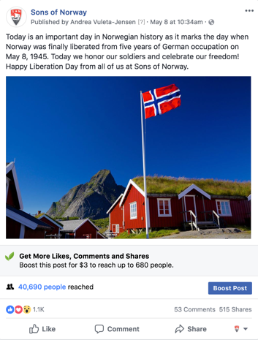
Amplifying Our Message
Available for your use:
Using Facebook to Connect with Members
Social Media Policy for Lodges
Sons of Norway Facebook Policy
To access resources, log in then go to:
Member Resources > Lodge Leadership Resources >
Administrative Resources > Communications Toolkit
Notes:
SPREAD THE WORD ABOUT SONS OF NORWAY IN YOUR OWN COMMUNITIES USING SOCIAL MEDIAL, AND TAKE ADVANTAGE OF THE ONLINE TIPS IN THE ONLINE MEMBER RESOURCES.

Slide 7
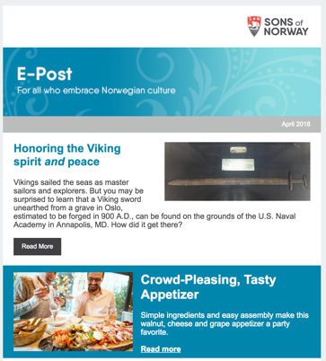
Amplifying Our Message
Newsletters
E-Post – monthly e-newsletter for all who embrace Norwegian culture. Sent to 26,000 member and non-member subscribers.
Newsletter Service – provides pre-written articles for each month that may be re-printed in your lodge newsletter.
Resource – Deadlines, news and updates for lodge leaders.
Notes:
OUR NEWSLETTERS REACH A WIDE READERSHIP OF MEMBERS AND NON-MEMBERS ALIKE.
LODGES ARE ENCOURAGED TO USE ARTICLES PROVIDED IN NEWSLETTER SERVICE, SENT TO LODGE EDITORS EVERY OTHER MONTH, AS SPACE ALLOWS IN THEIR OWN NEWSLETTERS.

Slide 8
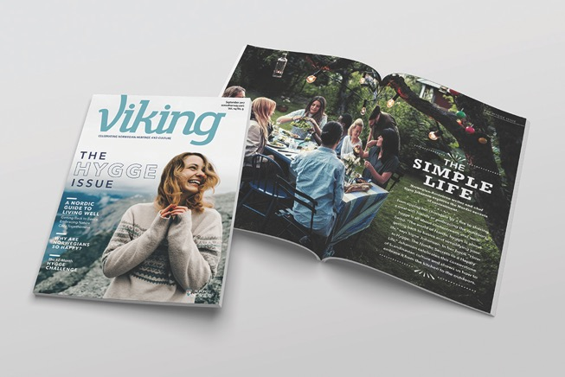
Amplifying Our Message
Viking
Notes:
- The ever popular Viking magazine continues to be a favorite among members.
Overall readership is estimated to be 100,000 readers per month!
Features continue to strike a balance between Nordic traditions and heritage and modern Norway.

Slide 9
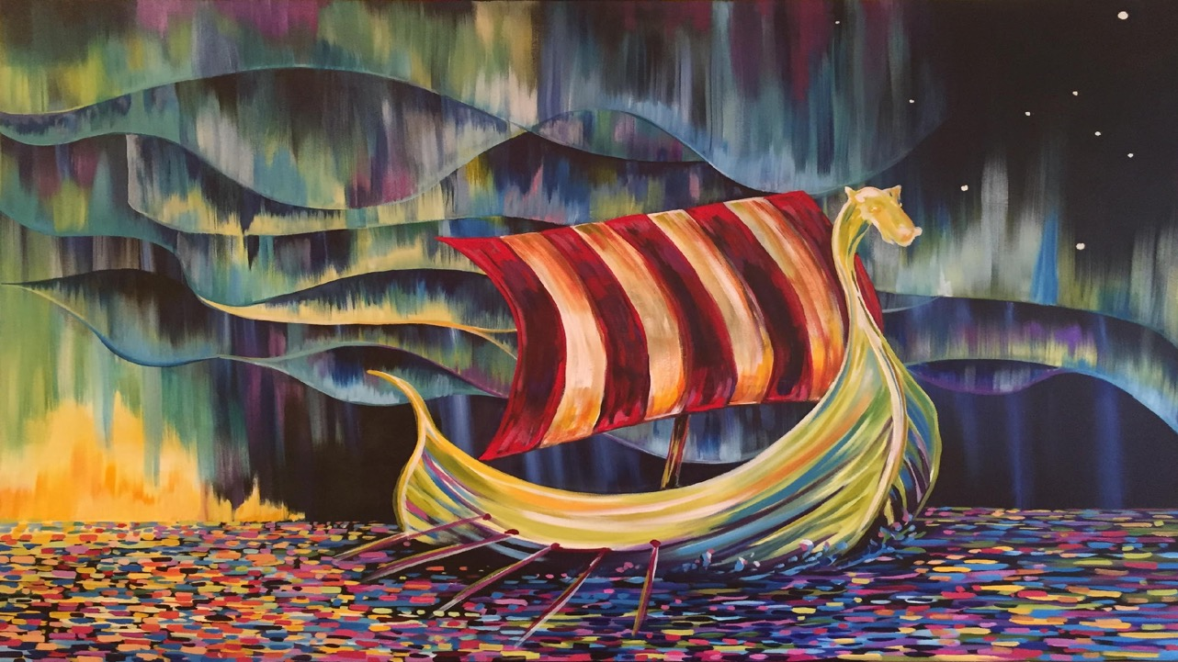

Creating a Facebook Page

Slide 10
Why Facebook?
As of 2020, there are more than 2.4 billion active Facebook users worldwide, so there’s a wide audience for your lodge
A Facebook page is a free resource for your lodge to share events, photos, updates and news to members and non-members
Facebook tools can allow you to focus your lodge page on a specific target or group

Slide 11
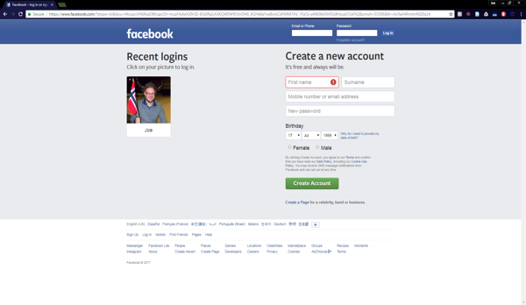
How to Create a Page
Step 1. Log into Facebook
You will need a Facebook account.
If you do not already have one, view this tutorial for creating your own personal Facebook profile.
Keep in mind, your personal profile will be linked to your page. You can add more administrators to your lodge page later on.

Slide 12
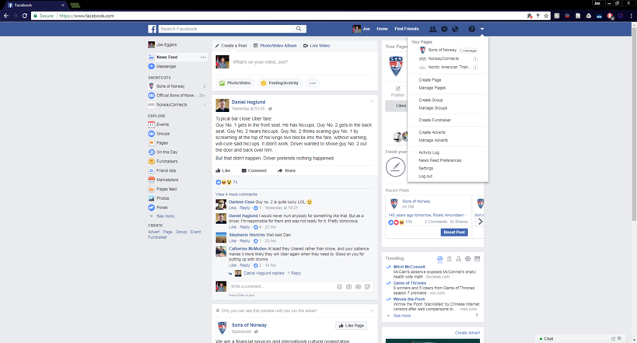
Once You’re Logged In
Step 2. Access the Create Page Button

Slide 13
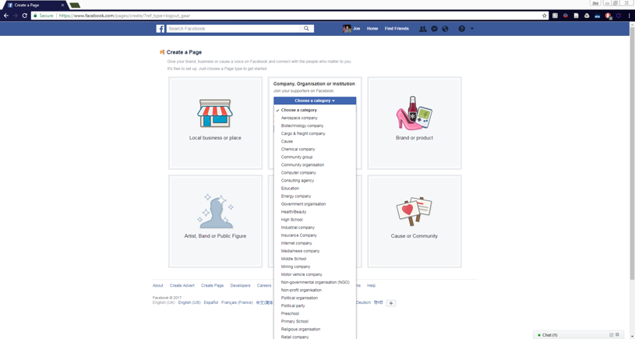
Pick a Page Template
Step 3. Click on “Company, Organization or Institution” and select “Community Organization”

Slide 14
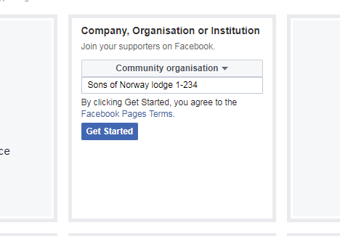
Name Your Page
Step 4. Choose a name for your page that makes your lodge easily identifiable. Keep in mind, brevity is important

Slide 15
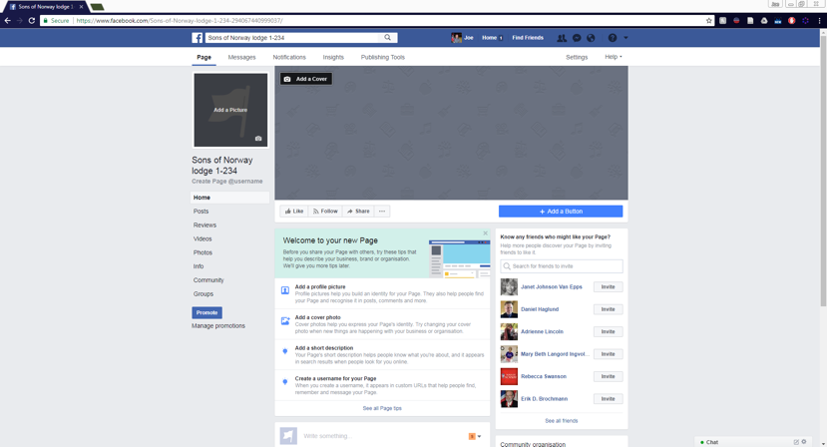
Start Building Your Page
Step 5. Select images that will help your lodge stand out on Facebook.
A Small image can be used as your page’s logo.
The size requirement is 180x180 pixels
A cover image is the perfect place to showcase your lodge. Try using one from a lodge event!
The size requirement here is 828x315 pixels.

Slide 16
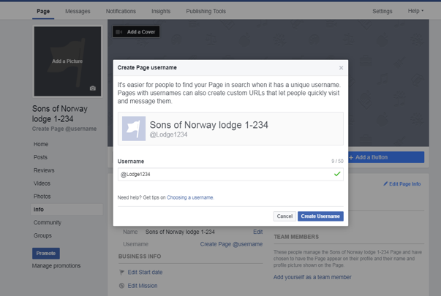
Start Building Your Page
Step 6. Give your page a name. This will make it easier to share your page with people outside of Facebook.
First, click on “Create Page @username”
Next, use your lodge name a number to create a custom Facebook page link.
In this case, the link will be facebook.com/lodge1234

Slide 17
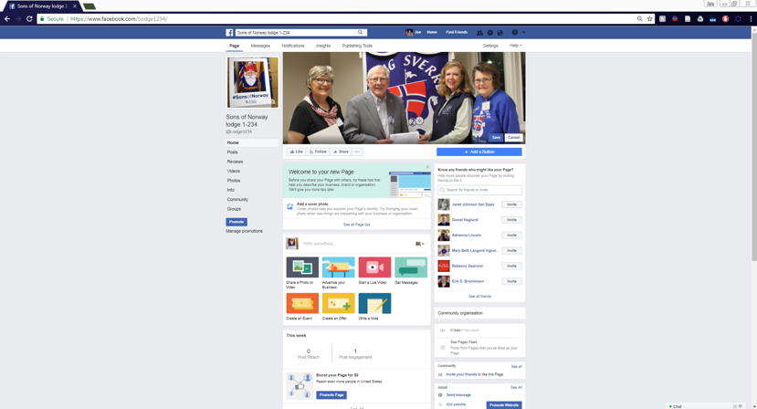
Check in - How is Your Page Looking?
At this point, your lodge page’s basic elements should be coming together.
Here’s what Sons of Norway Lodge 1-234’s page looks like.
Want to see explore this page to learn more?
Visit Facebook.com/Lodge1234 to see how it looks.

Slide 18
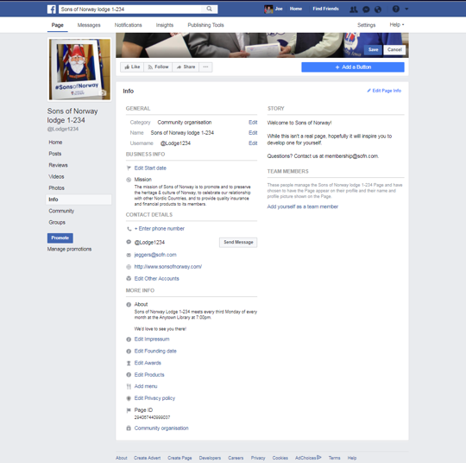
Wrapping up
Step 7. Don’t forget the extra content.
Clicking on info will take you to the additional information you’ll need to make your page useful.
Share a bit more about your lodge under the “Story” section and give users a way to contact you.

Slide 19
You’re All Set!
Your Facebook page should be all ready to go.
Our next tutorial will highlight resources to fill your page will information about your lodge.
Don’t forget: Share your page with members to increase your engagement.
Looking for more help? Email your questions at membership@sofn.com or better yet, find Joe on Facebook!

Slide 20
Lodge Exposure Tips
Throw a party and invite your friends, family, neighbors. Make traditional Nordic cuisine, decorate your lodge, and show your non-member friends how great it is to be part of Sons of Norway
Order Sons of Norway merchandise that can help create exposure out in the public.
Host a folk art competition and invite members of the community to participate.
Throw a lodge open house. Invite the community to come learn about Sons of Norway and what being a member is all about.

Slide 21
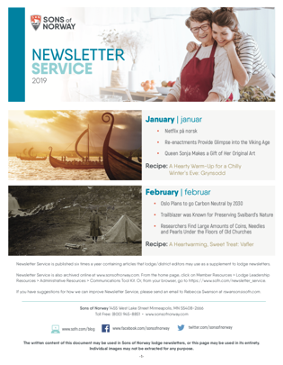
Newsletter Service
Looking to enhance your newsletter? We provide article suggestions for your newsletter to help ease the stress of coming up with content.
Newsletter Service entails:
Norwegian/English translation articles
Sons of Norway headquarters news
Recipes
Membership recruitment call-outs
History articles
Modern Norway insight
and so much more!

Slide 22
Other SofN Resources
Lodge Programming (https://www.sofn.com/member_resources/lodge_leadership_resources/lodge_programming/)
Cultural Programming(https://www.sofn.com/member_resources/cultural_programming/)
Communications Tool Kit (https://www.sofn.com/member_resources/lodge_leadership_resources/administrative_resources/communications_tool_kit/)
Looking for more help? Email your questions at membership@sofn.com

Slide 23

Don’t Forget

Slide 24
Items to remember
Protecting Member Privacy
Social Media Policy
Publicize your events

