Slide 1

Sons of Norway
Since 1895
Leadership Training
Module 5 – Sons of Norway Foundation

Slide 2
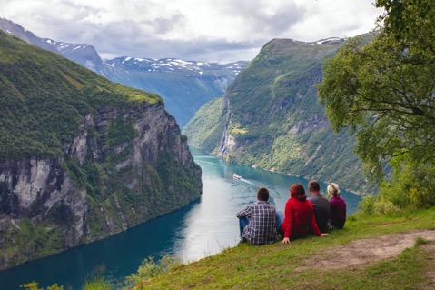

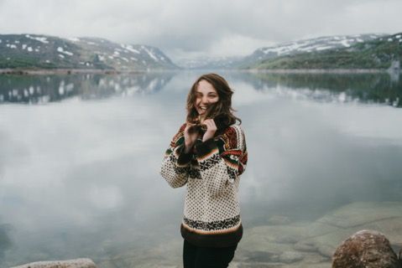
Sons of Norway Foundation’s Mission
The Sons of Norway Foundation is dedicated to funding activities that preserve and promote Norwegian heritage, positively affect members, and make Sons of Norway communities a more vibrant place to live.

Slide 3
Foundation’s Core Values
1) Creating the heritage of the future
2) Sustaining the link to contemporary Norway
3) Committing to life-long learning and service
4) Preserving compassion for those in need
5) Funding innovative individuals and opportunities
6) Fostering a cohesive community of philanthropy

Slide 4
The Foundation is here for members in 3 ways:
GRANTS for lodges, community partners and members in need
SCHOLARSHIPS for post secondary education and cross cultural exchanges
LEGACY PLANNING to help you leave a legacy of philanthropy in the Nordic community

Slide 5
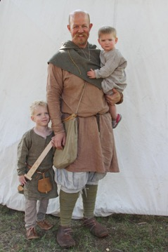
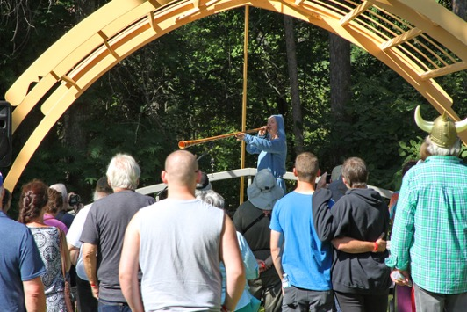
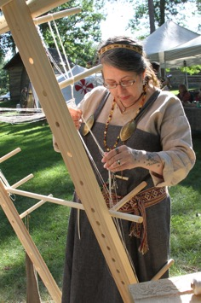
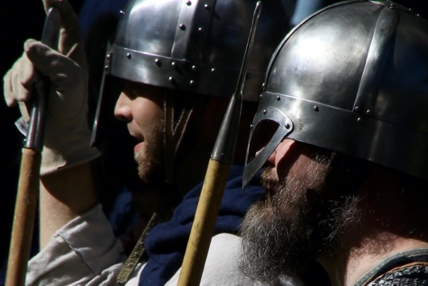
Grants
We offer grants in a range of categories for lodges, community partners and individuals. These grants provide funding to support Nordic culture and heritage events, humanitarian aid to children and members in need, and lodge programming.
“Receiving a grant from the Sons of Norway Foundation was crucial to the success of our first Viking Festival. Not only did the grant allow us to expand the scope of the experiences we could offer, but provided the credibility we needed to leverage additional funding, both from the community and our lodge members. “ – Sagatun Lodge, Brainerd, Minnesota
Please encourage lodges and community partners to apply for grant opportunities!

Slide 6
Grant Opportunities:
Lodge Vitality Grant
- Operational or small capital support for lodges, up to $1,000
Lodge Culture and Heritage
- Focusing on Norwegian heritage and culture, lodges only, up to $1,500
Community Partnership
- Norwegian heritage and culture, non-members only, up to $1,000
Helping Hands to Children
- Lodges that run programs for kids or partner with local agencies to help kids in need, up to $1,000
Helping Hands to Members
- rolling basis all year, helps members affected by natural disasters
~$30,000 - $50,000 given out annually depending on applications
All due December 31st – please apply!

Slide 7
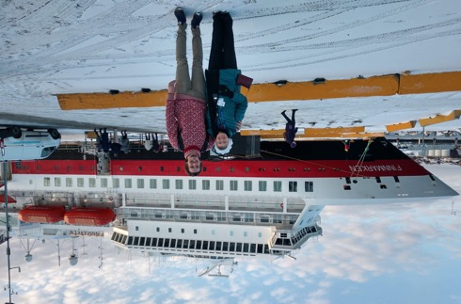
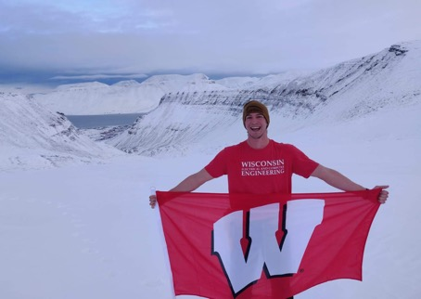
Scholarships
With the rising cost of higher education, the Sons of Norway Foundation is here to help with 15+ scholarship opportunities.
For many recipients, these awards are a life changing opportunity to explore educational passions here in the US or in Norway.
“What I wish to convey above all is that this
scholarship, for lack of a less cliché phrase, made my dreams come true. I’ve found my
long-lost family and had the greatest
experience of my life.”
- Kai Pederson, 2019 scholarship recipient

Slide 8
Scholarship Opportunities:
Over $100,000 awarded annually to students of all types:
- Americans studying domestically or in Norway
- Norwegians studying in the USA
- Adult learners
- Undergraduate, vocational/trade, graduate
- Members (or children and grandchildren of members) and non-members
- Norwegian Folk High Schools or Oslo International Summer School
- Awards range from $1,000 to a full year of tuition
- Check the website for up to date information, opportunities are added as they become available!
Applications open in October. Encourage students and members in your district/lodge to apply!

Slide 9

Camperships
Over $10,000 provided annually for youth to attend Norwegian camps through the Draxten Fund & Evenson Fund
Foundation sends funds to each District, the District makes the awards
Camps are available everywhere:
Skogfjorden (Concordia Language Village) – In District 1
Camp Trollhaugen, Nidaros and Normanna – In District 2
Land of the Vikings – In District 3
Trollfjorden, BjØrnetann and Trollhaugen - In District 4
Masse Moro – In District 5
Camp Norge – In District 6

Slide 10
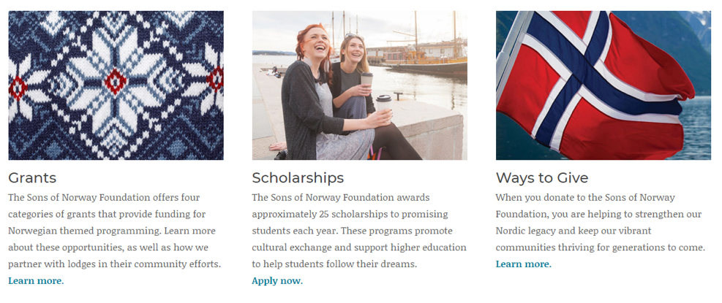
How to Apply for a Grant or Scholarship
Online only: www.SonsofNorway.com/Foundation
Grant and Scholarship Portal Opens: Every year in October
Deadlines vary by opportunity – be sure to check the website often!

Slide 11
Leaving a Legacy
The majority of our scholarships and funds were created by members just like you!
- Many had an opportunity to study abroad or to complete higher education with financial assistance and want to see others do the same
- Some wanted to honor a loved one by giving back to others with similar passions
- Districts and lodges wanted to pool resources for scholarships supporting local youth
- ALL wanted to leave a legacy for good in the Nordic community and knew the
Sons of Norway Foundation was the best option for their philanthropy
Endowment funds last forever – a gift that never stops giving
- The principal of the fund is never touched but is invested with a percentage of the interest earned used every year for grants or scholarships
- We have the flexibility to accommodate your plans! We can help you build a scholarship that fits your educational passions, create an endowment to fund Nordic culture and heritage events in your district, or a wealth of other options.

Slide 12
How Can I Give?
By contributing to the Sons of Norway Foundation, you are supporting programs that benefit your lodge, your community, and the young Sons of Norway members who will keep our Nordic legacy strong for future generations.
Ways to support our mission:
Online donations at www.sofn.com/give
Stock donations (save capital gains taxes!)
IRA distributions
Gifts of real estate
Charitable trusts
Gifts of life insurance
Legacy gifts
District and local lodge fundraisers
The Sons of Norway Foundation is a 501c3 organization. All gifts are tax deductible in accordance with state and federal law.

Slide 13
How Else Can I Get Involved?
Become a District or Lodge Foundation Director
- Inform your Zone Director and Lodge members of our grant and scholarship opportunities
- Be an ambassador for the Foundation’s grant and scholarship recipients
- Help raise funds for our programs
- Promote the Foundation’s Core Values
Apply for the Board of Governors
- Applications accepted late summer/early fall
- Take on a leadership role with an organization that is passionate about serving others and
sharing our Nordic values
- Searching for people with legal, fund development and social media skills
Become a scholarship or grant reviewer
  - Help the foundation make funding decisions by providing your expertise and time

Slide 14

Contact the Foundation today!
You can contact your district’s Foundation Director or contact Sons of Norway Foundation directly with the contact information below:
Anne Olson
Foundation Director
612-821-4632
foundation@sofn.com
www.sofn.com/foundation

