Slide 1

Sons of Norway
Since 1895
Leadership Training
Module 6 – Financial Products

Slide 2
Growth Initiatives
Increase the number of Insurance Professionals associated with a lodge
  102 direct contracted agents
Increase independent agent base
  266 independent agents
Increase the number of new insurance and annuity products
  Launched two new annuity products in 2019
  Enhanced five life insurance products to include membership fees
Hire experienced sales department with broad industry experience
  Fully staffed sales department as of 10/19
  Broad industry experience with all sales employees
Enhance the Sons of Norway website to highlight insurance products and
provide better sales support materials
Notes:
THESE GROWTH INITIATIVES WERE DESIGNED
To help recruit new members
To contact more members about our financial products and services
To reach more members in geographical areas currently not reached
To help grow Sons of Norway so as to pass on our heritage
to the next generations
To help with members needs that weren’t addressed before. For example, some members are uninsurable

Slide 3
The impact of Life and Annuity sales on lodges
Protecting our members with quality and competitive insurance products.
  Our products protect their families and their financial security.
    Life insurance protects them from life's unexpected events
    Annuities protect their financial security from market fluctuations and provide predicable reliable income
Sons of Norway insurance sales subsidies 61% of the Fraternal operation
  Member dues only fund 39% of lodge operations
Every sale of an insurance product directly gives back revenue to the lodge.
Notes:
For example, dollars to help pay the cost of publishing the Viking Magazine
In 2017, the dollar amount was $1.415 million to help support the Fraternal operation
Provides dollars to lodges based on the number of insured members
Provides dollars for the lodges to spend on lodge programs, social functions, etc.

Slide 4
Nordics Pay it Forward — 5 Steps
To explain in a clear fashion how the purchase of a Sons of Norway financial product benefits members, lodges and communities, the “Nordics Pay it Forward” infographic was developed.
It consists of 5 steps, beginning with a member purchasing a financial product and ending with the lodge receiving a check that can be used in a number of ways.
Let’s take a look at the 5 Steps.

Slide 5
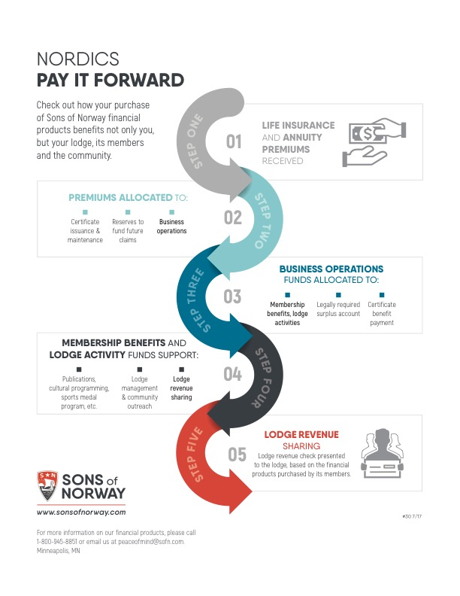
Financial Products and Services
Notes:
Step One — Life insurance and annuity premiums received.
Step Two — Premiums are allocated to certificate issuance and maintenance, reserves to fund future claims and business operations.
Step Three — Business operations funds are allocated to certificate benefit payment, legally required surplus account and membership benefits and lodge activities.
Step Four — Membership benefits and lodge activity funds support publications, cultural programming, sports medal program, lodge management and community outreach and lodge revenue sharing.
Step Five — Lodge revenue sharing – A check is presented to the lodge based on the financial products purchased by its members.

Slide 6
Sons of Norway’s
Newest Financial Products
Financial Products and Services

Slide 7
Sons of Norway’s Newest Products
Simple Solution - Simplified Issue Whole Life
Guaranteed Solution – Guaranteed Issue Whole Life
One Solution – Simplified Issue Single Premium Whole Life
Bonus Single Premium Annuity
Multi-Year Guarantee Annuities – 3, 5 and 7 year

Slide 8

Simple Solution Whole Life
Fewer Medical Questions
Fulfills the need for a lower death benefit at an affordable rate
with fewer health questions. This product will also cover final
expenses plus other debts, thus providing peace of mind.
Here are the advantages:
Available to anyone up to age 85
3 health questions – no medical exam
Face amounts $10,000 - $50,000
Guaranteed cash values
Fixed premiums
Sons of Norway, Minneapolis, MN offers financial products. Products are not available in all states. Products issued by Sons of Norway are available to applicants who meet membership, insurability and residency requirements.

Slide 9

Guaranteed Solution Whole Life
No Medical Questions Asked,
Guaranteed Acceptance
Funeral costs, medical bills, left-over debts; these are expenses
that you and your family can expect upon the death of a loved
one. But with the affordable insurance plan, you can ease the
burden of immediate final expenses, regardless of your health.
Here are the advantages:
Available to anyone up to age 85
No medical exam or health questions
Face amounts $5,000 - $25,000
Guaranteed cash values
Fixed premiums
Sons of Norway, Minneapolis, MN offers financial products. Products are not available in all states. Products issued by Sons of Norway are available to applicants who meet membership, insurability and residency requirements.

Slide 10

Membership Now Included
Our Selling agents now enjoy the benefits of a simplified membership process that rolls the dues for a Local Lodge Membership in the cost of these Insurance Products:
Simple Solution - Simplified Issue Whole Life
Guaranteed Solution – Guaranteed Issue Whole Life
One Solution – Single Premium Simplified Issue Whole Life
Participating Fully Underwritten Whole Life
Single Premium Fully Underwritten Whole Life

Slide 11

Annuities
Features:
A solution for retirement
Accumulate money on a tax-deferred basis
Periodic withdrawals of your cash – both
principal and interest
Guaranteed lifetime income options available
Ideal for rollover of 401k, 403b and other
qualified retirement plans

Slide 12
In Summary
Do something for your loved ones
Protect them with a certificate from Sons of Norway
Take full advantage of your member benefits with competitively priced insurance available only to members
  • Secure your family’s finances against life’s unknowns
  • Get protection you can trust from a not for profit organization dedicated to its members and communities

