Slide 1
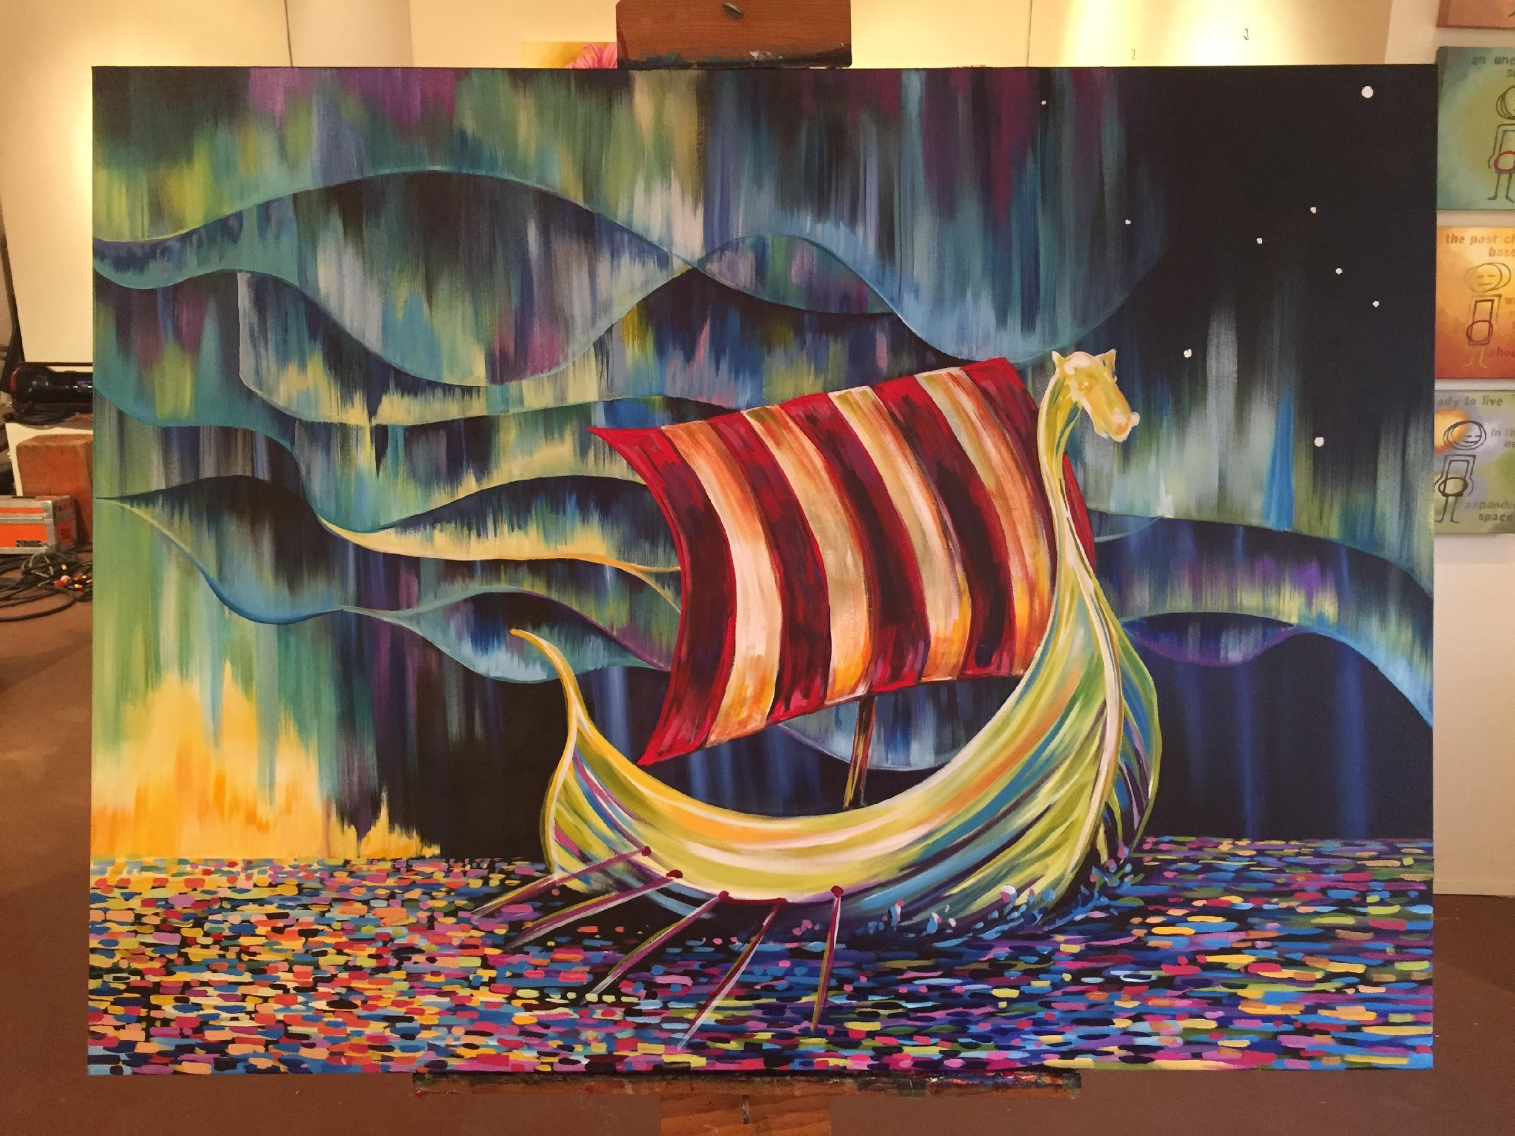
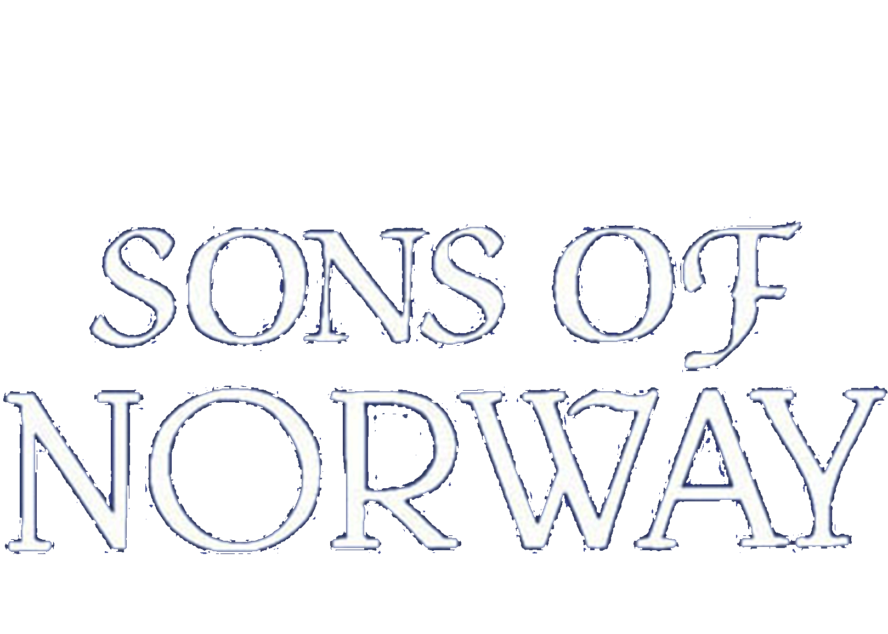
Shared Values
A Simple Promise
About Us

Slide 2
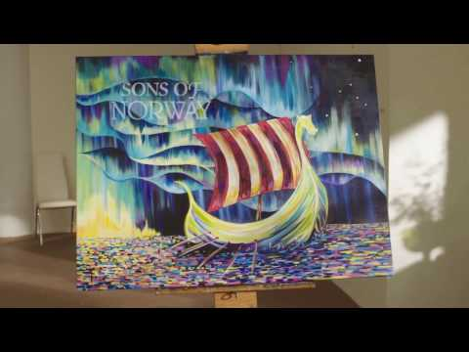

Slide 3
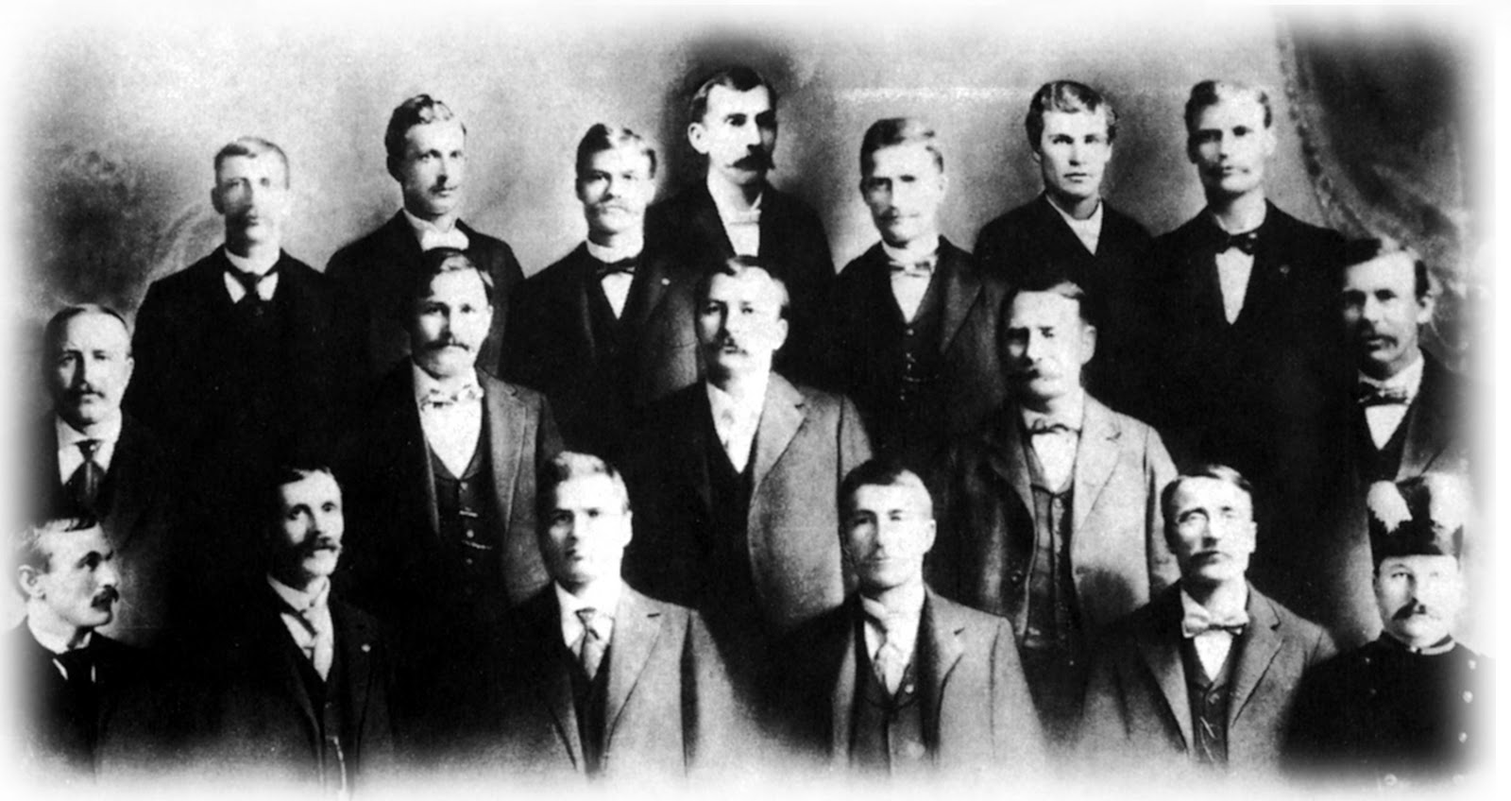
Who Are We?
We were founded by 18 Norwegian immigrants in 1895...
More than 120 years later, we continue to advance our mission to promote and preserve the heritage and culture of Norway, celebrate our relationships with other Nordic countries and provide quality insurance and financial products to our members.

Slide 4
Sons of Norway’s Mission
The mission of Sons of Norway is to promote and to preserve the heritage & culture of Norway, to celebrate our relationship with other Nordic Countries, and to provide quality insurance and financial products to its members.

Slide 5
Sons of Norway Today
In staying true to its mission statement, Sons of Norway focuses on three core business areas:
Cultural Programming: Whether your passion is art, language, fitness or simply getting together with like-minded people to celebrate your heritage, there are offerings for everyone.
Financial Products: We provide financial security to members and invest the proceeds back into the organization so we can continue to support our shared values.
Philanthropic Outreach: We are known for giving back and investing in our communities through volunteer programs or supporting our Foundation, which offers scholarships, grants and emergency assistance.

Slide 6
How Do We Do This?
Members
Lodges
FBCs
Int’l & Foundation Boards
District
HQ

Slide 7
Questions?

