Slide 1
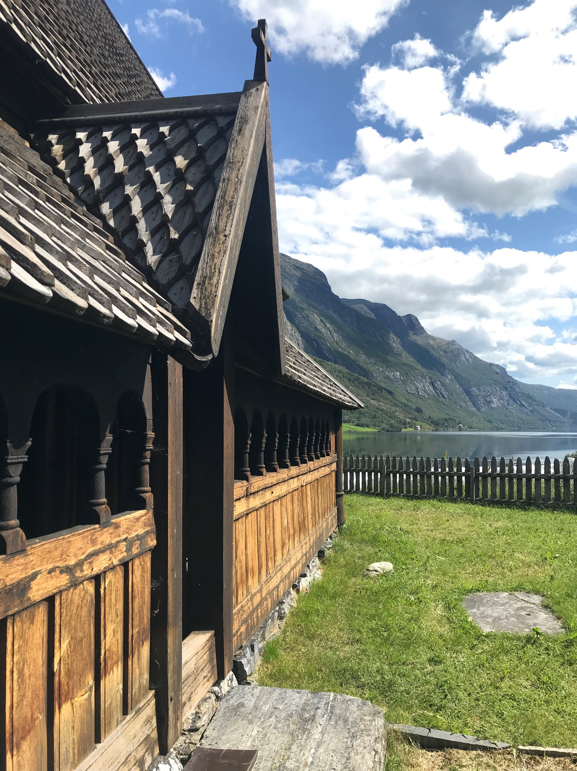
Stave Church Trivia
Can you get them all right?
Created By:

Slide 2
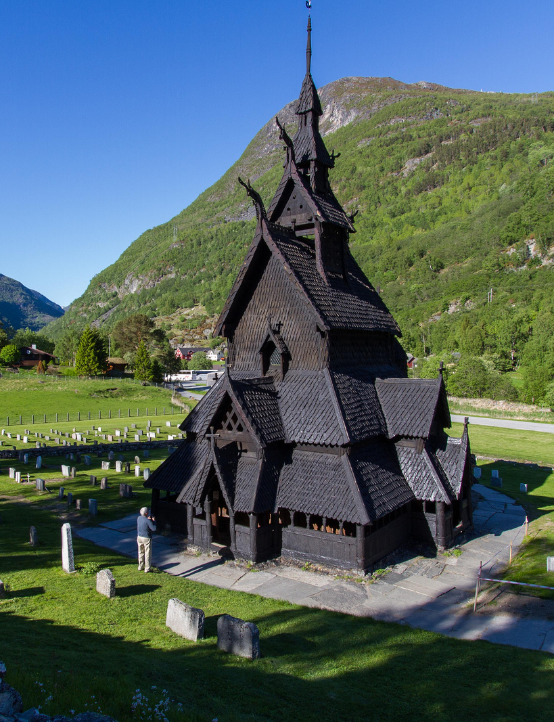
Stavkirker/stavkyrkjer (stave churches) are considered to be among the most important examples of wooden medieval architecture in Europe. Today there are only 28 left in existence and they are all located in Norway. This quiz will test your knowledge of these magnificent structures.
Photo: Andrew Knott/Borton Overseas Client

Slide 3
Take turns calling out which question on the grid you would like to select. To see the correct answer to a question, use the “Answer” button. The “BACK” button on the answer pages returns you to the quiz grid. As we go through the game, fill in your answer sheet to keep track of whether you got it right. There are six categories with three questions each, ranging in point value from 1-3 depending on difficulty. Select the “Done” button at the end of the quiz and tally up the scores. The person with most points wins a prize!
How to Play - Individual
Have fun!!!

Slide 4
Pick your teams and choose a team member to fill in your answers on your team’s answer sheet. Play follows as with individual play, taking turns among teams to select the questions. At the end we will tally up the scores and the team with most points wins. Draw from the team member names to select the lucky winner of prize!
How to Play- Teams
Let’s Get Started!

Slide 5
Which church is it? | Past & Present | How they are built | Church & State | Sognefjord in a Nutshell | Stave Church Replicas
1 | 1 | 1 | 1 | 1 | 1
2 | 2 | 2 | 2 | 2 | 2
3 | 3 | 3 | 3 | 3 | 3
Done

Slide 6
It’s time to tally up the scores and see who won! Use the Calculate Your Score column on your answer sheet to find your total points. You will need to multiply your correct answers by the degree of difficulty for each row. You can do that like this: Row 1 correct answers x 1 point each Row 2 correct answers x 2 points each Row 3 correct answers x 3 points each Once you have your row totals, add them up and put your final score in the Total Points box at the bottom of the sheet. The person with the most points wins!
How to Score

Slide 7
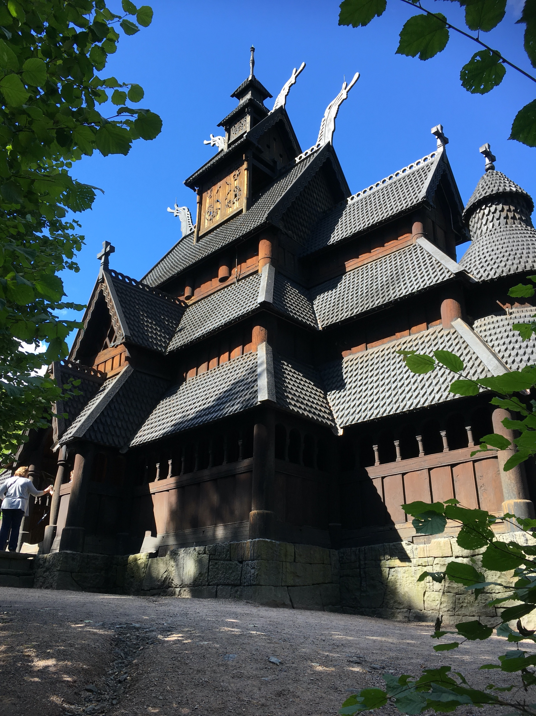
Thanks for Playing!
Presented by:

Slide 8
True or False: Urnes is the oldest surviving stave church.

Slide 9
TRUE: Urnes Stave Church was built around 1130 A.D. The distinctive carvings on the north portal are from an even older church. It was declared an UNESCO World Heritage Site in 1979.

Slide 10
True or False: Heddal Stave Church is the smallest surviving stave church.

Slide 11
FALSE: Heddal Stave Church is the largest! It is 20 meters long and 16 meters wide, with 3 turrets standing 26 meters tall.

Slide 12
True or False: Gol stave church has always been located in Oslo.

Slide 13
False: Gol Stave Church was disassembled from its original location in Gol in 1881, and in 1885 was reconstructed on Bygdøy peninsula in Oslo. It is now part of the Museum of Cultural History.

Slide 14
What was the name of the troll who, legend says, helped build the Heddal Stave Church?
Olaf Sigurd Grendel Finn

Slide 15
Finn Finehair He is said to have completed the Heddal Stave Church in just three days! According to legend, Finn Finehair (Finn Fagerlokk) also played a part in building Nidaros Cathedral in Trondheim and Lund Cathedral in Sweden.

Slide 16
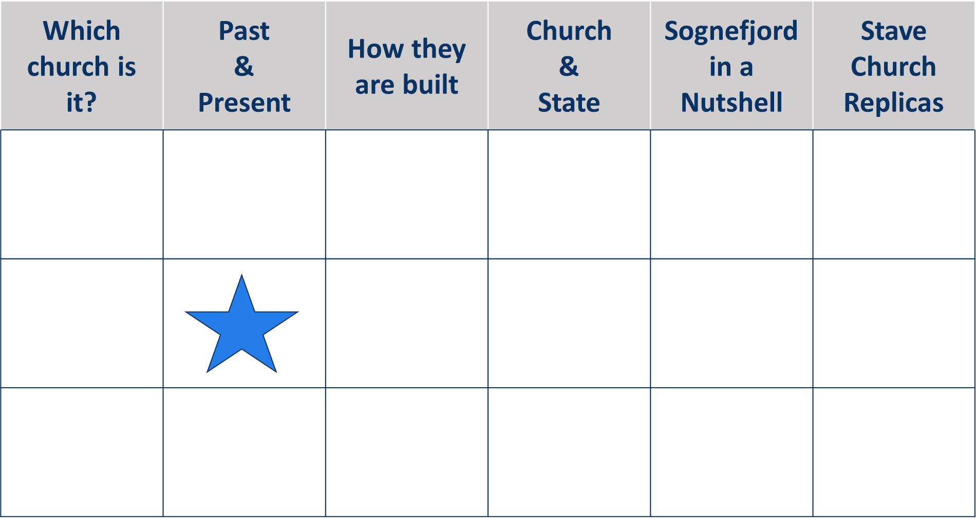
The Society for the Preservation of Ancient Norwegian Monuments (Fortidsminneforeningen) manages how many of the 28 remaining stave churches?
2 8 19 All of Them

Slide 17
8 They include the churches of Borgund, Urnes, Hopperstad, and Uvdal.

Slide 18
The heyday for stave churches was between the 12th and 14th centuries. How many churches were thought to have been built during this time period?
200-300 552 880 Over 1,000

Slide 19
Over 1,000 It is estimated that 1-2 thousand stave churches were built during this era all across Europe. Only 28 remain today and all are located in Norway.

Slide 20
True or False: Stone, metal and wood were all common structural materials used in the building of stave churches.

Slide 21
FALSE: Stave churches have a post and lintel building structure composed primarily of wood. Metal was only used on decorative door panels and locks.

Slide 22
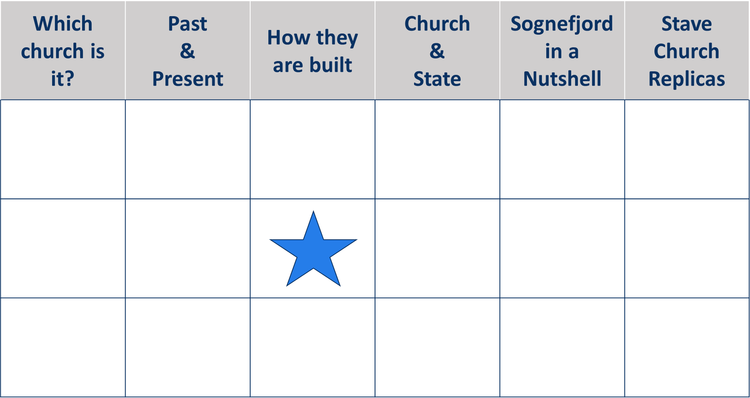
Late Viking-era carvings are featured on which part of the Urnes Stave Church?
Entry Doors
Altar
Between the Pews
Interior Walls

Slide 23
Entry Doors The wooden door panels are the original example of the Urnes Style of carving, which depicts sinuous animals interlacing and looping, with long eyes pointed forward. This style dates from 1050 A.D. into the 12th century.

Slide 24
Ore-pine is the English translation for the cured heartwood of mountain fir trees that were used for the central supports of stave churches across Scandinavia. Each region had its own pronunciation for ore-pine. Which of these is Norwegian?
malmfura malmfuru malmfyr málmfura

Slide 25
Malmfuru Is the Norwegian diction and it stems from Old Norse root words that each region shared during the Viking era. Malmfura = Swedish, Malmfyr = Danish, Málmfura = Icelandic

Slide 26
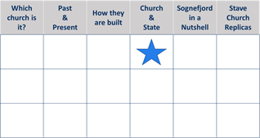
What denomination were the majority of stave churches built to service?
Lutheran
Catholic
Anglican
Baptist

Slide 27
Catholic Stave churches were built before the Protestant Reformation that swept Norway in 1537 A.D.

Slide 28
True or False: Borgund Stave Church is dedicated to Saint Andrew.

Slide 29
TRUE: Borgund Stave Church was built around 1180 A.D. and dedicated to Saint Andrew, the patron saint of singers and fishermen.

Slide 30
Canonized in 1031 A.D., who is the patron saint of Norway?
Harald Hardrada
Ragnar Lodbrok
Olaf Harraldson
Magnus V

Slide 31
Olaf Harraldson Also known as St. Olaf, he is known to be buried within Nidaros Cathedral, located in Trondheim.

Slide 32
How many stave churches are in Sogn og Fjordane? 10 5 4 2

Slide 33
5 Borgund, Hopperstad, Kaupanger, Undredal & Urnes

Slide 34
True or False: The surviving stave churches in Sogn og Fjordane were all built at the end of the 14th century.

Slide 35
FALSE: They all date back to the 12th century, which was the beginning of the era in which the style and construction of stave churches was popular.

Slide 36
Considered the largest of the stave churches in the Sognefjord region, Kaupanger Stave Church has how many stave supports?
18 22 24 28

Slide 37
22 Kaupanger Stave Church contains 22 stave supports and has a capacity of 125 people. It is still being used as the local parish church every Sunday.

Slide 38
How many replicas of Borgund Stave Church are there in the United States? None 5 3

Slide 39
3 They are located in: Rapid City, South Dakota Lyme, Connecticut Washington Island, Wisconsin

Slide 40
True or False: Gol Stave Church is featured as a full size replica in Minot, North Dakota, at the Scandinavian Heritage Park.

Slide 41
TRUE: The original Gol Stave Church is at the Museum of Cultural History in Norway.

Slide 42
To which country did Norway gift a replica of its Haltdalen Stave Church to honor the country’s 1000-year anniversary of Christian conversion?
Denmark
Finland
Sweden
Iceland

Slide 43
Iceland The replica was constructed on the island of Heimaey in the year 2000. Heimaey is only a 30-minute ferry ride from the town of Landeyjarhöf on Iceland’s southern coast.

