Slide 1

127 Years of Protecting Families
Insert Picture here

Slide 2

Rich History of Protecting Members
Who are the Sons of Norway?
Founded by 18 Norwegian immigrants
Pooled their resources to guard against hardships
Evolved into the Fraternal Insurance Company we are today
Notes:
Here at Sons of Norway, we have a rich history and story which sets us apart from most insurance companies, and Fraternal Societies.
1. Founded 125 years ago by 18 Norwegian immigrants who wanted to protect one another in a new world.
2. They pooled their resources to help guard against the hardships that come with starting a new life in the new world.
3. Through banding together and pooling these resources, they founded the basis for the Fraternal organization and insurance that exists and protects families of all backgrounds 125 years later.
5. Over the past 125 years, the evolution of the organization has lead us to opening the door to everyone who needs to protect their families with insurance. This allows us to strengthen the communities in which we live and give back to them with the foundation, volunteering and competitive insurance products.

Slide 3
Steps That Provide a Secure Financial Future
Financial security isn’t just for the wealthy. It is achievable for everyone with a plan in place
Securing a lifestyle you are used to is something that could be done if the right steps are taken, including:
  Starting at the right age
  Saving money using a diverse strategy
  Protecting your family with Life Insurance
Notes:
An individual who seeks financial planning services is often motivated by a specific situation or set of circumstances. Early in the planning relationship, these motivating factors could be transformed into well-defined goals that the client aims to achieve.
Personal assumptions, based on client-related variables, such as retirement age(s), life expectancy(ies), income needs, risk factors, time horizon, and special needs
Economic assumptions, based on economic-based data or performance (current and/or historic), such as inflation rates and investment returns

Slide 4


Retirement Concerns of Today
53% of people ages 50-64 are worried they will outlive their money in a recent Gallup survey *
People are living longer and recognize the need to have a portion of their money in safe reliable financial vehicles
By 2050, the centenarian population is expected to hit 3.7 million**
A TIAA-CREF survey also revealed that 84% of Americans said that having guaranteed income in retirement is important
Only 14% had taken steps to secure a lifetime income with an annuity
53%
84%
14%
>100 in Year 2050
*https://news.gallup.com/poll/104605/many-americans-fear-theyll-outlive-their-money.aspx
**Millions more people will soon be living past 100 - MarketWatch
Notes:
1. For 127 years, Sons of Norway has been protecting families. Our products could help with many of the common issues facing them and many retires today
2. When it comes to concerns around retirement, 53% of Americans between the ages of 50-64 do have a real concern they will run out of money in retirement.
3. People are living longer, it is expected that by the year 2050 there will be over 1,000,000 Americans over age 100!
4. A TIAA_CREF Survey showed that 84% percent of Americans have a secure retirement check they cannot outlast, but only 14% of Americans have taken the steps to buy a vehicle like an Annuity that can provide lifetime income!
5. In the same TIAA survey, only 14% of respondents said they have taken all the necessary steps to ensure they can live comfortably for their life expectancy.
Sons of Norway products could provide you with options and effective tools as you sort out your planning needs. Please schedule a free no-commitment review after the presentation.

Slide 5


Stages In Life
Notes:
While everyone’s path is different, there are two major phases of protecting your financial future where Sons of Norway can help!

Slide 6
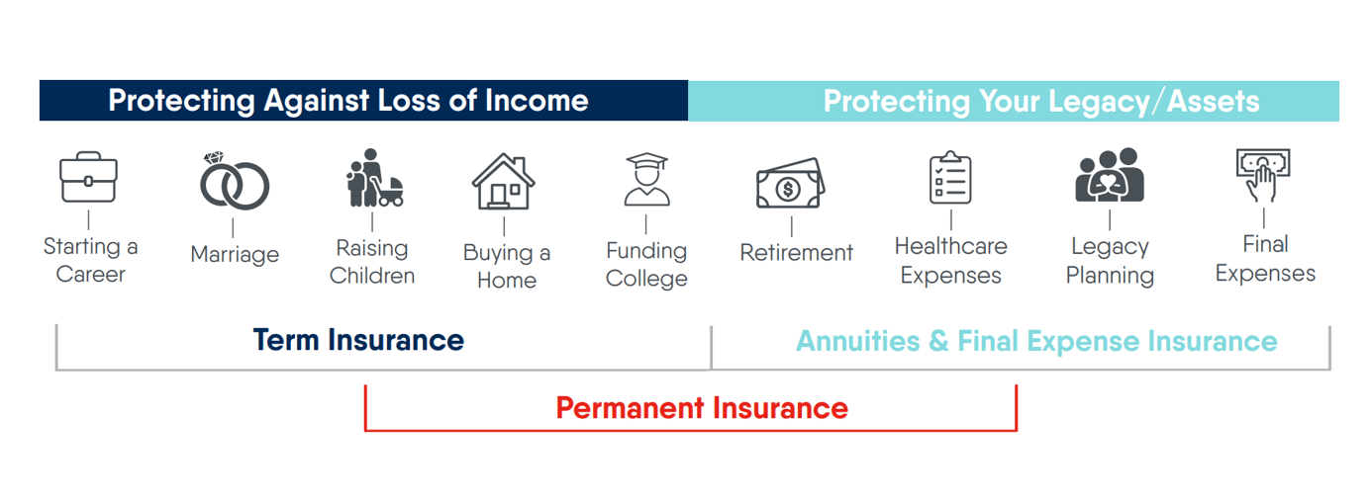
Stages In Life
Notes:
Protection against Loss of Income when in you’re in earlier stages of life … during this time you’ll need more a bit more coverage as an income loss would cause a major impact to your lifestyle … A Term policy is a great fit when you’re at a young age and being in good health will help keep your premiums low.
Once you reach the stage in your life where you are accumulating assets from all your hard work, now you want to ensure you have the proper protection.…. A fixed annuity can be a perfect fit at this point, they avoid market exposure and provide options for income and even free withdrawals during the growth phase. Annuities can also be used to pass money directly to a beneficiary because they avoid probate.
There may also be a need to bridge the gap and build cash value … this is where permanent whole life and universal life policies could be just what you need.
In a perfect world you buy term insurance in the first stage and convert with no evidence of insurance to permanent cash value insurance. At retirement when you no longer need insurance and 1035 the cash value of your life insurance to fund an annuity with income that can't be outlived! Sons of Norway can help you with all these stages!

Slide 7
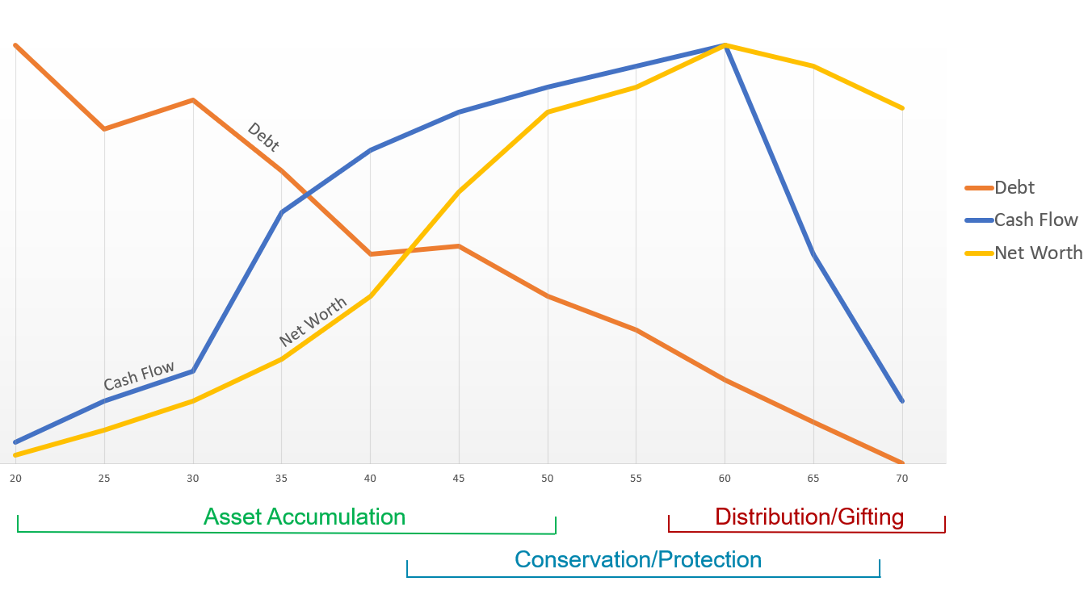
Stages In Life
Age
Notes:
A 35-year-old client may identify goals such as saving for retirement and providing a similar standard of living for his family, should he unexpectedly pass away. Alternatively, a 65-year-old’s goals would likely include securing retirement income and leaving an inheritance to her children and grandchildren.
The beginning of this phase is characterized by the following: 
Limited excess funds for investing
High degree of debt to net worth
Low net worth
Lack of concern for risk
As the person moves through the asset accumulation phase, there is
increased cash available for investments
reduced use of debt as a percentage of total assets
increased net worth
The asset accumulation phase, a client is usually in this phase until approximately age 45 or later if the client’s children are not yet independent
With the conservation or protection phase, a client is usually in this phase from approximately age 45–60 or immediately preceding the client’s planned retirement date. This may last throughout the client’s working life or, in some cases, until death
Increases to cash flow, assets, and net worth
Decreases in proportionate use of debt
With the distribution or gifting phase, a client is usually in this phase from approximately age 60, or the planned retirement date, until the date of death

Slide 8
Life Insurance in the Overall Plan
102 Million uninsured and underinsured recognize they need (or need more) life insurance*
33% of consumers believe they would have to pay taxes on a life insurance death benefit and 4 in 10 aren’t sure. The reality is the proceeds from a life insurance death benefit are not taxed*
25% of all U.S. households would feel adverse financial impacts within one month if a primary wage earner died*
*https://www.limra.com/siteassets/newsroom/fact-tank/fact-sheets/facts-of-life-2021-format-vfinal.pdf

Slide 9





Life Insurance In The Overall Plan
Who Needs Life Insurance?
Anyone who wants to protect survivors or dependents against financial hardship if the unexpected happens. For example, if your family were to have trouble getting by without your salary, a life insurance policy could provide the funds they need to continue living their lives. Here are some other ways, life insurance could benefit you:
  Final Expense
  Mortgage Protection
  Income Replacement
  Estate Planning
  Charitable Giving
Notes:
When clients think of life insurance, they think someone has to pass on in order to benefit.
With permanent products, they have access to cash value with loans and withdrawals.
If they no longer need life insurance, they can 1035 the funds tax-free to an annuity for retirement
Rather than using the term life insurance use
Final Expense
Mortgage Protection
Income Replacement
Estate Planning
Charitable Giving
Life insurance is an excellent vehicle to fund these items

Slide 10






Life Insurance Needs
How Much Life Insurance Do You Need?
Every individual’s insurance needs are different based on various factors, including:
  Future Education Needs
  Retirement and Financial Goals
  Your Age and Life Stage
  Current Income Levels
  Current Savings
  Accumulated Debt
Notes:
Use a needs analysis calculator.
https://lifehappens.org/insurance-overview/life-insurance/calculate-your-needs/
Make up an example or use an audience member.

Slide 11

Life Insurance Needs
Let's look at the stages for a male 25 married with 2 children ages 1 and 2, earning $40,000 a year.
Liabilities
Student loans $50,000
Mortgage $125,000
Auto loans $15,000
Credit Cards $10,000
Final Expense Needs
$15,000
Needs
Income replacement $1,200,000
Liabilities $215,000
College fund $160,000
Final Expense $15,000
Current insurance ($40,000)
Total Need $1,550,000
Current Insurance Through Work
$40,000
Notes:
550LIFE insurance
Liabilities, Income, Final expense and Education.
Education based off $20,000 a year for 4 years in 17 years
Income replacement. 75% of $40,000 through age 65.

Slide 12
Life Insurance Needs
Now 20 years later 45 married with 2 children ages 21 and 22, earning $60,000 a year.
Liabilities
Mortgage $175,000
Auto loans $20,000
Credit Cards $15,000
Final Expense Needs
$15,000
Current Insurance Through Work
$60,000
Needs
Income replacement $900,000
Liabilities $210,000
Final Expense $15,000
Current insurance ($60,000)
Total Need $1,065,000
Notes:
LIFE insurance
Liabilities, Income, Final expense and Education.
Income replacement. 75% of $60,000 through age 65.

Slide 13
Life Insurance Needs
Another 20 years 65 married with 2 children ages 41 and 42, retired
Liabilities
Mortgage $75,000
Final Expense Needs
$15,000
Estate Planning/Legacy
$200,000
Total Need $290,000
Notes:
LIFE insurance
Liabilities, Income, Final expense and Education.

Slide 14
Understanding Life Insurance
Life Insurance Products
Term life insurance is designed to cover you for a specified period of time – usually 10, 20, or 30 years. A death benefit is only paid if the insured dies within the term period.
This type of coverage is ideal for many situations and is most commonly purchased at younger ages.
Notes:
A simple way to look at term insurance is like renting. You have the coverage in place at the lowest cost when you need it.
Term is the lowest cost of coverage. You also have the ability to convert with no evidence of insurability to permanent coverage.

Slide 15
Understanding Life Insurance
Life Insurance Products
Permanent life insurance has no fixed term and is designed to cover you for your lifetime. The premiums are typically higher than term life insurance but often, it comes with a cash value component. The most common permanent life insurance products include:
  Whole life insurance provides traditional life insurance coverage with a savings component that accumulates cash value with all the guarantees. Guaranteed premiums, death benefit and cash value.
Notes:
Permanent life is like owning.
With permanent products they have access to cash value with loans and withdrawals.
Emergency funding
College savings
Supplementing retirement needs
Dream vacation
2nd home or cabin

Slide 16






Life Insurance
What Options Do I Have With Sons of Norway?
Term
Whole Life
  Participating
  Single pay
  Simplified Issue
  Guaranteed Issue
Juvenile Life

Slide 17
Retirement Income
What Options Do I Have With Sons of Norway?
Sons of Norway offers Annuities that provide options, security, and could provide income for life.
An Annuity is a contract between you an insurance company, you purchase a certificate with premiums and they provide you with a safe and predictable income.
Notes:
Protect your principal and gains during market volatility
Have access to penalty-free withdrawals on qualiﬁed dollars
Perfect for rollover money
Secure a steady and predictable stream of income
Receive guaranteed income for life
Never lose money even when the market is down with guaranteed minimum rates

Slide 18
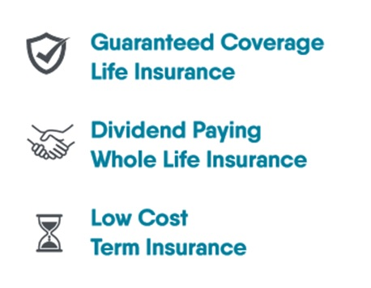
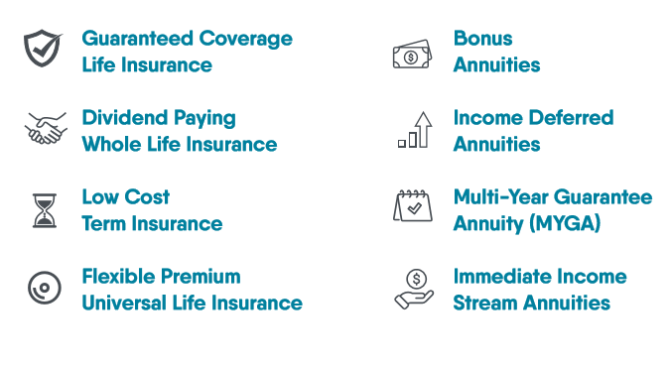
Why Choose Sons of Norway?
Notes:
We have a variety of products from insurance to investments to best suit your needs.

Slide 19



Why Choose Sons of Norway?
Why Would I Choose a Fraternal Life Insurance Company?
A Fraternal Insurance Company is established for the mutual benefit of it’s members, whereas an Insurance Company is often owned by shareholders who expect a profit.
Fraternal companies like Sons of Norway have lodges across the country that volunteer and give back to the communities in which they live.
Sons of Norway is a not-for-profit company with a membership that unites individuals with a common bond, empowering them to safeguard their families’ financial security by offering life insurance and investment products.
Notes:
Fraternal insurance companies form some of the nation’s most effective and efficient volunteer networks, delivering direct financial aid and community service to those who need it most.

Slide 20
Membership
Membership Dues:
  Membership is included in the premium with all products except Annuities and Term.
  If the insured and the owner are the same, no additional dues are required.
  There is a one-time flat fee of $24.
  If the insured and the owner are different, an additional $24 will need to be collected with the first month’s premium.
  The membership fee is only due at issue, and you do not need to remain an active member to keep the policy in force.
.
  Payors are not required to have a membership with Sons of Norway.
Notes:
Sons of Norway offers members access to a variety of benefits including Viking magazine (the top-rated member benefit), monthly E-Post digital newsletter, language lessons and cultural resources, plus discounts on travel, clothing, food, entertainment, rental cars and more—all conveniently available online

Slide 21
For More Information
    For a Complimentary Financial Review
    Valued Agent
    Phone: 555-555-5555
    Email:
Insert Picture here

Slide 22
THANK YOU!
Sons of Norway, 1455 West Lake Street, Minneapolis, MN, offers financial products, but not all products are available in all states. Products issued by Sons of Norway are available to applicants who meet membership, insurability, and residency requirements. This information is not intended as a recommendation of a specific certificate or investment strategy, rather, it is intended to be general and informational in nature. Speak with your Insurance professional to discuss your specific financial goals and insurance needs. All guarantees are backed by the claims-paying ability of the issuing company.
Visit www.sofn.com/financial_products/find-an-agent/ to locate an agent.
PP520 4/2022

