Slide 1
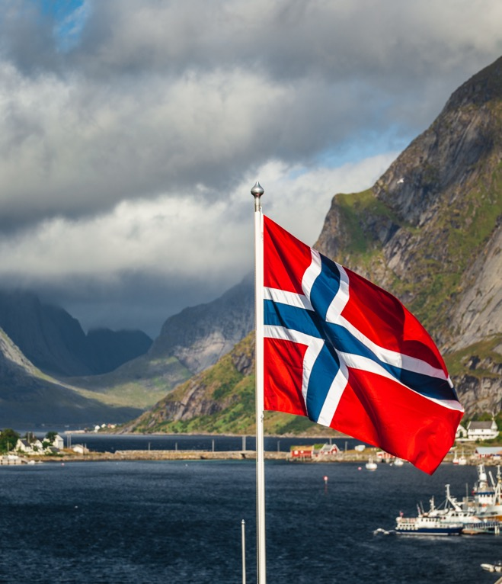
Renaissance of Sons of Norway

Slide 2
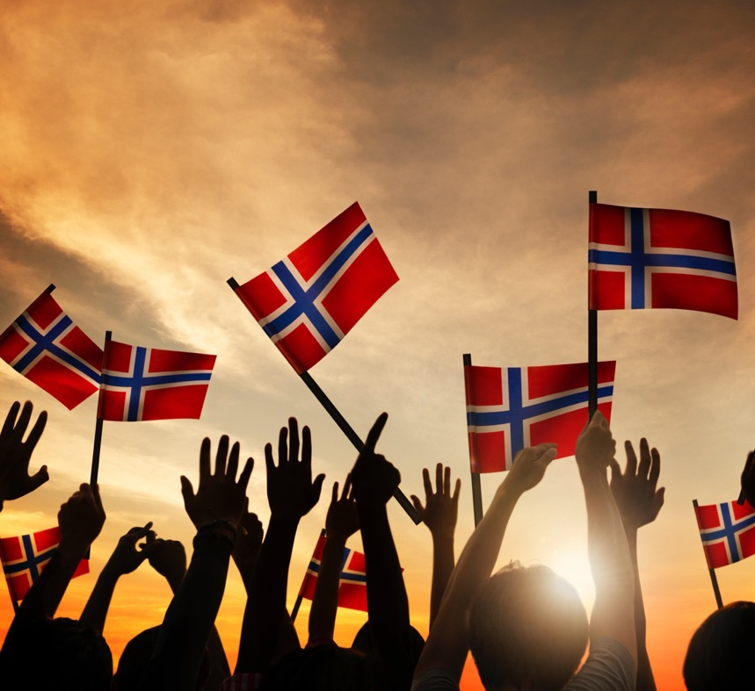
History of Sons of Norway
Here at Sons of Norway, we have a background and story which sets us apart from most insurance companies and Fraternal Societies
Founded 127 years ago by 18 Norwegian immigrants who wanted to protect one another in a new world ​
They pooled their resources to help guard against the hardships that come with starting a new life

Slide 3
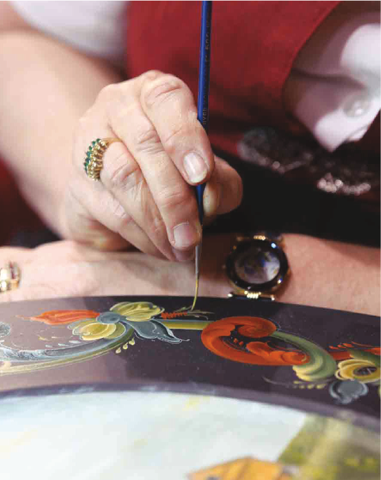
History of Sons of Norway
Through banding together and sharing resources, they founded the basis for our fraternal and insurance organization that still exists and protects families of all backgrounds,
125+ years later
The other common bond they shared was to celebrate Norwegian culture with all its traditions like food, crafts, storytelling and giving back to the community
This allows us to share our rich history with everyone and strengthens the communities in which we live and volunteer. This also sets the stage for the next phase in our evolution

Slide 4
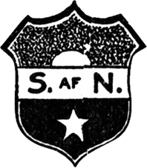
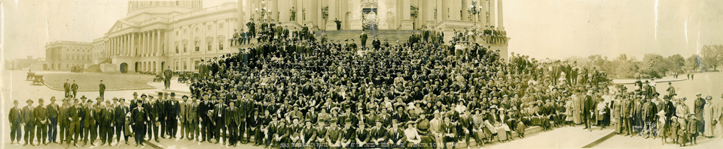
Remembering Our Roots
A look back at Sons of Norway’s origins and key milestones in its development into the robust and thriving organization we enjoy today
Notes:
Read the timeline and add your comments, this is just a walk through history!

Slide 5
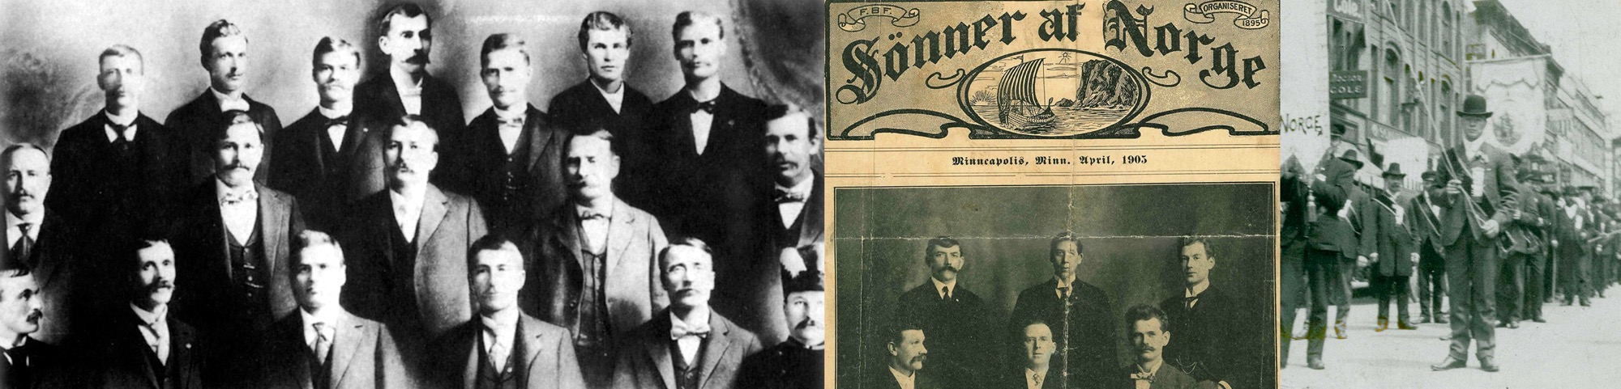
1895
1901
1910
A group of 18 Norwegian immigrants, most from Trøndelag, form a mutual benefit society in Minneapolis, Minn., called Bjørnstjerne Bjørnson, after Norway’s beloved poet and nationalist. Concerns that Americans won’t be able to pronounce the name prompt a change a week later to Sønner af Norge.
Life insurance is available in amounts of $100 to $500, but only for men ages 20 to 50. Monthly premiums range from 5 cents per $100 of insurance for the youngest members to 19 cents for the oldest.
The Midwest lodges, having expanded in Minnesota and into Wisconsin, North Dakota, South Dakota and Illinois, merge with a similar organization, Sons of Norway of the Pacific Coast, which formed independently in 1903 in Seattle. The merger leads to a change in the Midwest lodges, which begin to accept non-insurance social members.
Notes:
The Midwest lodges, having expanded in Minnesota and into Wisconsin, North Dakota, South Dakota and Illinois, merge with a similar organization, Sons of Norway of the Pacific Coast, which formed independently in 1903 in Seattle. The merger leads to a change in the Midwest lodges, which begin to accept non-insurance social members.

Slide 6
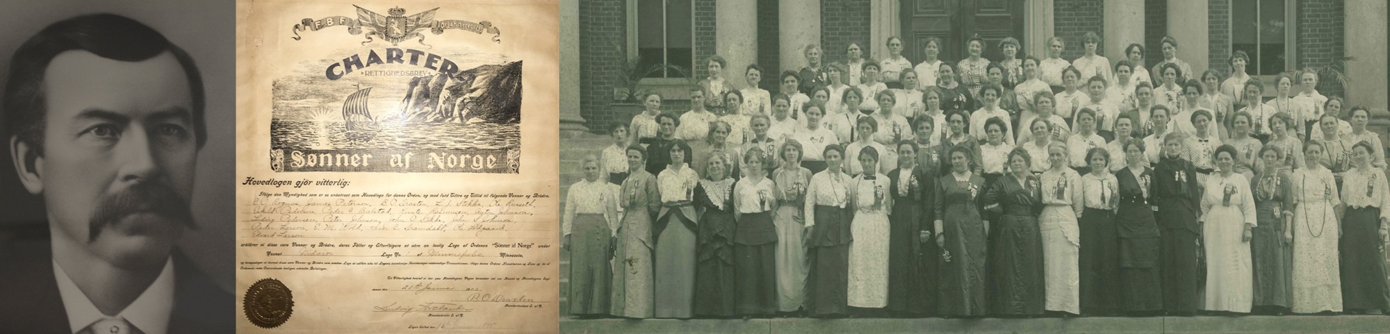
1912
1913
1920
1942
Women are accepted into the organization as social members.
The first Canadian lodge is formed in Edmonton.
An early version of the Sons of Norway shield with the Viking ship is adopted. Also this year, the first English-speaking lodge is formed in Chicago. Gradually, English becomes the language of Sons of Norway.
Sons of Norway declares English as its official language.

Slide 7
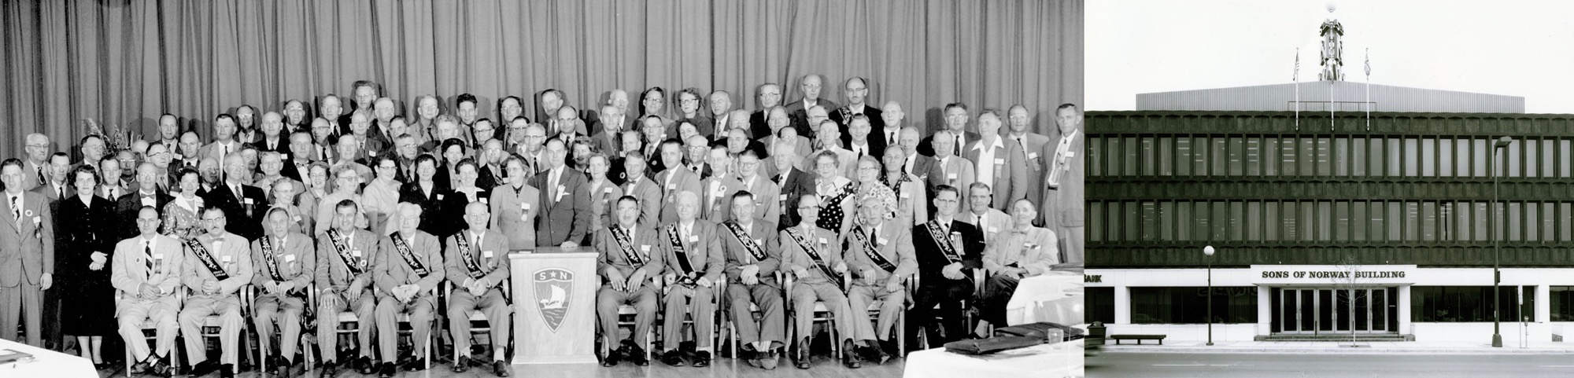
1945
1946
1961
1966
After several years of work supporting the allied efforts in World War II, such as donations to aid Norwegian troops in exile at Camp Little Norway in Canada, members celebrate the end of the war. Sons of Norway’s magazine carries ads for Box Units – cases of food that members can buy and have shipped to relatives living on rationed food in Norway.
Membership
is opened to
non-Norwegians.
New international headquarters are built on Lake Street in Minneapolis. After many years of renting space around the city, then buying and remodeling a building in 1955, the organization builds a new home for itself.
The Sons of Norway Foundation is established.

Slide 8
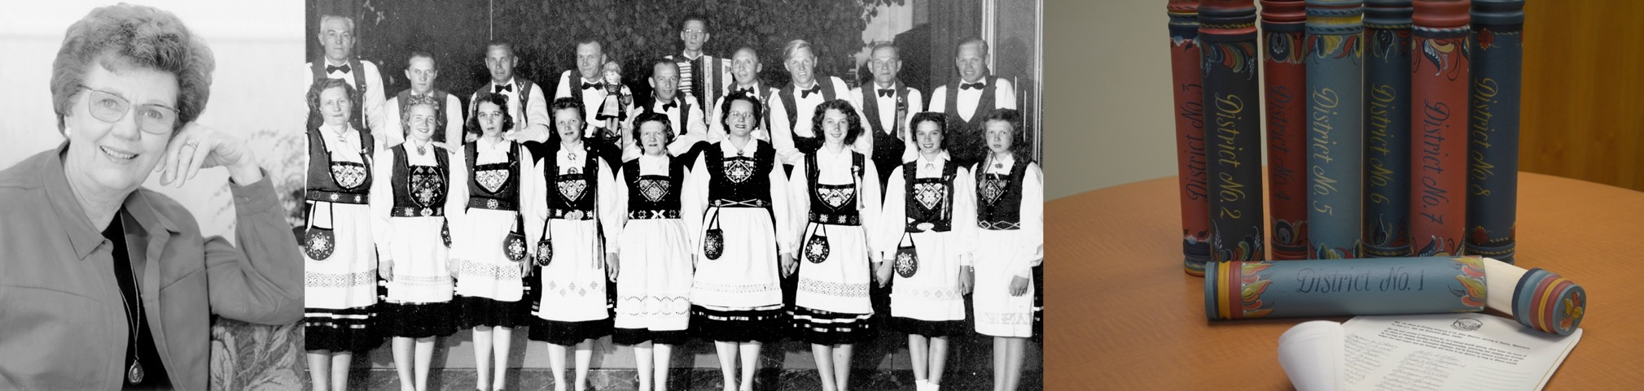
1982
1995
1998
2007
District 8 is created in Norway.
At this time Oseberg, the first Norwegian lodge in Tønsberg, has been meeting for 18 months.
Sons of Norway commemorates its centennial with celebrations throughout the organization.
Penny Joseph Knudsen is elected Sons of Norway’s first female International President.
The Sons of Norway Foundation reaches nearly $5 million in assets for the first time.

Slide 9
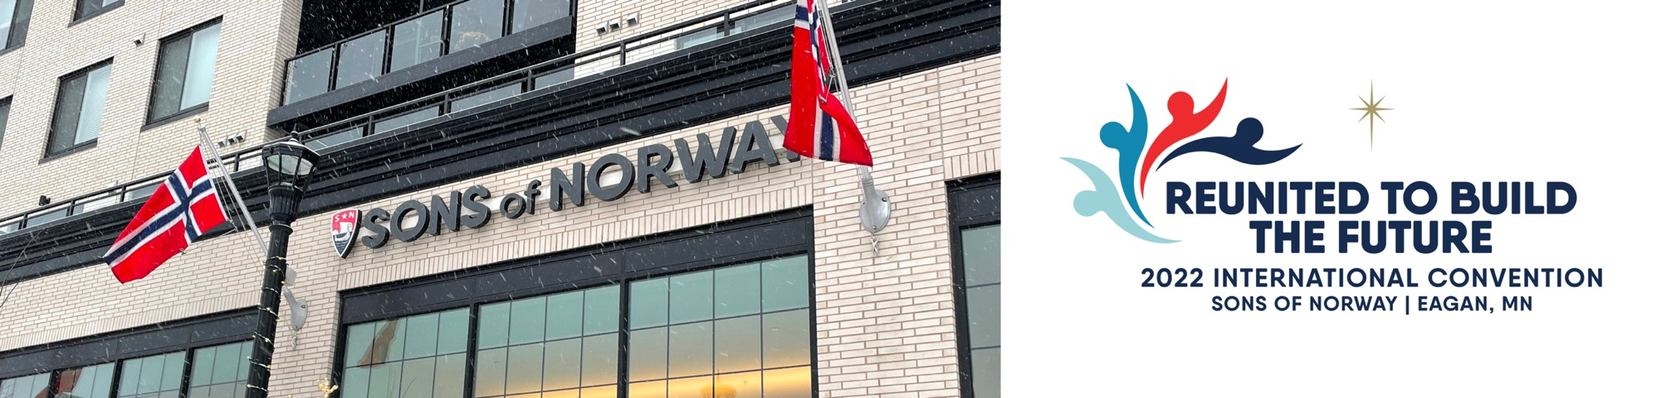
2020
2021
2022
Sons of Norway celebrates its 125th Anniversary with a newly constructed headquarters building at the site of its historic home in the Uptown neighborhood of Minneapolis, Minnesota.
With the arrival of the COVID-19 pandemic, much of our work continued remotely. Our 66th International Convention was postponed and district and international officers’ terms were extended for an additional two years.
Referendum to change Sons of Norway’s international governance passed
September 27, 2021.
2022 International Convention is held virtually.

Slide 10
Thank you for participating in
Sons of Norway!
We are grateful for the Sons of Norway members who came before us
You help write the story of tomorrow
Thank you!

Slide 11
Thank You!

