Slide 1

Leadership Training
Protecting Your Families

Slide 2
Industry Overview
Are Families Prepared For The Unexpected?
20%
of US adults don’t have some type of life insurance
41%
of US adults feel that they don’t have enough life insurance coverage
44%
of US households would feel financial hardship within 6 months

Slide 3





Industry Overview
Why do people purchase life insurance?
85%
cover burial and final expenses
67%
help replace lost income of a wage earner
52% supplement retirement income
63%
transfer wealth or leave an inheritance
54%
help pay off mortgage

Slide 4
Industry Overview
Our Philosophy Remains…
“We secure our members’ financial wellbeing regardless of where they are in life.”

Slide 5


Product Overview
How Do We Look At Our Products?

Slide 6
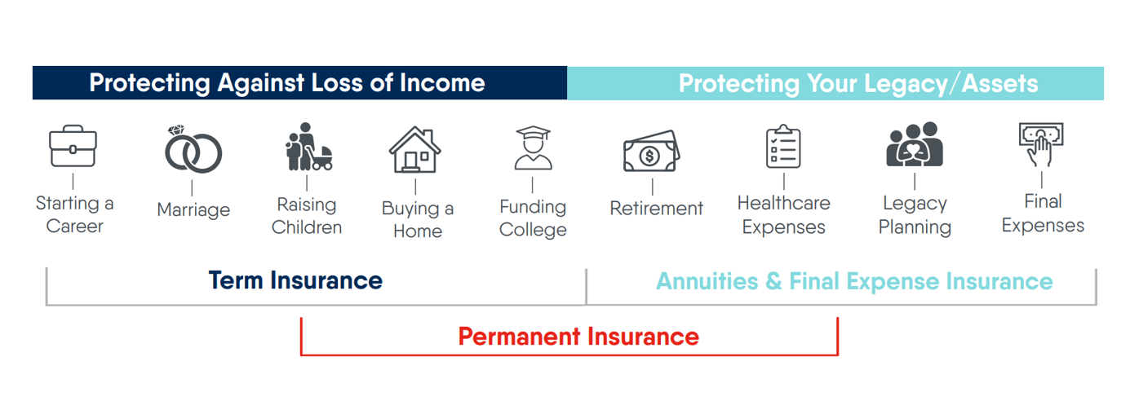
Product Overview
Financial Journey

Slide 7



Product Overview
Choosing the Right Protection
Term Life Insurance
Protection for a limited time span
Provides a large amount of coverage for an affordable premium
Best used for meeting short-term or specific financial goals

Slide 8



Product Overview
Choosing the Right Protection
Permanent Life Insurance
Protection for the insured’s lifetime, regardless of length
Provides an opportunity for cash value growth on a tax-deferred basis
Best used for long-term financial planning and covering final expense concerns

Slide 9




Product Overview
What Sons of Norway Offers
Term Products
Permanent Products
10, 15, 20, & 30 Year Term
Whole Life (Including Zero Refunds)
Simplified Issue Suite (Whole Life & Single Premium)
Juvenile Term (Viking Voyager)

Slide 10


Product Overview - Term
Term Life Insurance
Available Terms: 10, 15, 20 & 30
Convertible to permanent insurance: Your clients can decide at a later date to keep their insurance beyond the selected term.
This may be in addition to the permanent coverage they currently have

Slide 11


Product Overview - Term
Juvenile Term (Viking Voyager)
Clients ages 0-17
Your client sees the value in protecting the insurability of their children while they are young and healthy
May convert to any available permanent insurance, up to three times the amount of current coverage

Slide 12



Product Overview – Permanent Life
Whole Life (participating and nonparticipating)
Refund to members (dividends) for participating only
Valuable Riders Available
Ages 0-50, under $100k – No Medical Exam

Slide 13


Product Overview – Permanent Life
Simplified Issue Whole Life
No Medical Exam
No Personal Health Interview
Participating (dividends paid to the member)
Single Premium option is also available

Slide 14




Product Overview
Choosing the Right Protection
Annuity Product Offerings
Single Premium Immediate Annuity (SPIA)
Single Premium Deferred Annuity (SPDA)
Flexible Premium Deferred Annuity (FPDA)
Bonus Annuity

Slide 15
Membership
Membership Dues
  Membership is included in the premium with all products except Annuities and Term.
  If the insured and the owner are the same, no additional dues are required.
  There is a one-time flat fee of $60 if the insured is different, or if the product does not include dues.
.

Slide 16
Thank you everyone!

