Slide 1


Slide 2
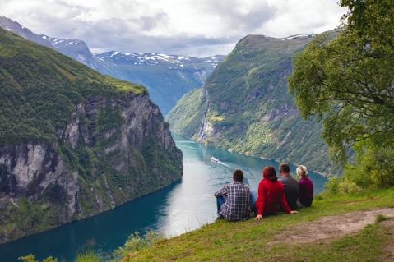

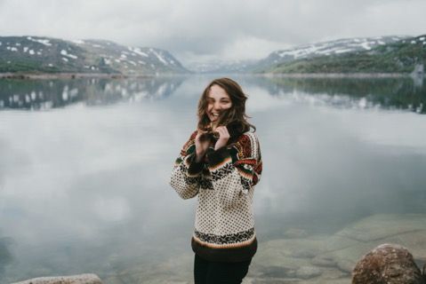
Sons of Norway Foundation’s Mission
The Sons of Norway Foundation is dedicated to funding activities that preserve and promote Norwegian heritage, positively affect members, and make Sons of Norway communities a more vibrant place to live.

Slide 3
Foundation’s Core Values
1) Creating the heritage of the future
2) Sustaining the link to contemporary Norway
3) Committing to life-long learning and service
4) Preserving compassion for those in need
5) Funding innovative individuals and opportunities
6) Fostering a cohesive community of philanthropy
Notes:
The Foundation wants our core values represented in everything we do, especially the partnerships we support through our grant making program.
When you make a gift to the Sons of Norway Foundation, you are also reflecting our shared Nordic values.

Slide 4
The Foundation is here for members in 3 ways:
GRANTS for lodges, community partners and members in need
SCHOLARSHIPS for post secondary education and cross-cultural exchanges
HELPING YOU ACHIEVE YOUR PHILANTHROPIC GOALS by providing the opportunity to incorporate your interests in passions in your annual and legacy giving
Notes:
Remember, the Foundation is here for our members.
We provide grants to our lodges and other partners to advance our core values
We provide scholarships to members and their children and grandchildren. One scholarship makes many many years of membership well worth it!
We provide the opportunity to leave a legacy based on your interests and passions.

Slide 5
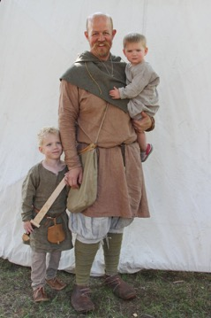
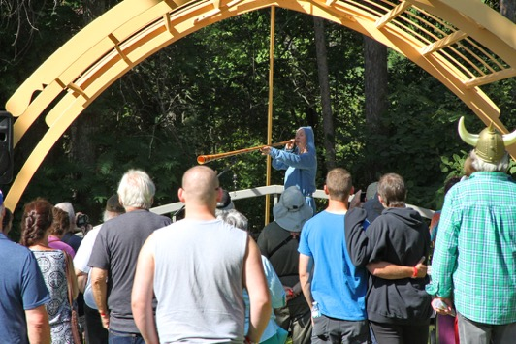
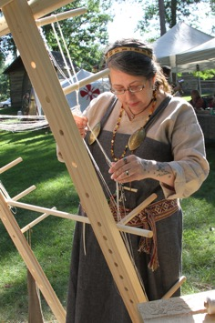
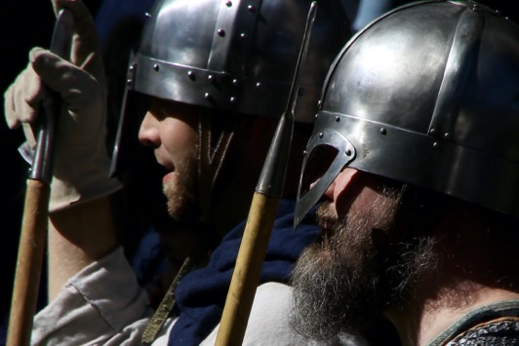
Grants
We offer grants in a range of categories for lodges, community partners and individuals. These grants provide funding to support Nordic culture and heritage events, humanitarian aid to children and members in need, and lodge programming.
“Receiving a grant from the Sons of Norway Foundation was crucial to the success of our first Viking Festival. Not only did the grant allow us to expand the scope of the experiences we could offer, but provided the credibility we needed to leverage additional funding, both from the community and our lodge members. “ – Sagatun Lodge, Brainerd, Minnesota
Please encourage lodges and community partners to apply for grant opportunities!

Slide 6
Grant Opportunities:
Lodge Vitality Grant
- Operational or small capital support for lodges, up to $1,500
Lodge Culture and Heritage
- Focusing on Norwegian heritage and culture, lodges only, up to $1,500
Community Partnership
- Norwegian heritage and culture, non-members only, up to $5,000
Helping Hands to Children
- Lodges that run programs for kids or partner with local orgs for children, up to $1,500
Helping Hands to Members
- rolling basis all year, helps members affected by natural disasters or severe
illness/injury, up to $5,000
~$50,000 given out annually depending on applications
All due December 31st – please apply!
Notes:
The Foundation created the Lodge Vitality grant in 2017 in response to our member’s feedback regarding operational support needed by lodges. This is for a specific, ONE-TIME project.
The Lodge Culture and Heritage grant allows lodges to apply for support for a Norwegian culture/heritage event, project or program.
Community Partnership grants allow non-members to apply for support for a Norwegian culture/heritage event, project or program.
Helping Hands to Children encourages lodges to partner with local schools or organizations to support children or to hold a Norwegian culture/heritage event, project or program for children at their lodge or in their community.
Helping Hands to Members grants support members whose homes were significantly damaged & are displaced due to natural disaster or those who are uninsured, underinsured or suffering a major financial setback due to an extreme illness or injury. These applications are accepted year round.
As you can see, the Sons of Norway Foundation is here to help and serve! And there are no longer any match requirements.

Slide 7
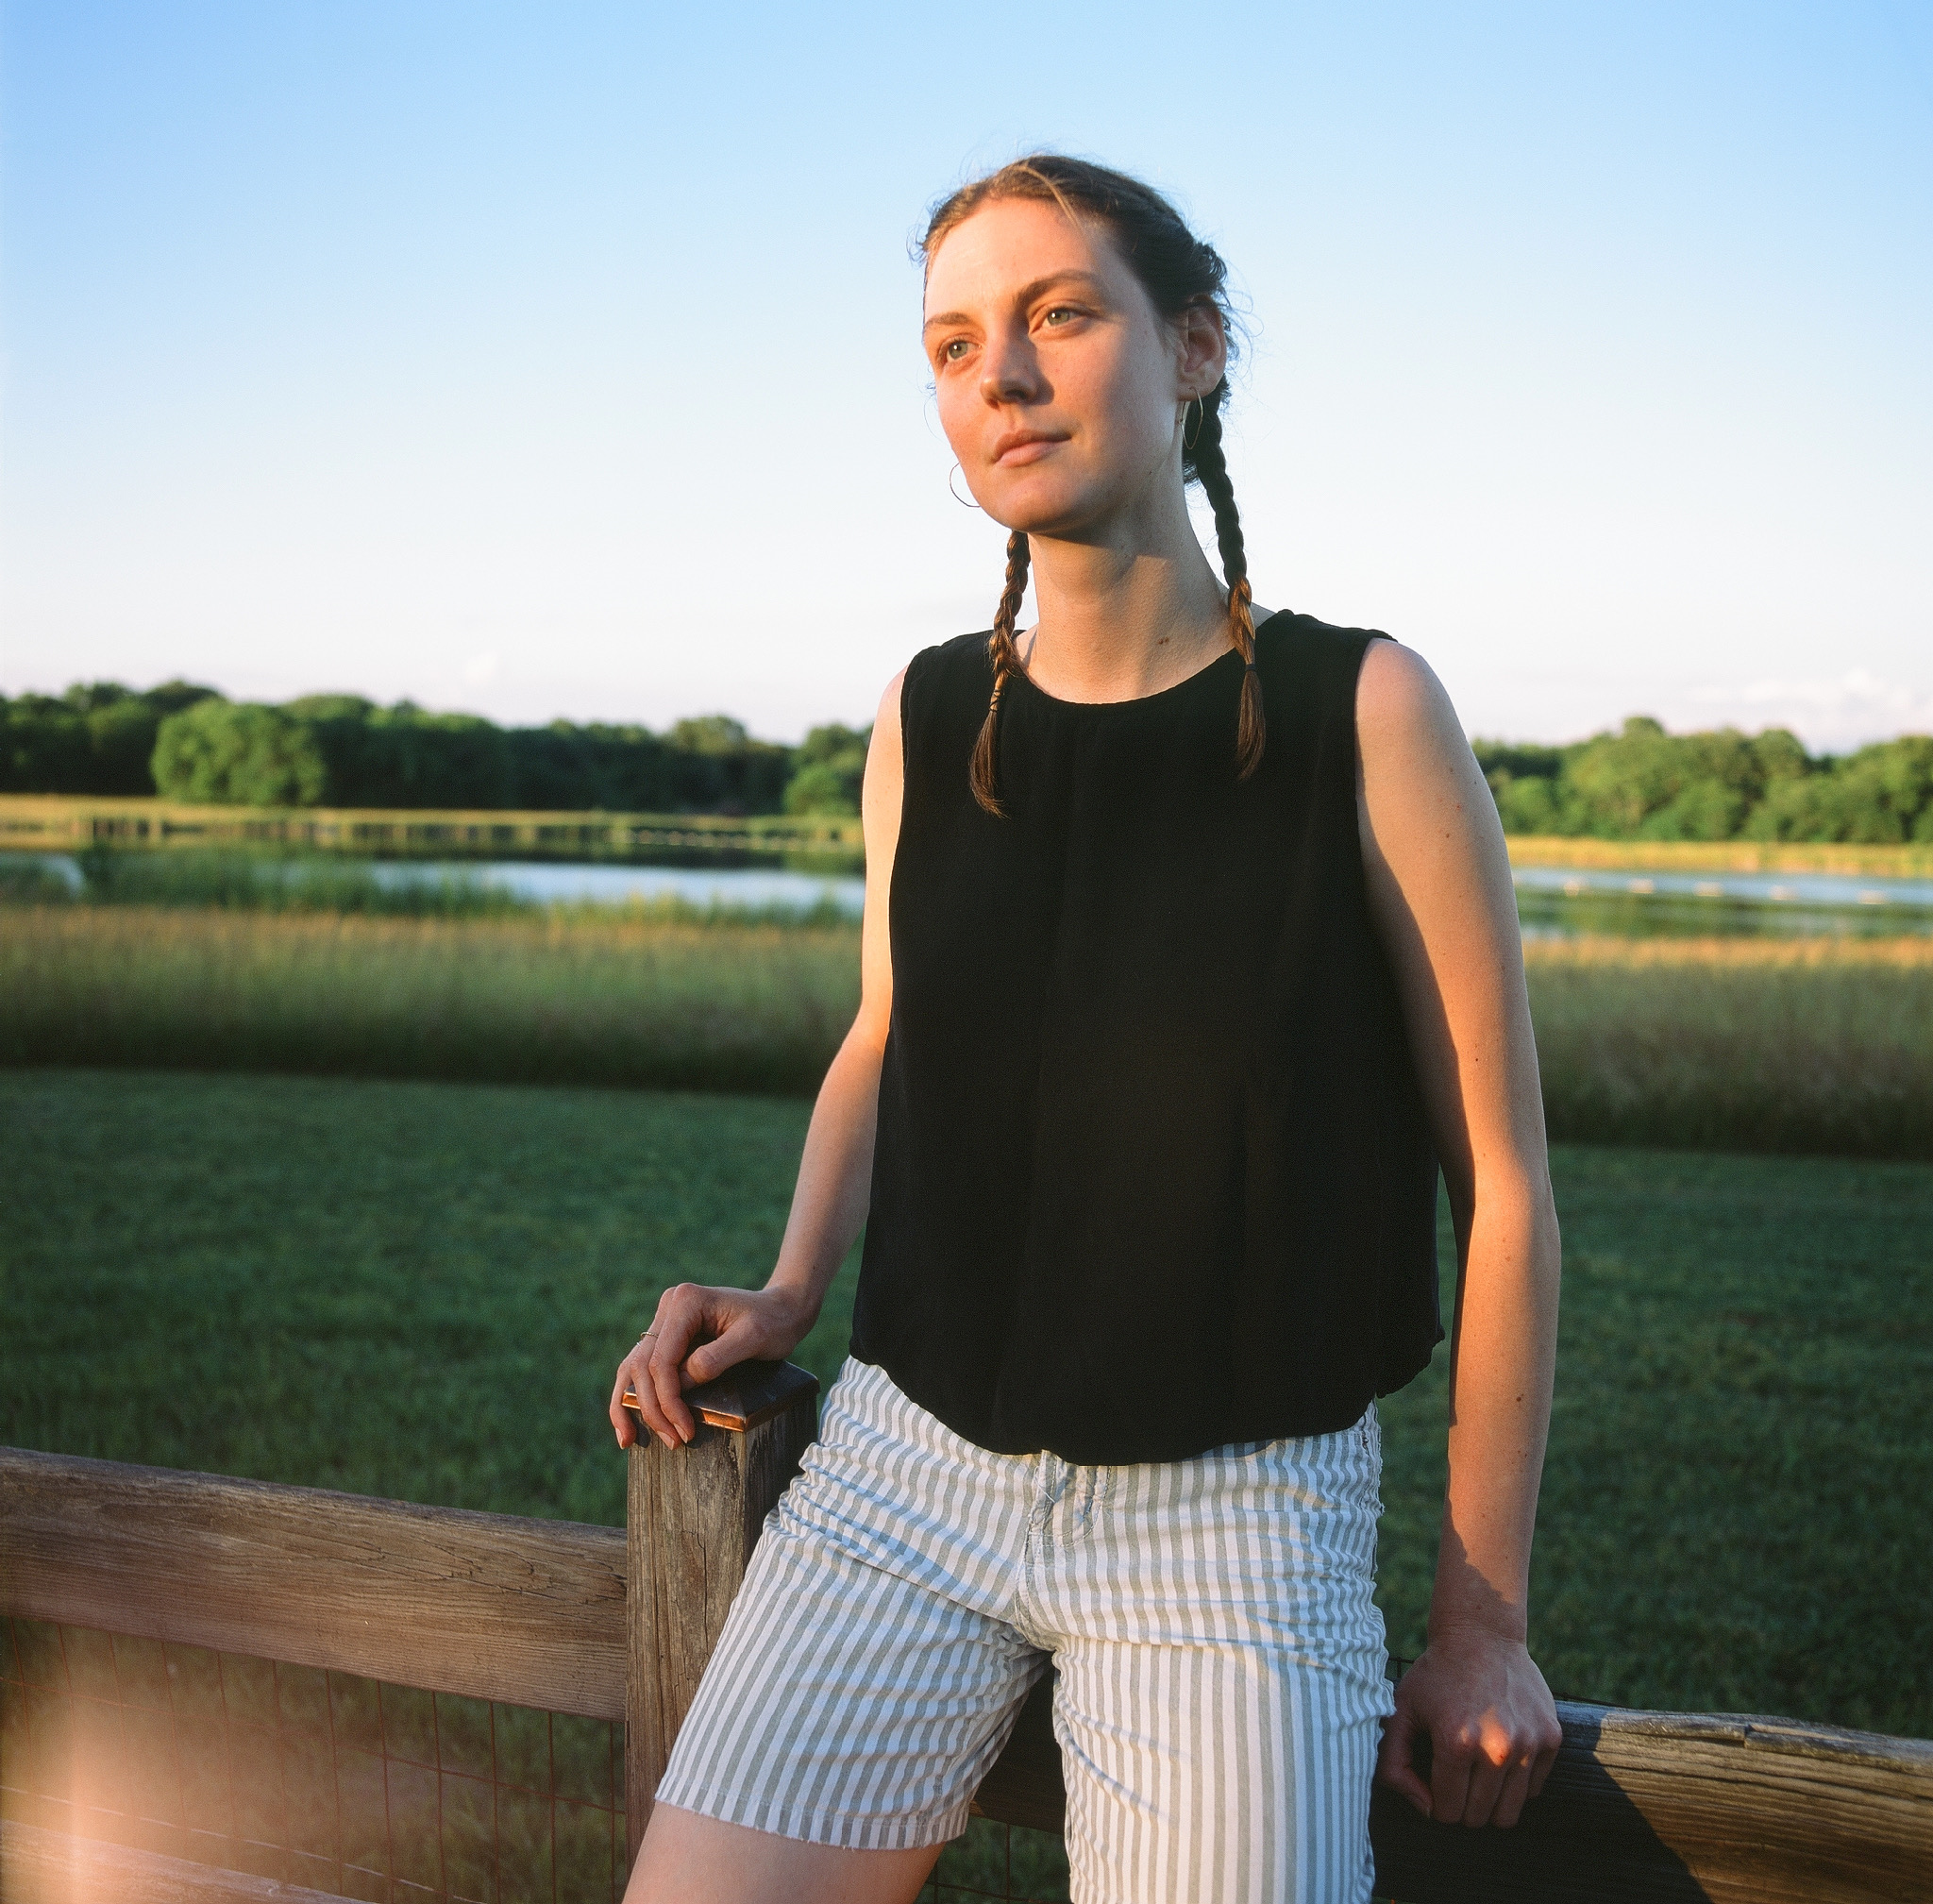
Scholarships
With the rising cost of higher education, the Sons of Norway Foundation is here to help with 15+ scholarship opportunities.
For many recipients, these awards are a life-changing opportunity to explore educational passions here in the US or in Norway.
- 2021 King Olav V Scholarship recipient Amalia Waiter Lewis made this video about her experience.
https://www.sofn.com/blog/scholarships-in-action/?fbclid=IwAR29_sTFDVywS1jSZGS3gbVvb95uogZZYRqvHnYnxr8cnFFHlhAYBWfPzI4

Slide 8
Scholarship Opportunities:
Over $100,000 awarded annually to students of all types:
- Americans studying domestically or in Norway
- Norwegians studying in the USA
- Adult learners
- Undergraduate, vocational/trade, graduate
- Members (or children and grandchildren of members) and non-members
- Norwegian Folk High Schools or Oslo International Summer School
- Major specific (elementary education, women studying engineering/science)
- Awards range from $1,000 to a full year of tuition
Check the website for current information and opportunities.
Applications open in October. Encourage students in your district/lodge to apply!
Notes:
The Sons of Norway Foundation currently has 15 different scholarship opportunities. We add new opportunities fairly often, so the most up to date information is always on our website.
Most scholarships require Sons of Norway membership (can be under a parent or grandparent) but some do not
Some opportunities are unique, like the Nancy Lorraine Jensen Memorial Scholarship that was created to honor a member’s daughter after she passed away at a young age. This scholarship can fund full tuition for a female student studying certain engineering or science fields. Another unique scholarship is the Bernt Anker Scholarship, created by a member who wanted students without parents to have the same opportunities. This scholarship is open to members and non-members alike.
Many of our scholarships are also open to non-traditional or adult students.
CHECK THE SCHOLARSHIP GUIDELINES ON THE WEBSITE FOR FULL DETAILS! You can also contact the Foundation with specific scholarship questions.

Slide 9
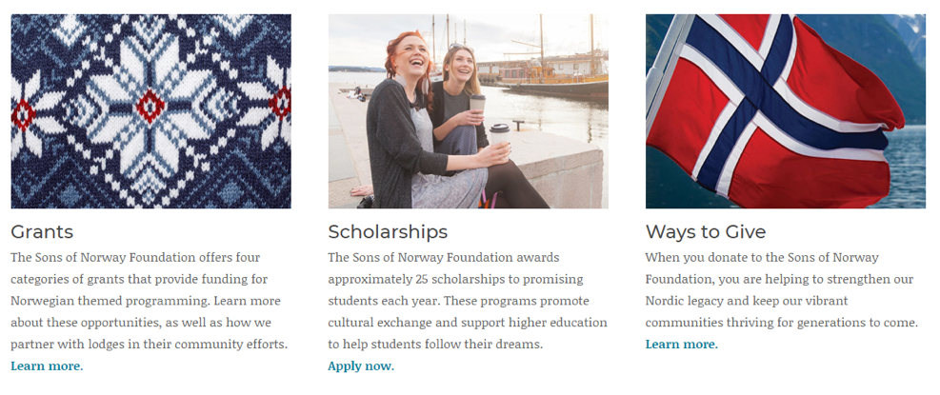
How to Apply for a Grant or Scholarship
Online only: www.SonsofNorway.com/Foundation
Grant and Scholarship Portal Opens: Every year in October
Deadlines vary by opportunity – be sure to check the website often!
Notes:
NOTE: Helping Hands to Members grants are open year-round
-The Apply Now button on the website takes you to the grant portal. You will make a username and password different from your sons of Norway login to complete the grant applications.

Slide 10
How Can I Give?
By contributing to the Sons of Norway Foundation, you are supporting programs that benefit your lodge, your community, and the young Sons of Norway members who will keep our Nordic legacy strong for future generations.
Ways to support our mission:
Online donations at www.sofn.com/give
Stock donations (save capital gains taxes!)
IRA distributions
Gifts of real estate
Charitable trusts
Gifts of life insurance
Estate Bequests
District and local lodge fundraisers
All gifts are tax-deductible in accordance with state and federal law.
Notes:
- If you are doing philanthropy planning, consider what the most meaningful legacy is for you.
If you identify with the Foundation’s core values, you may consider making a planned gift and joining the Foundation’s Legacy Society.
Or, if you want to make a planned gift, such as 10% or 20% of the death benefit of your life insurance or annuity product to your lodge, you may do so through the Foundation. This type of planning may reduce the taxes to your estate without disinheriting your heirs!
Please contact Emily Stark if you are interested in including the Foundation in your estate.

Slide 11
How Else Can I Get Involved?
Become a District or Lodge Foundation Director
- Inform your Zone Director and Lodge members of our grant and scholarship opportunities
- Be an ambassador for the Foundation’s grant and scholarship recipients
- Help raise funds for our programs
- Promote the Foundation’s Core Values
Apply for the Board of Governors
- Applications accepted late summer/early fall
- Take on a leadership role with an organization that is passionate about serving others and
sharing our Nordic values
- Searching for people with legal, fund development and social media skills
Become a scholarship or grant reviewer
  - Help the foundation make funding decisions by providing your expertise and time
Notes:
Volunteering at the Foundation is a great opportunity to learn more about what we do and get involved. We are always looking for:
Foundation Directors at your local lodge, zone or district.
Foundation Board of Governors – if you are looking to get involved at a leadership level or know someone who might be interested, let us know!
Scholarship or grant reviewers – Have fun learning more about the students, lodges and organizations that apply for funding through the Foundation and help us make informed decisions. Application reviews take place during the Winter months and the time commitment is flexible to fit your needs!

Slide 12

Contact the Foundation today!
You can contact your district’s Foundation Director or contact Sons of Norway Foundation directly with the contact information below:
Emily Stark
Foundation manager
612-821-4655
foundation@sofn.com
www.sofn.com/foundation
Notes:
Other presenters can feel free to add in their information here as well!

